Slide 1
Meeting Document August 2023 Jack & Jill Client

Slide 2
Meeting Agenda
What items do you want added to the agenda today?
Recap of last meetings discussions
How we can work together
Next steps

Slide 3
10-3-Now Revisited
Blank 10-3-NOW – can handwrite or use OneNote to add details

Slide 4
Chaos to Greatness
CHAOS | MEDIOCRITY | EMERGING BUSINESS | GREAT BUSINESS | LASTING GREATNESS
Take Any Client No Systems/Processes Profit Negligible No Value Proposition Run Around Like A Headless Chook Owner Doing Everything Family Member Doing Books Owner Doing Lots Of Red Tax Issues No Business Plan No Marketing Plan Putting Out Fires Reactive Decisions Made On Price Office Looks Cheap | Some Systems Owner On The Tools Cash Flow Inconsistent Beige Unclear Pricing Unclear Positioning Possible Low-Level Staff Unclear Job Roles Duplication Things Get Missed Profit Low Owner In Red/Blue Key Person Dependent First Brick Wall | Systems In Place Functional Roles Some Black Activity Branding Positioning Referrals Clear CVP Outsource/Insource Red Cash Flow Steady Less Owner Dependent Owner Free To Go Part- time Owner Has Coach/Mentor Business Debt Second Brick Wall Values Identified | Systems Clear And Followed Functionality Clear Positioning Known Branding Recognisable Clear CVP Owner Freed Up Management Systems Strong Distribution Pricing & Packaging High-Level Staff Employer Of Choice Financial Systems & Reporting Mature Business Team Ethos Advisory Board Values Lived | Good Systems Followed Strong Culture Inspiring Vision Higher Purpose Mentoring/Coaching Development Plans For Staff Good Profit Good Cash Flow High Performing Team Talent Magnet Professional Leader Saleable Other Business Opportunities Succession Debt Free Full Board Governance Contribute To Society
OWNER’S FEELINGS
Stressed Pressured Scared | Pressure Trapped Apathy? | Safe Relieved/Relaxed Energised | Relaxed Confident Pay Back | Proud Satisfied Fulfilled

Slide 5
Stages of Development
Stages
3. Advanced Growth
Position
Distribution
Functionality
Capability
Succession
‘feelings’
4. Plateau
Skills
5. Decline
2. Growth
1. Start-Up
day 1
invest
stress
lost
time
excited
frantic
good times
payback
frustration
Current position

Slide 6
Red Blue Black
Strategy
Positioning / Marketing
Client Management
Culture
Succession
New Business Opportunities
Business Development
Pre-sold
Sales
(Expectation)
Future $
Operations
Design
(Quality Efficiency)
Non Revenue
Business Support
todays $
Delivery
(Experience)
Admin
IT
Acc/Fin
Facility Management
Resourcing People
IT & Communications
Legal
Compliance
Client Services
(Relationship)

Slide 7
Risk Management
1 REDUCE
2 AVOID
3 TRANSFER
4 RETAIN
INVESTMENT RISK | TAXATION RISK | ESTATE RISK | LITIGATION RISK | BUSINESS RISK | OTHER RISKS
How much investment risk? End goal Live too long Spend too much Market risk Income required Diversification Specific risk Liquidity | Risk profile Governance Tax structures Tax plans | Protect beneficiaries Fund the estate Insurance issues Wills Powers of Attorneys Agreements Death benefit nominations Legacy Fair V equal Challenges | Structures Warranties Directorships Entities Guarantees Staff Compliance | Covenants Directorship Staff Succession Key Person risk Advisory board Mergers and acquisitions | Family Relationships Divorce Finance Cash flows Inflation Health Communication Governance

Slide 8
Draft Scope of Work
Risk management matrix
Understand development finances & required cashflows
Information Memorandum preparation & finalisation – due diligence reports required?
Raise capital for development (finance & potentially investors) – who’s going to do this?
Tax structures (asset protection lens)
Best of breed professionals - Accounting, Legal, Finance, Tax etc.
Project management of development
Advisory board establishment & vetting of members
Reporting & governance
Personal guarantees & warranties register & plan
Total balance sheet reporting
Shareholder agreement / buy/sell agreement review
Business succession plan
Review logistics business key people & key team member retention strategies
Scenario model - how much retirement capital do we need to achieve desired lifestyle?
Capital allocation plan
Super strategy & review
Insurance review - personal, business (logistics & development) & general
Retirement funding plan
Debt plan
Relationship agreement prudent with new partner?
Legacy & estate planning - wills, poa (incl corporate), family constitution
Loan agreements

Slide 9
Providing business owners with confidence & clarity
CONTEXT OUR ROLE
Help develop business:
People
Vision
Business Game Plan
Help you articulate the businesses goals & aspirations
Strategy
Accountability
Develop a game plan to bring clarity and confidence across business strategy
Act as accountability coach and sounding board to business
Develop Advisory Board
Surround you with appropriate best of breed professionals to achieve your desired outcomes and objectives
CONTENT
CHAOS | MEDIOCRITY | EMERGING BUSINESS | GREAT BUSINESS | LASTING GREATNESS
Take Any Client No Systems / Processes Profit Negligible Run Around Like A Headless Chook Owner Doing Everything Family Member Doing Books Owner Doing Lots Of Red Activity Tax Issues No Business or Marketing Plan Putting Out Fires & Reactive Decisions Made On Price Office Looks Cheap | Some Systems Owner On The Tools Cash Flow Inconsistent Beige Unclear Positioning & Pricing Possible Low-Level Staff Unclear Job Roles Duplication Things Getting Missed Profit Low Owner In Red/Blue Key Person Dependent First Brick Wall | Systems In Place & Functional Roles Some Black Activity Branding & Positioning Referrals Clear Client Value Proposition Outsource/Insource Red Cash Flow Steady Less Owner Dependent Owner Free To Go Part- time Owner Has Coach/Mentor Business Debt Second Brick Wall Values Identified | Systems Clear And Followed Functionality Clear & Owner Freed Up Positioning Known & Branding Recognisable Clear Value Proposition Strong Distribution Pricing & Packaging High-Level Staff Employer Of Choice Financial Systems & Reporting Mature Business with Team Ethos Advisory Board Values Lived | Exceptional Systems Inspiring Vision & Strong Culture Higher Purpose Mentoring / Coaching Development Plans For Staff Strong Profit & Cashflow High Performing Team Talent Magnet Saleable Succession Plan Implemented Debt Free Full Board Governance Contribute To Society

Slide 10
“WHO – not how” - Dan Sullivan – Strategic Coach

Slide 11
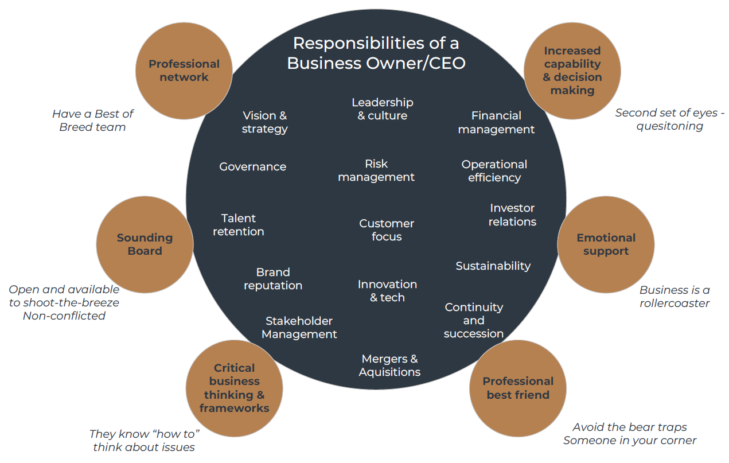
Why An Advisory Board?

Slide 12
A Best of Breed Team Approach
Client - CEO
Advisory Board
Vision
Accountability
Governance
Confidence & capability
Strategy
Accountant
Lawyer/s
Insurance Broker
Banker / Broker
CFO
Business Coach
Tax structures
Compliance
Tax planning
Risk management
Strategy
Tax structures
Asset protection
Agreements
Terms of trade
Risk management
Right policies
Risk management
Finance facilities
Bank accounts
Strategy
Financial controller
Assist with business plan
Cashflow forecasting
Projections
Enhance skills for team members & director/s
Assist with implementing business plan
Connections
Sense maker

Slide 13
Service Offering Options
Option C
Advisory Board & Home Office Establishment role
Most comprehensive offering (option’s A & B + help build your own family office administration solution)
Bill paying
Group administration duties
Record keeping
Typically most appropriate after sale of business or other substantial investment (such as a development)
Highest touch & accountability
Greatest buy in & involvement
Personal administration outsourced to our family office team
Option B
Advisory Board role
Project management to your committed future across total balance sheet & establish advisory board/s
Understand all the risks
Fortnightly meetings
Develop risk management matrix
Develop project plan
Coordinate meetings to deliver project plan
Higher touch (fortnightly meetings) & accountability
Greater access to us & network
Greater buy in & involvement
Option A
Lead Adviser role
Most simplistic service offering
Introductions to network
Manage & run project
Financially well organised across estate, tax, investment etc. (wealth management lens)
Get you financially well organised with a financial game plan aligning with your goals & objectives
$3k p.m. + GST
$6k p.m. + GST
$8k p.m. + GST

Slide 14
Next steps
Which service offering option do you seek?
Engagement agreement
Clearly define projects & desired timeline
We shall commence our data collection and confirmation process
Can you provide us with access to your Accounting software files?

Slide 15
Draft Meeting Agenda
Meeting opening
What’s on your mind?
General business & project updates
External advisers reporting progress
Finance
People
Risk & governance
Next 2 weeks
Next 90 days
Other matters for noting
Date of next meeting
Meeting action items

