Slide 1
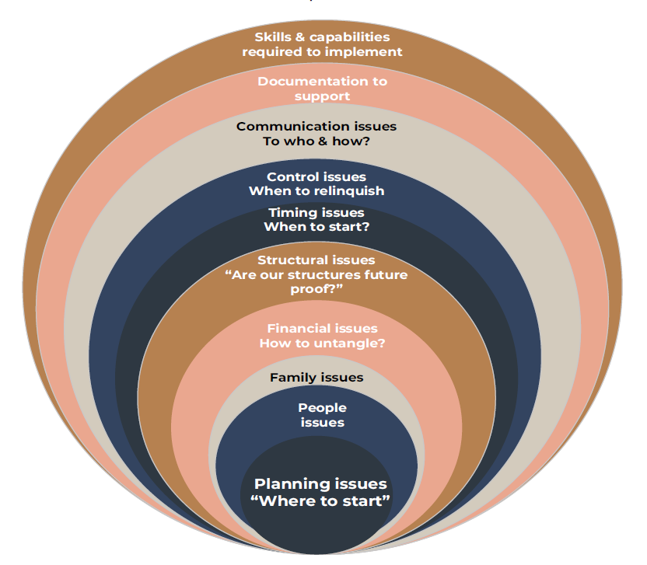
Succession Planning
Multiple issues
Planning issues “Where to start”

Slide 2
Capability & Planning Issues
Where to start?
Where are we going?
Ability will articulate our future direction?
Are we committed?
Our existing advisers competencies?
Who will champion the cause?
What capabilities do we need?
What are our decision trees?
How do we make tough decisions?
Best of Breed team required across tax, legal and wealth
How do we engage & communicate?
What does success look like?
What if the kids don’t like it?
How do we manage conflict?
Are we accountable?
Who will help us?
Risk Management Lens
1 REDUCE
2 AVOID
4 RETAIN
3 TRANSFER
RETAIN
People
Mum & Dad, dreams & aspirations
Adult children, dreams & aspirations
Relationship issues, divorce
Family breakdowns
Non interested children
Interested & can’t manage the money
Health Issues
Control issues
Staff issues, retaining good people
Communication issues
Mismatch of values and trust
Family
Non alignment
Communication
Disinterest or distrust
Self-righteousness
Expectance
Participants don’t want to get involved
Financial mismatch - some have money, some don’t
Divorce
Financial
How much do Mum & Dad need
Dollars they might need for the capital required
Charities
Loans to children
Children employed in business V’s not employed
Distribution and income in he future – Fair V’s Equal
Income & capital distribution
Reporting of finances
Investment decision making now & in the future
Investment advice
Who to seek advice from
Debts, guaranties, warranties
Structural
Who owns what
Is our structure fit for purpose
Are we asset protected & tax efficient
How does structure allow for handing over control
CGT & tax considerations
Are our structures future proof
So they represent our wills & estate planning
Can we easily report across the group
Timing
What’s the plan on timing handover for income, equity & control
When are we ready to retire
Can I retire & still participate on the board
When does a family member/s take over
How do I know with confidence it’s time
What happens if I die or lose capacity now
What’s the back up plan
Should we have a fire drill
I need all this in place now
How long does this take
Communication
We need to get clear first
We need our plan sorted first
How do I communicate to family
How do I communicate to extended family, spouses, partners etc
How do we keep everyone in the loop
Do people/family need to sign a non- disclosure document
Is there a forum for people to discuss concerns & disagreements
What happens if family disagree
What happens if 1 person is seen to be favoured
How can we make this robust
Required documentation:
Wills & estate wishes
All loan documents
Revised structures
All other agreements

