Slide 1
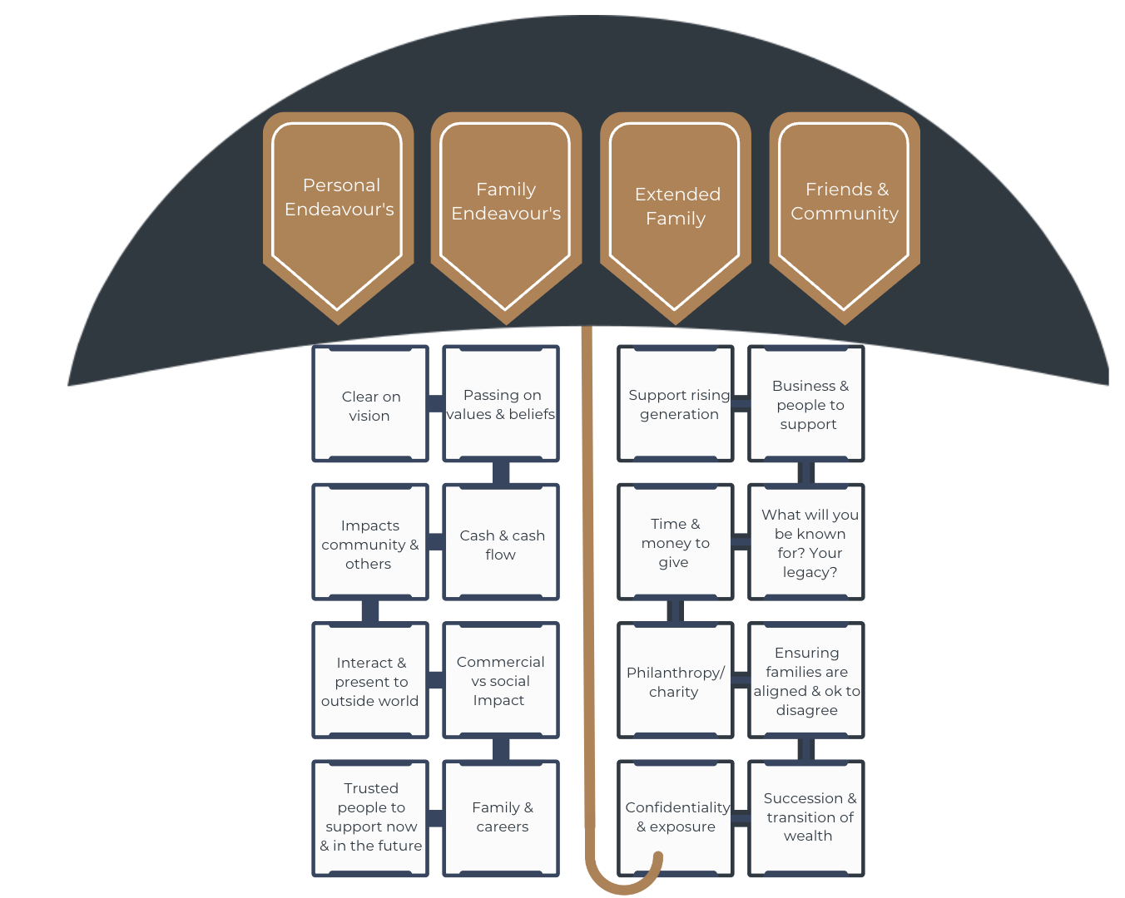
Be a Great Family- 100 Year Plan

