Slide 1
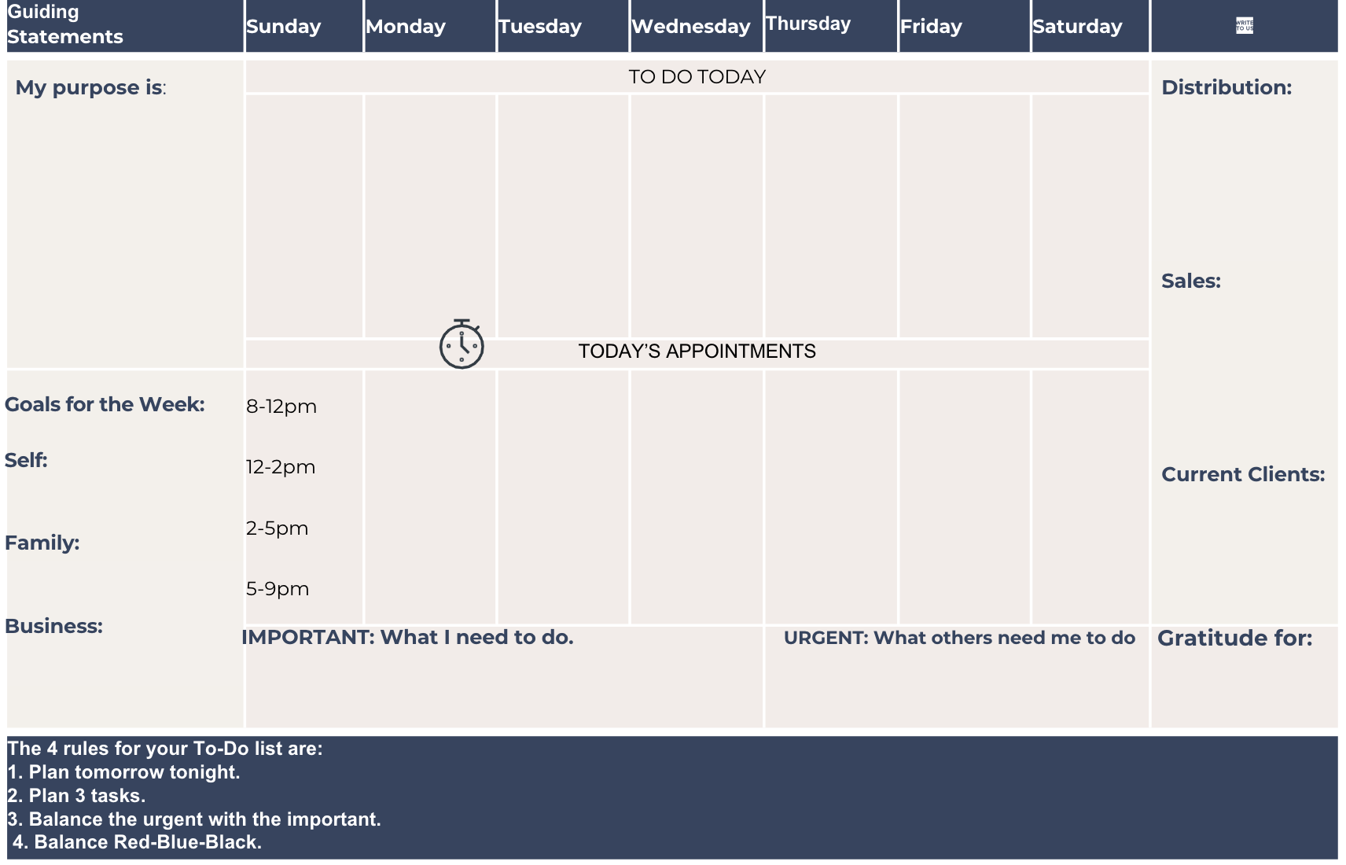
My Ideal Week
S A N
1

