Slide 2
Wednesday 22nd May 2024

Slide 3
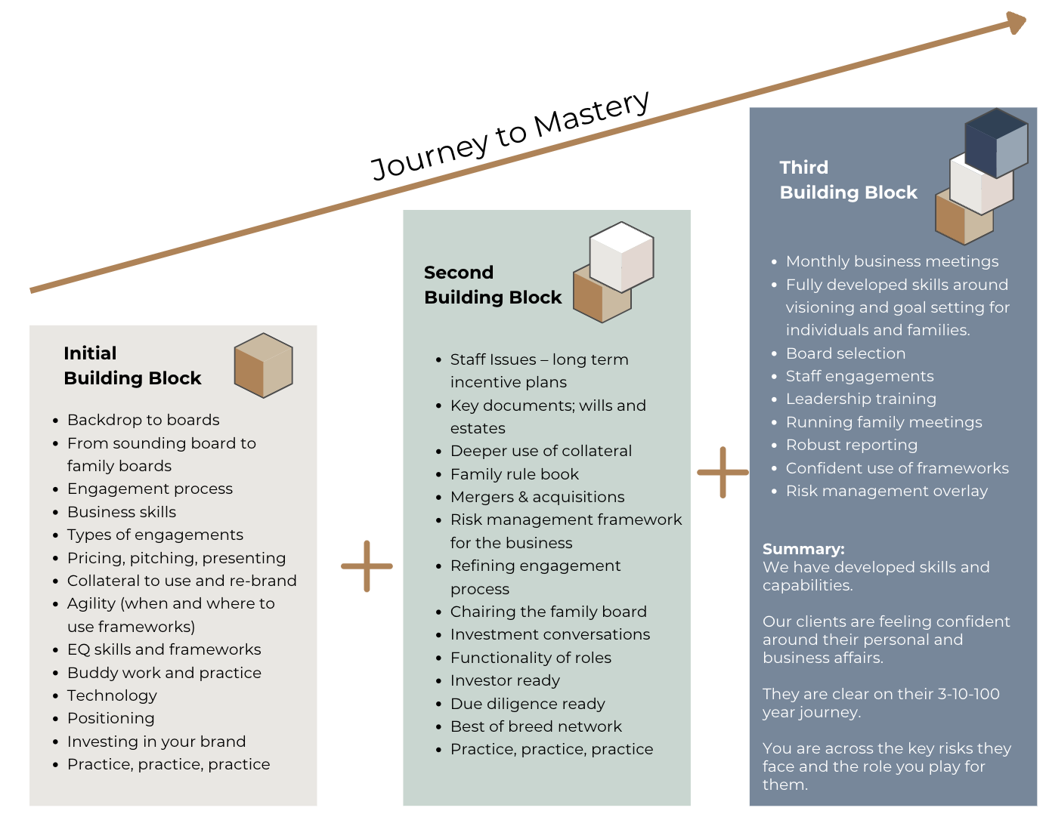
The SAN Learning Curve

Slide 6
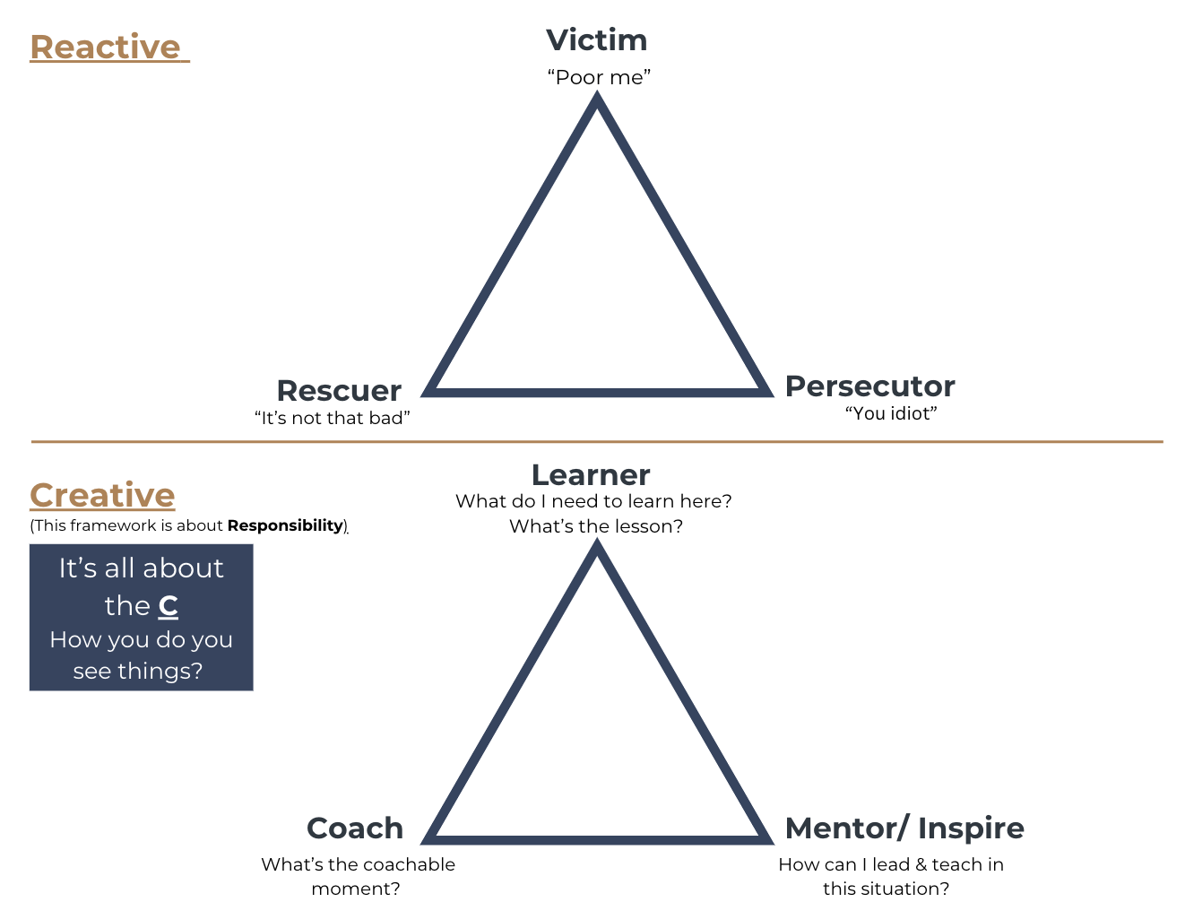
The Drama Triangle

Slide 7
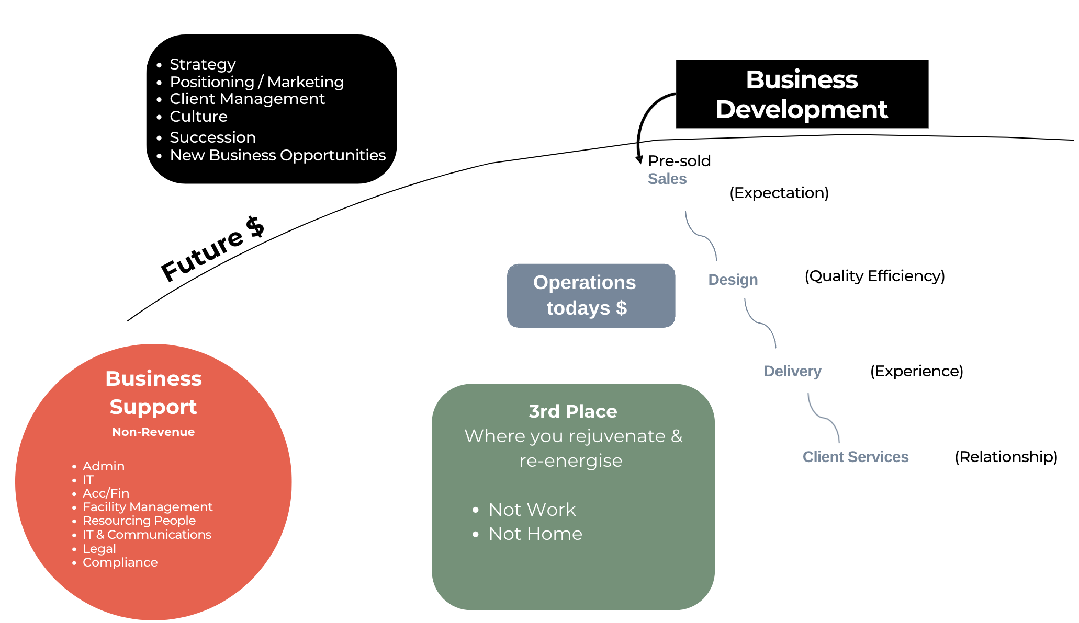
RED, BLUE, BLACK, GREEN

Slide 8
Innocence to Integration

Slide 9
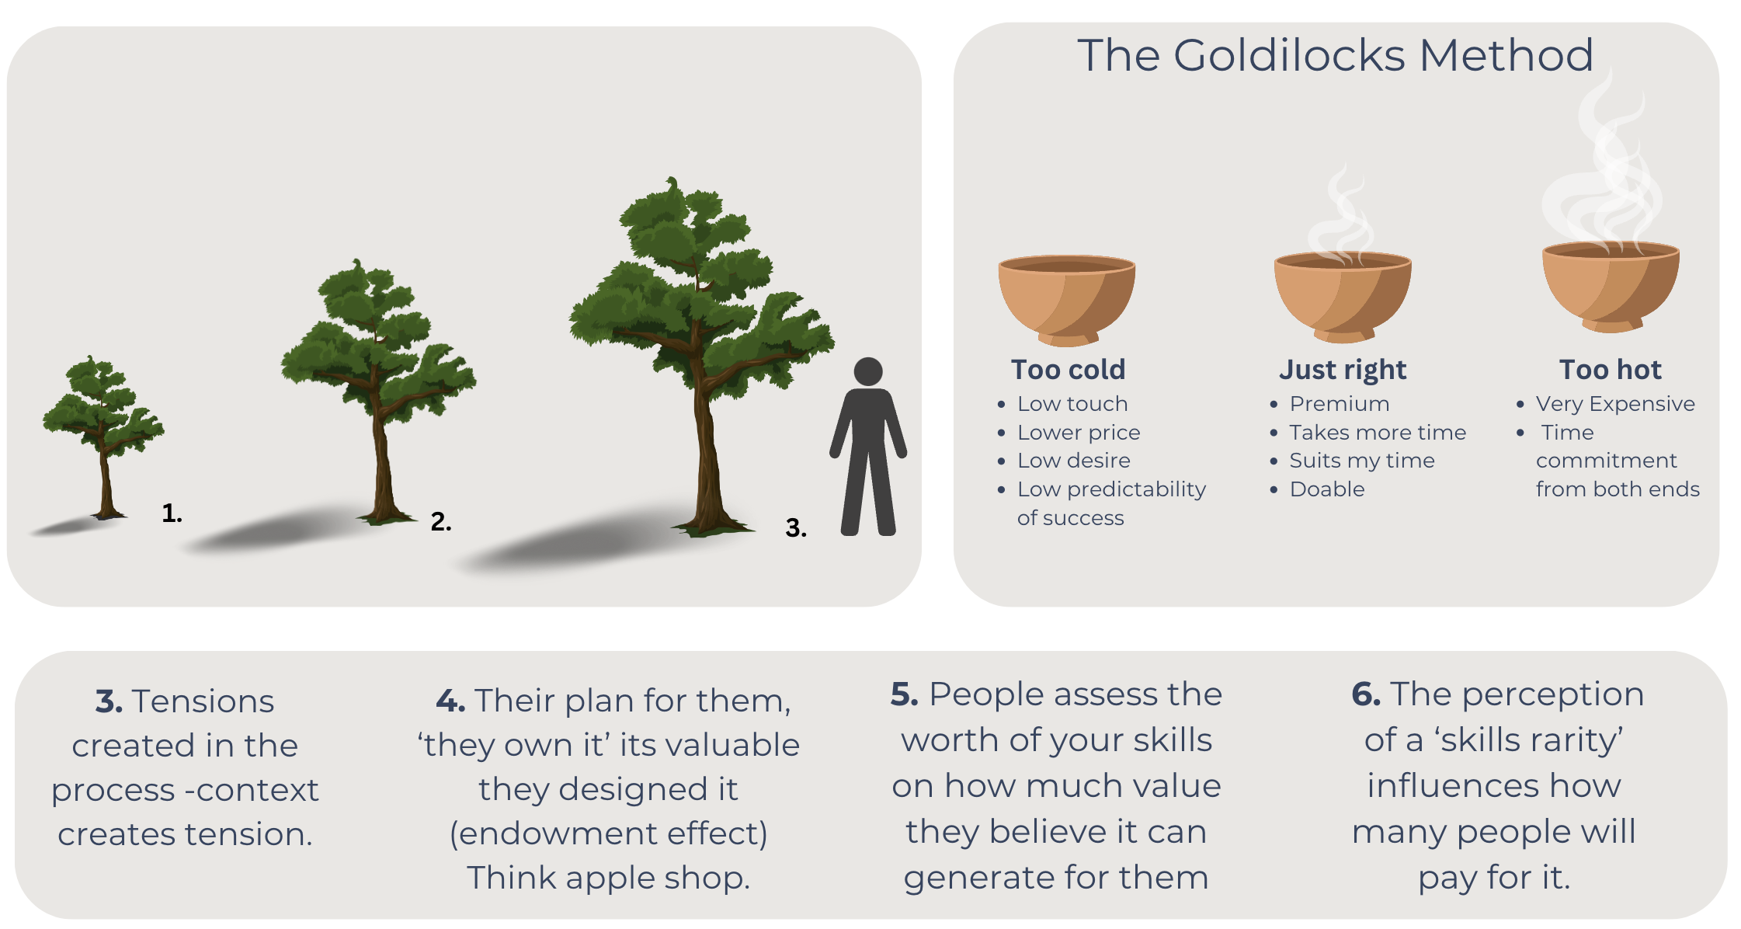
Value Lens
The value determined by comparison

Slide 10
The Investment Conversation

Slide 14
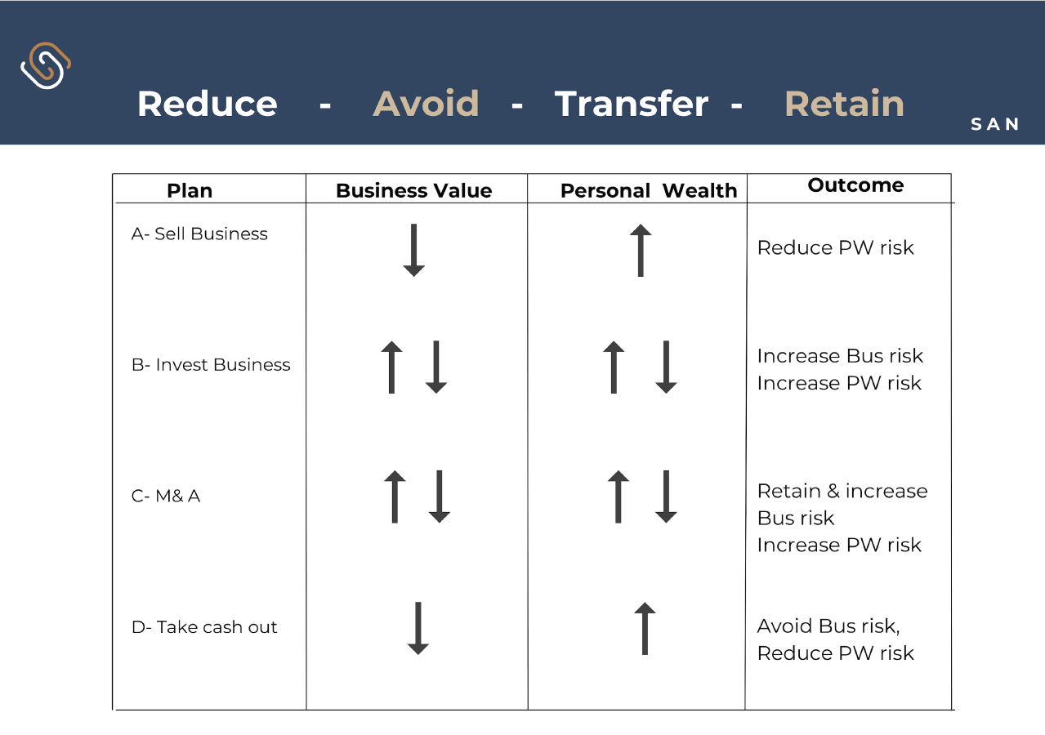

Slide 17
The Pitch Pack

Slide 18
10-3-Now – Mr & Mrs Client
<Date>
CONTEXT
Live
Love
Learn
Legacy
NOW |  | TO DO LIST | 3 YEAR GOALS | 10 YEAR GOALS
Mr & Mrs Client | Ages: 65 Children: 3 Grandchildren: 5 | Wills and Estate Family Rule Book Business Succession Asset Protection Family Advisory Board Governance Business Plan Complete New CEO Long Term Incentive Plan Finalise Loans to Kids Review Guarantees & Warranties Review Debt & Liquidity | Succession Estate OK Kids on Track Retired | Succession Fair Not Equal Deal with Son in Business Look After Kids Not Country Club Kids Look After Grandkids Retire Gracefully Maybe Sell/Merge Business
Residence | Value: ~$5 million
Investment Property + Company | Value: ~$5 million
Trust 1, Trust 2 | ~$10 million
Farm | ~$20 million
Business | Value: ~$20 million Staff: 80 1 son is in business
Superannuation | ~$5 million

Slide 19
Risk Management
1 REDUCE
2 AVOID
3 TRANSFER
4 RETAIN
INVESTMENT RISK | TAXATION RISK | ESTATE RISK | LITIGATION RISK | BUSINESS RISK | OTHER RISKS
How much investment risk? End goal Live too long Spend too much Market risk Income required Diversification Specific risk Liquidity | Risk profile Governance Tax structures Tax plans | Protect beneficiaries Fund the estate Insurance issues Wills Powers of Attorneys Agreements Death benefit nominations Legacy Fair V equal Challenges | Structures Warranties Directorships Entities Guarantees Staff Compliance | Covenants Directorship Staff Succession Key Person risk Advisory board Mergers and acquisitions | Family Relationships Divorce Finance Cash flows Inflation Health Communication Governance

Slide 20
12 Month Plan
This document sets out your 12 Month Financial Game Plan. It is intended to provide an overview of the areas in which we will be focusing upon in our 12 month engagement. Please do not act on this information.
FIRST QUARTER
January to March
SECOND QUARTER
April to June
THIRD QUARTER
July to September
FOURTH QUARTER
October to December
Review wills & estate
Risk Management across all assets
Board formally operating
Strategy & discussions
Business advisory Board formed
Set business direction
Reporting & Governance
Reporting across total Balance Sheet
1st informal management meeting
Review Key People and CFO
Succession plan agreed
Major risks identified and dealt with
General Risk Management health check
Risk Management Matrix
Adult children engaged
Board functioning well
Review Key People
Engage with family
Wills completed
Family strategy underway
Build succession plan
Risk Management Framework agreed & reported
Family engaged
Understand important new financial issues
Board operational
Feeling confident
REVIEW

Slide 21
Service Offering Options
Option C
Advisory Board & Home Office Establishment role
Most comprehensive offering (option’s A & B + help build your own family office administration solution)
Bill paying
Group administration duties
Record keeping
Typically most appropriate after sale of business or other substantial investment (such as a development)
Highest touch & accountability Greatest buy in & involvement
Personal administration outsourced to our family office team
Option B
Advisory Board role Project management to your
committed future across total balance sheet & establish advisory board/s
Understand all the risks
Fortnightly meetings
Develop risk management matrix
Develop project plan
Coordinate meetings to deliver project plan
Higher touch (fortnightly meetings) & accountability
Greater access to us & network Greater buy in & involvement
Option A
Lead Adviser role
Most simplistic service offering
Introductions to network
Manage & run project
Financially well organised across estate, tax, investment etc. (wealth management lens)
Get you financially well organised with a financial game plan aligning with your goals & objectives
$3k p.m. + GST
$6k p.m. + GST
$8k p.m. + GST

Slide 22
Thursday 23rd May 2024

Slide 24
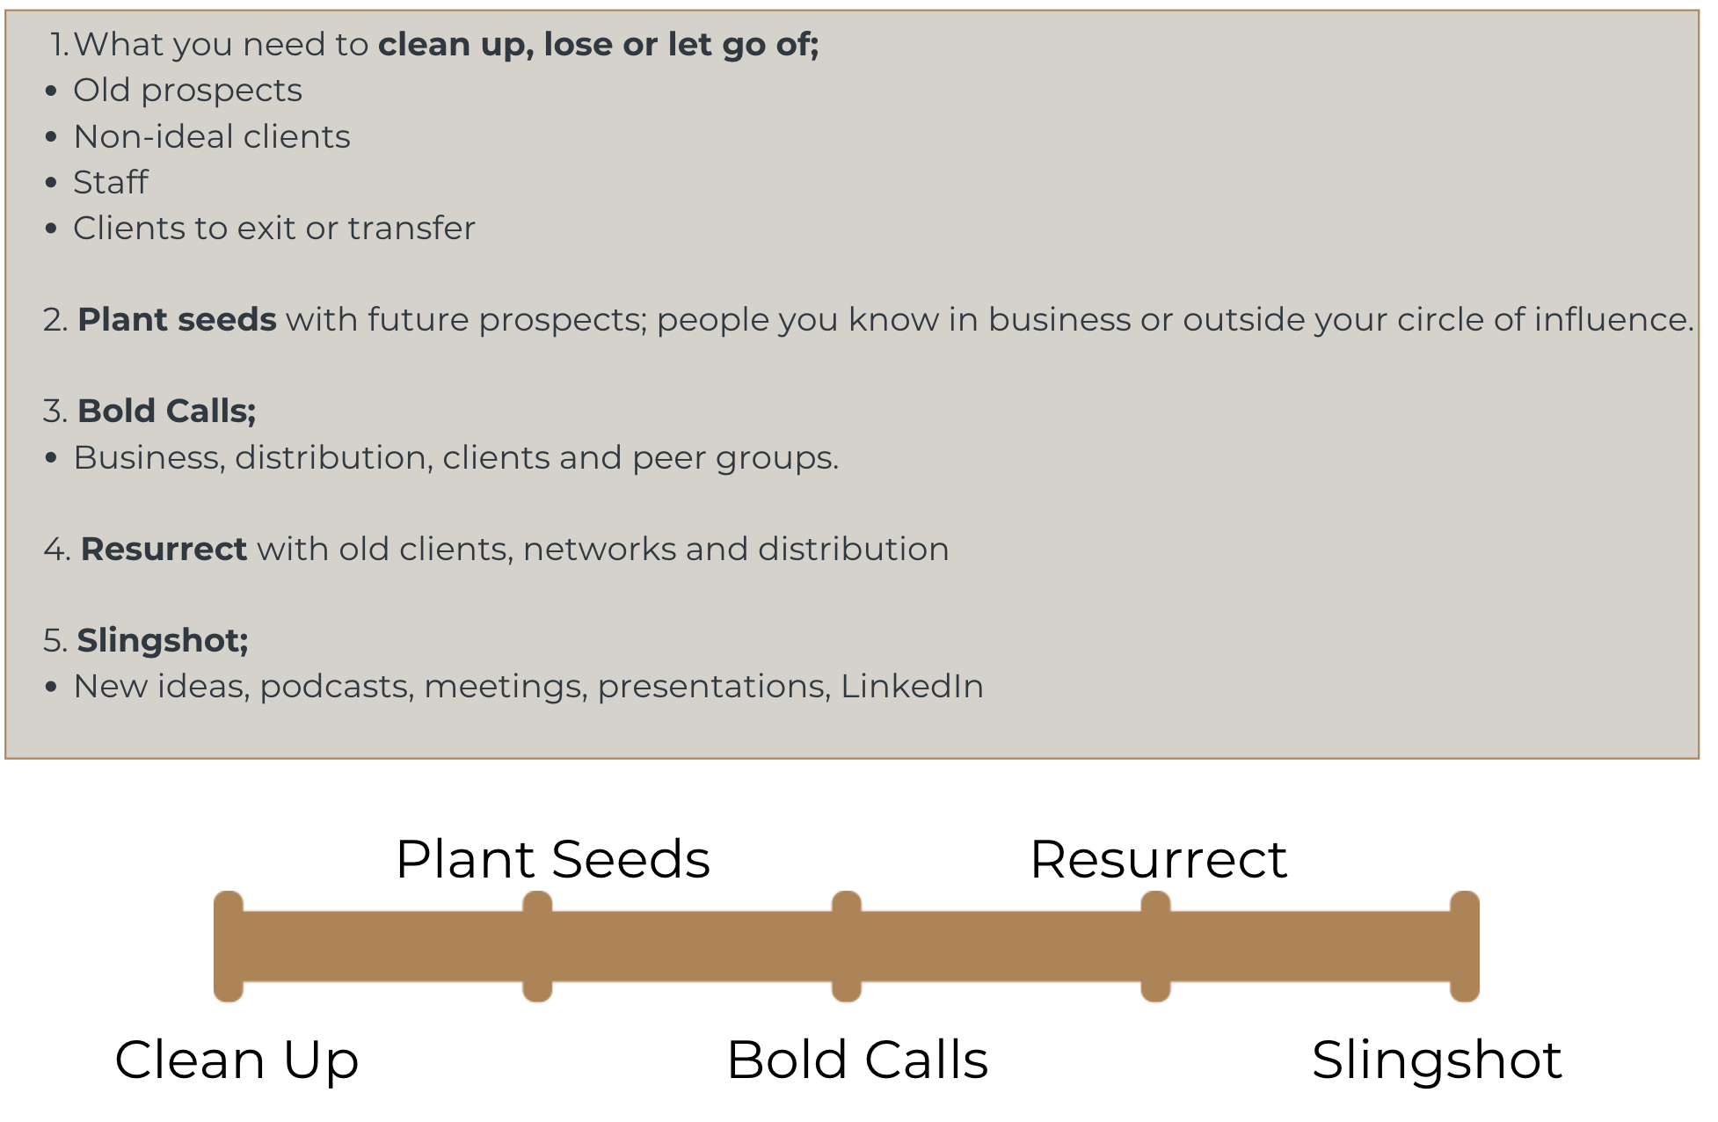
Pipeline to Success

Slide 25
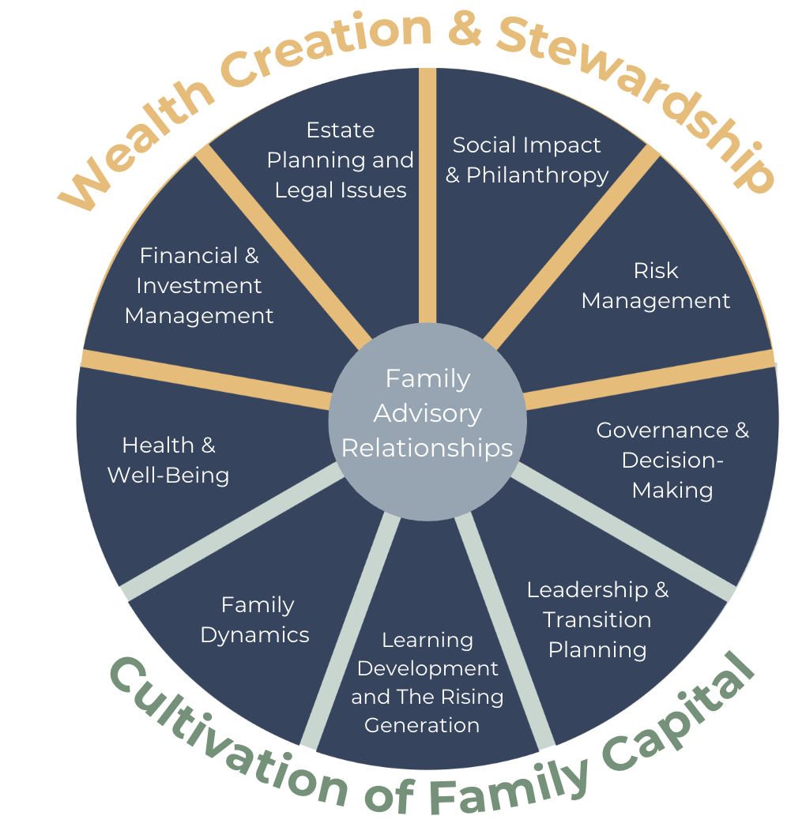
10 Domains of Family Wealth
Credit: The UHNW Institute, Inc

Slide 28
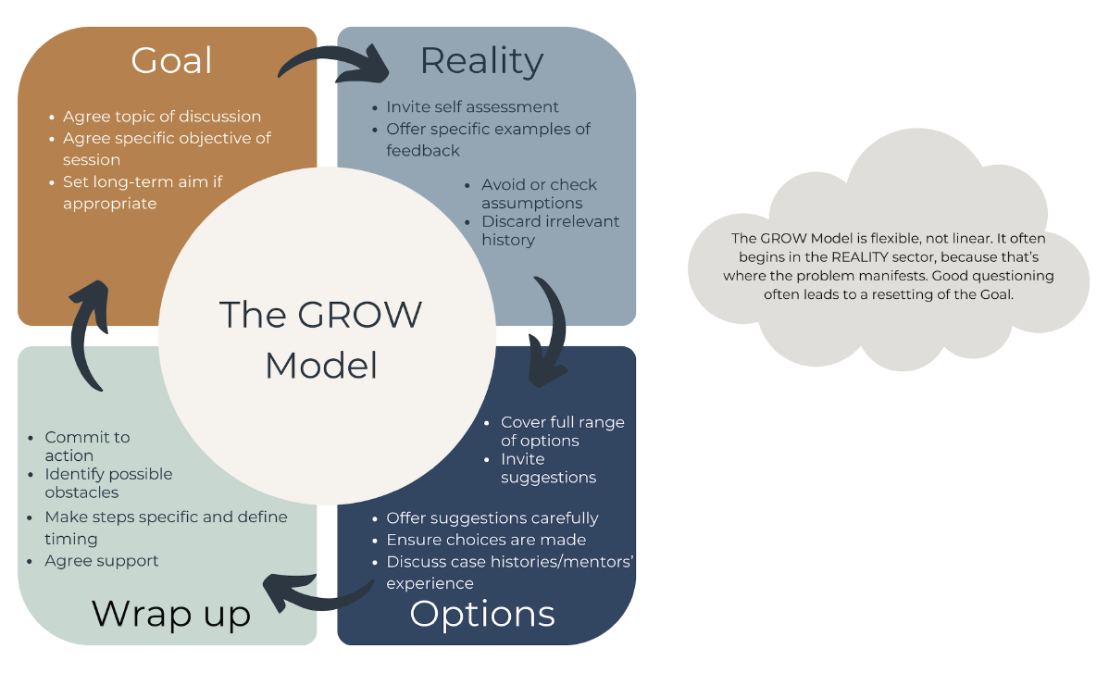
The GROW Model

