Slide 1
National Conference
23rd & 24th October
Sanctuary Cove QLD

Slide 2
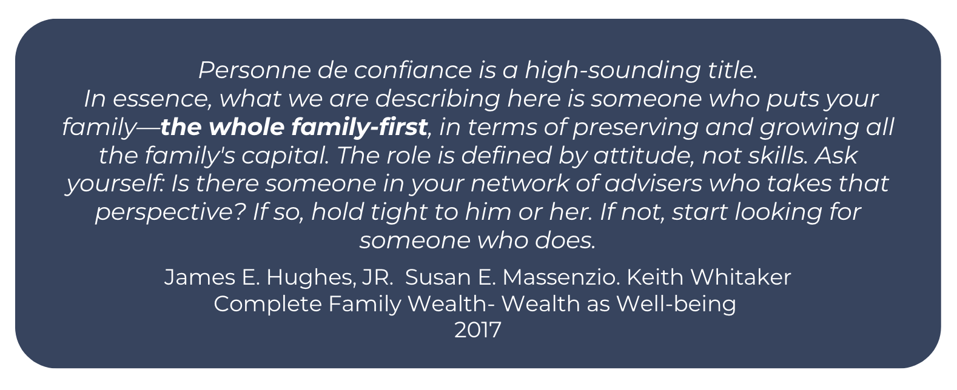
Personne De Confiance

Slide 3
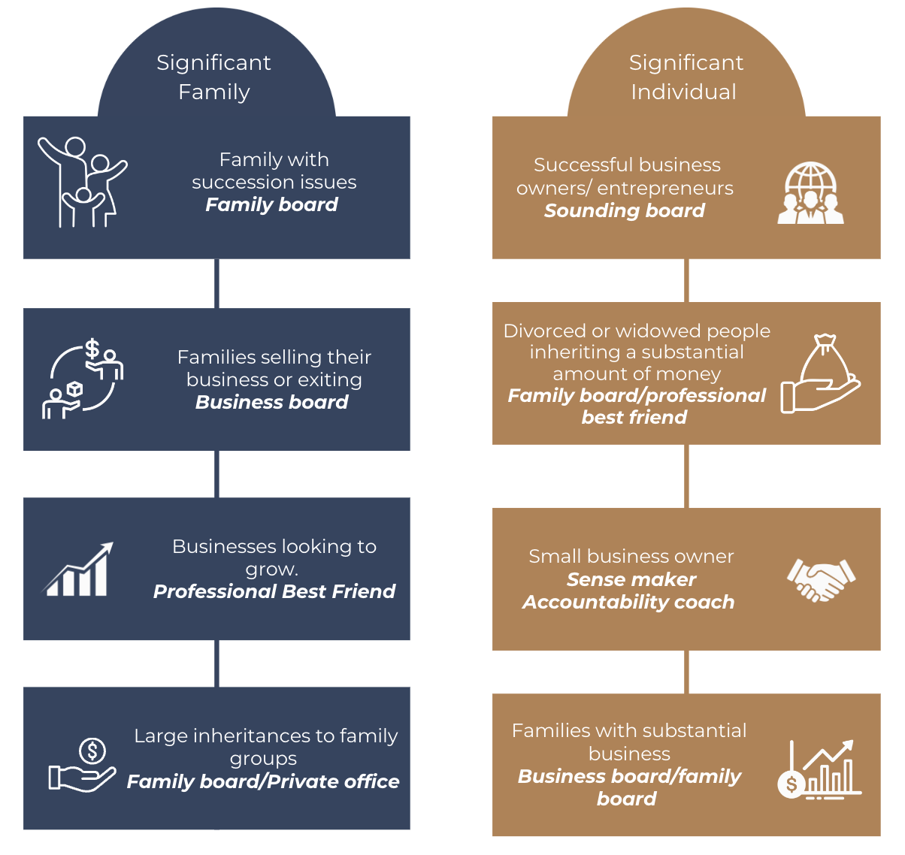
SAN Adviser- Possible Roles

Slide 4
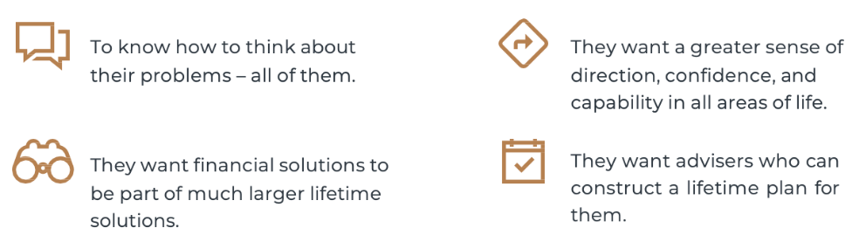
Conference Overlay
Clients perception of value
Armory:
Business Mastery | Client Mastery | Personal Mastery
Frameworks Decision making Governance HR functionality Positioning Stages EOS LTI Key people Strategy | Sounding board Family board Business board Engagement process Pitching Dealing with conflict Coaching/Mentoring Risk Management Technical expertise The Balance sheets | Self-awareness Relationships EI, VQ, EQ, AQ Creative vs Reactive Agile advisor Confidence & Capability Time management EQ models & frameworks

Slide 5
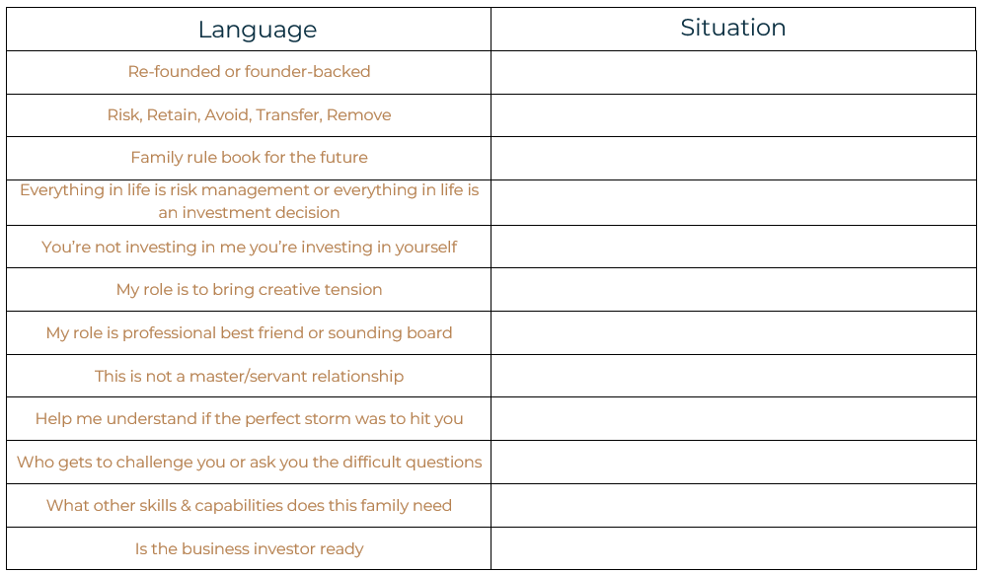
Significant Vocabulary

Slide 6
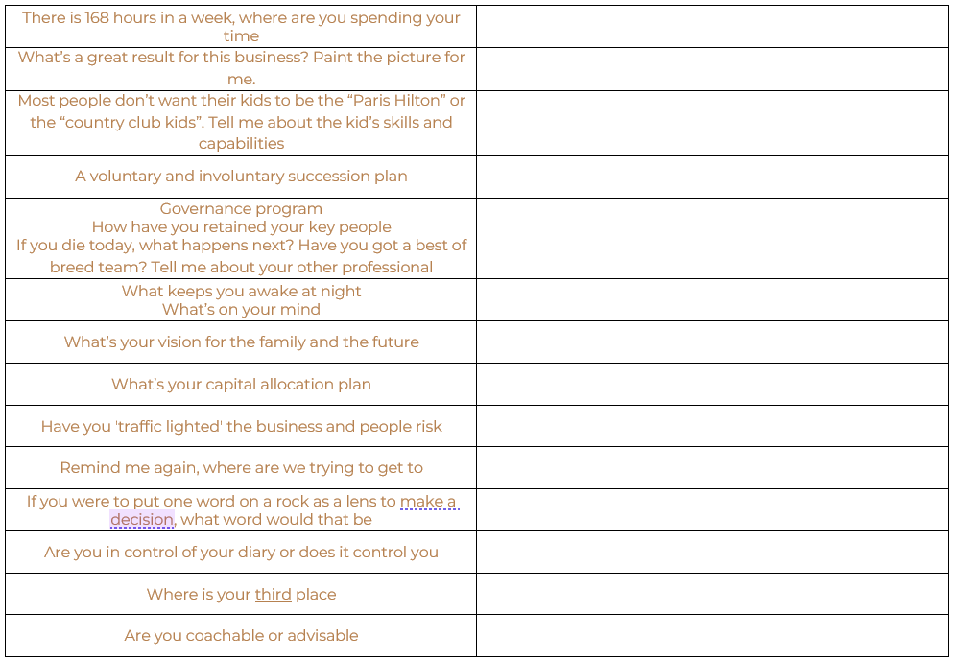
Significant Vocabulary continued…

Slide 7
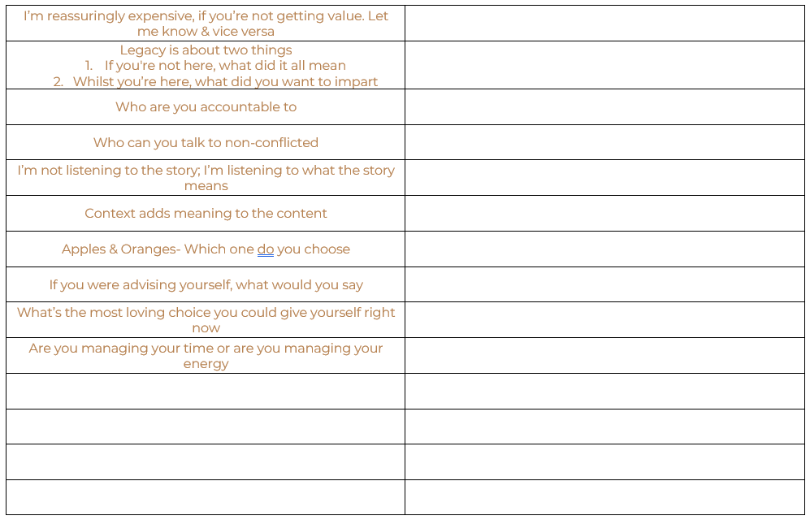
Significant Vocabulary continued…

Slide 8
Cybernetic Shield Pty Ltd

Slide 9
Risk Management
1 REDUCE
2 AVOID
3 TRANSFER
4 RETAIN
INVESTMENT RISK | TAXATION RISK | ESTATE RISK | LITIGATION RISK | BUSINESS RISK | OTHER RISKS

Slide 10
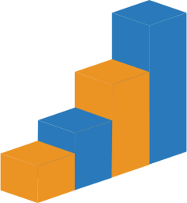
Business Readiness : Drivers of Company Value
Financial Performance
Monopoly Control
The Switzerland Structure
The Valuation Teeter-Totter
Recurring Revenue
Growth
Potential
The Customer Score
Hub & Spoke

Slide 11
What’s Important About Money To You?

Slide 12
What’s Important About Money To You?

Slide 13
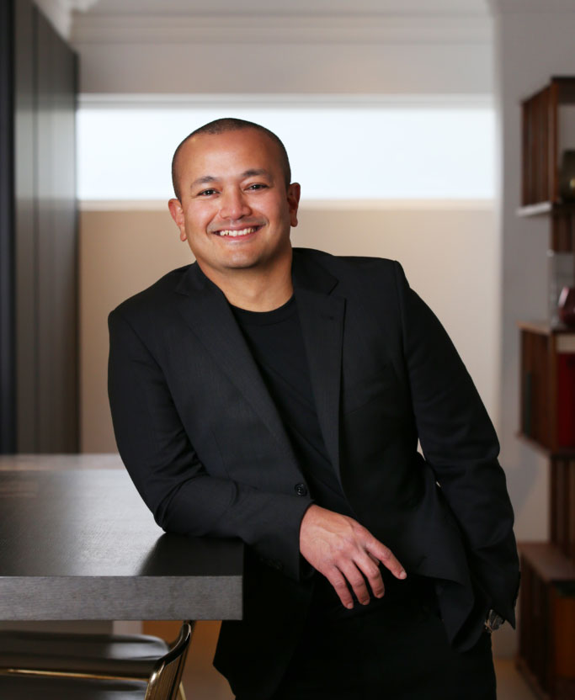
NIVIN THANABALAN
Nivin has extensive experience in guiding high-growth founders through critical scaling phases. Niv has worked with a diverse range of fast-scaling businesses, helping them navigate the complexities of growth while focusing on key drivers of success. Passionate about empowering founders in high-growth environments, Niv provides strategic insights that help advisors unlock new opportunities and optimize their support for founders aiming to scale their businesses rapidly.
Session Overview: This session will explore the unique challenges and opportunities in working with high-growth founders, focusing on how advisors can best support them through rapid scaling and strategic milestones.
Objectives and Outcomes:
Understand the key differences between high-growth founders and traditional business owners.
Gain in-depth knowledge on how to identify, prioritize, and address the critical needs of high-growth businesses.
Discover actionable strategies for advisors to engage with fast-scaling businesses and unlock new growth opportunities in this dynamic sector.
Contact Details
niv@integralinsights.io
http://www.integralinsights.io
+614 3036 3102

Slide 14
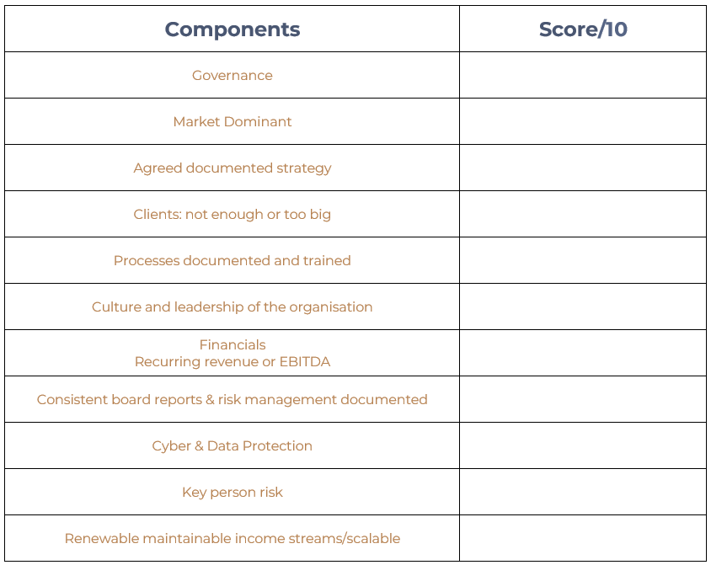
Where will I be discounted?

Slide 15
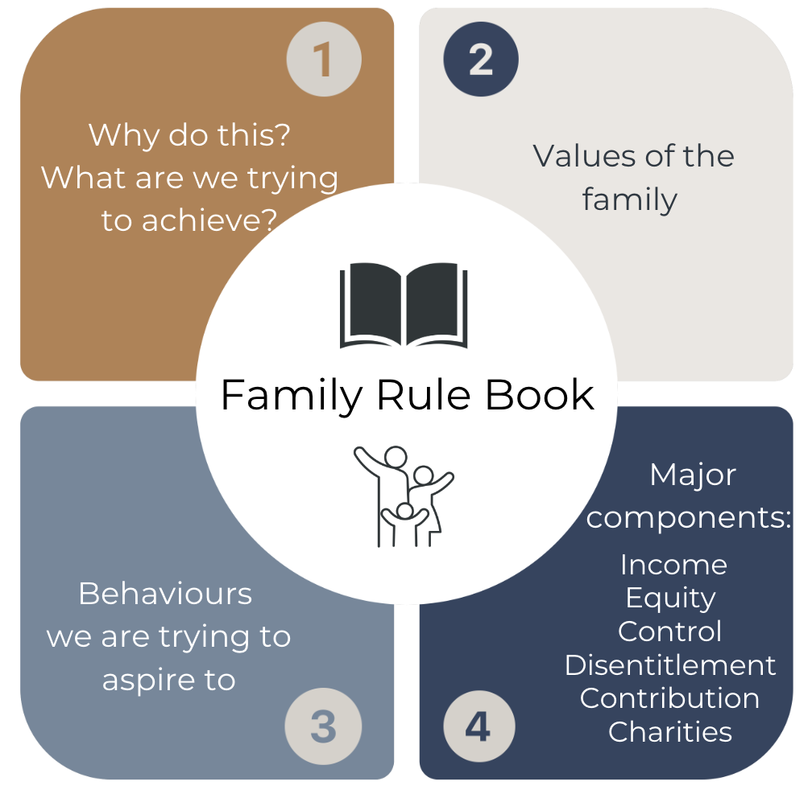
Family Rule Book

Slide 16
Stewardship Family Board Role

Slide 17
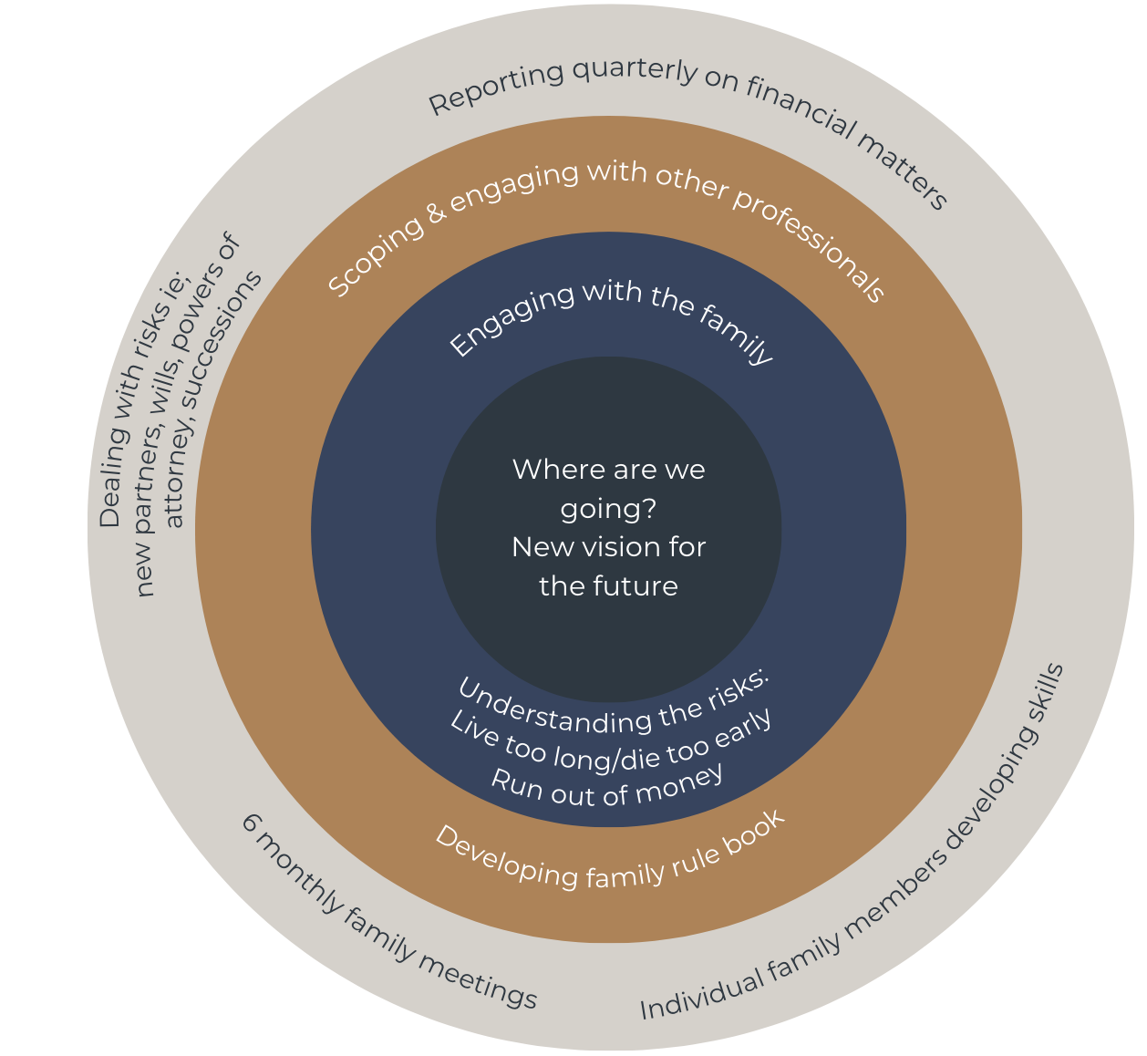
Advocacy
Family Board
Stewardship

Slide 18
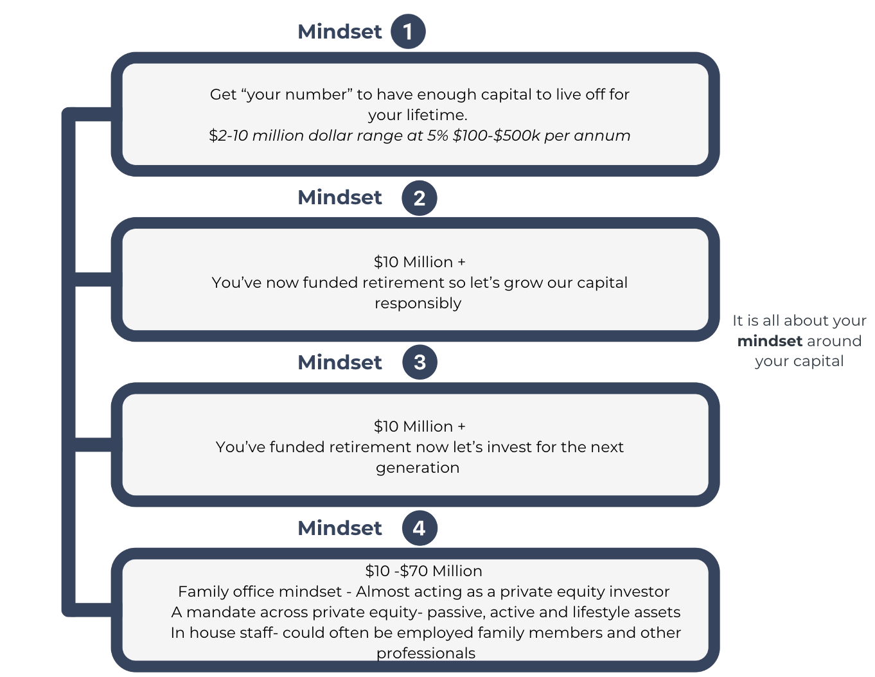
How to think about your capital

Slide 19
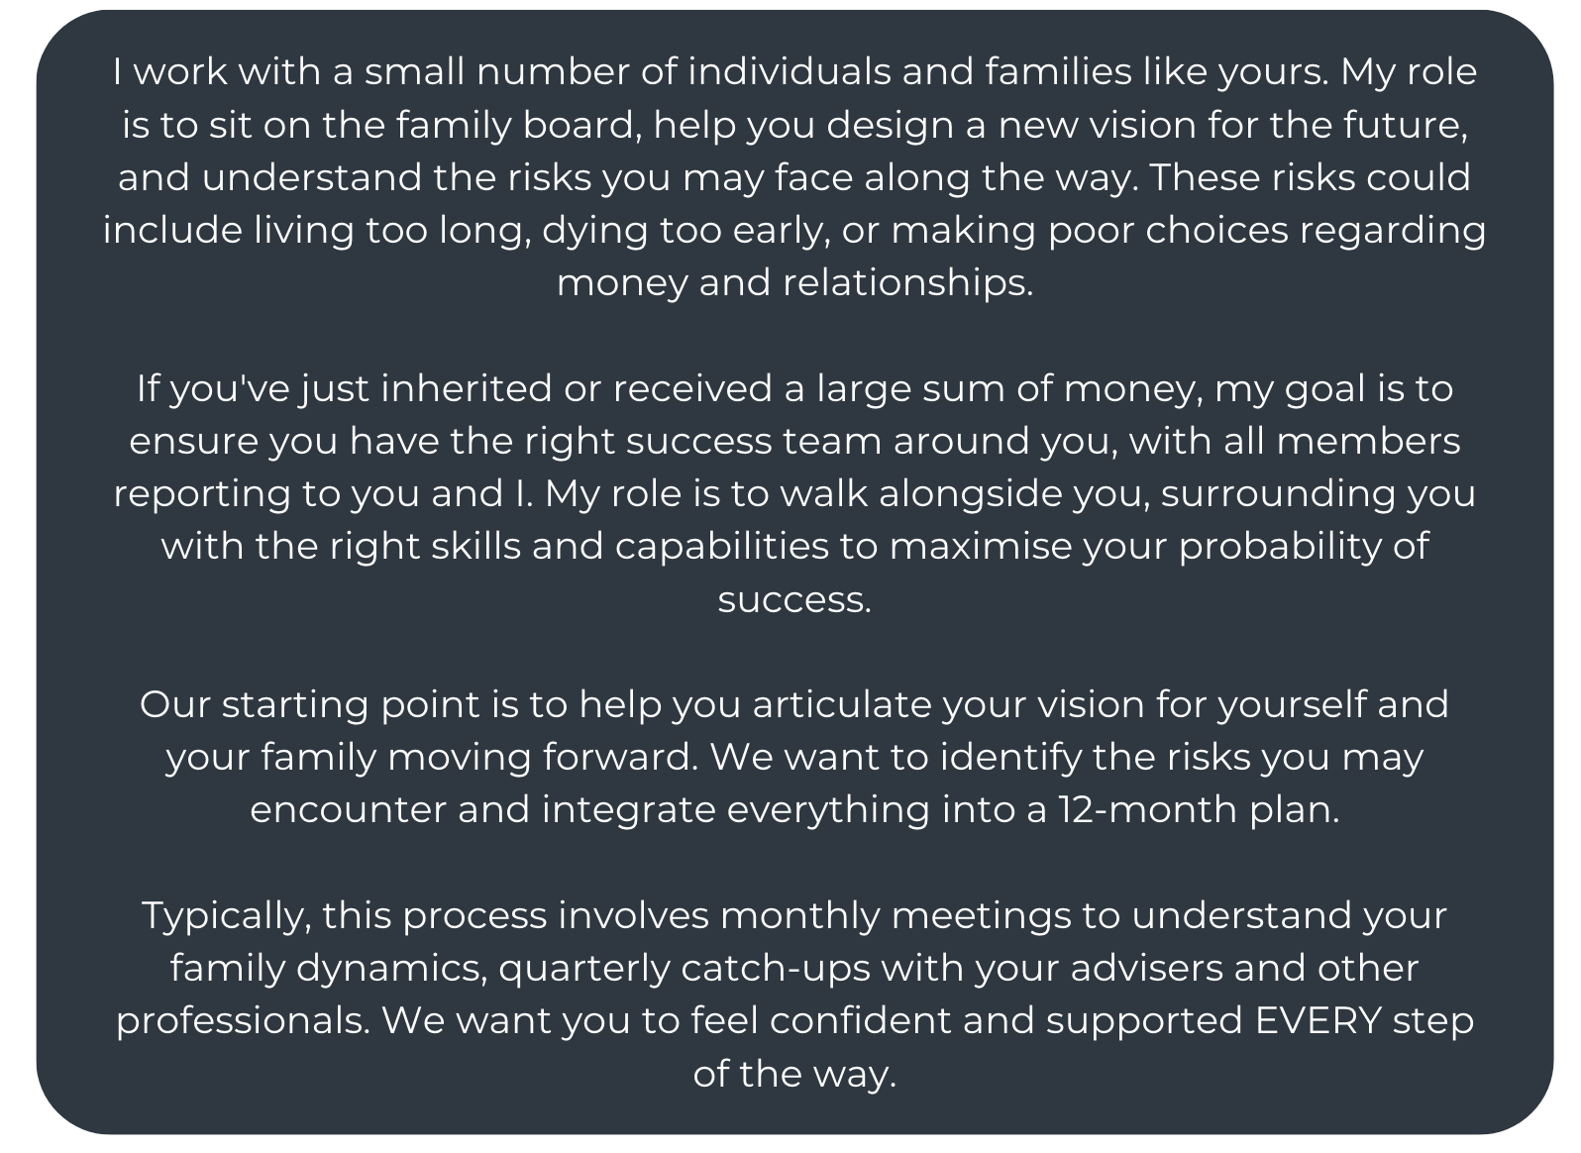
Advocate Role: Script

Slide 20
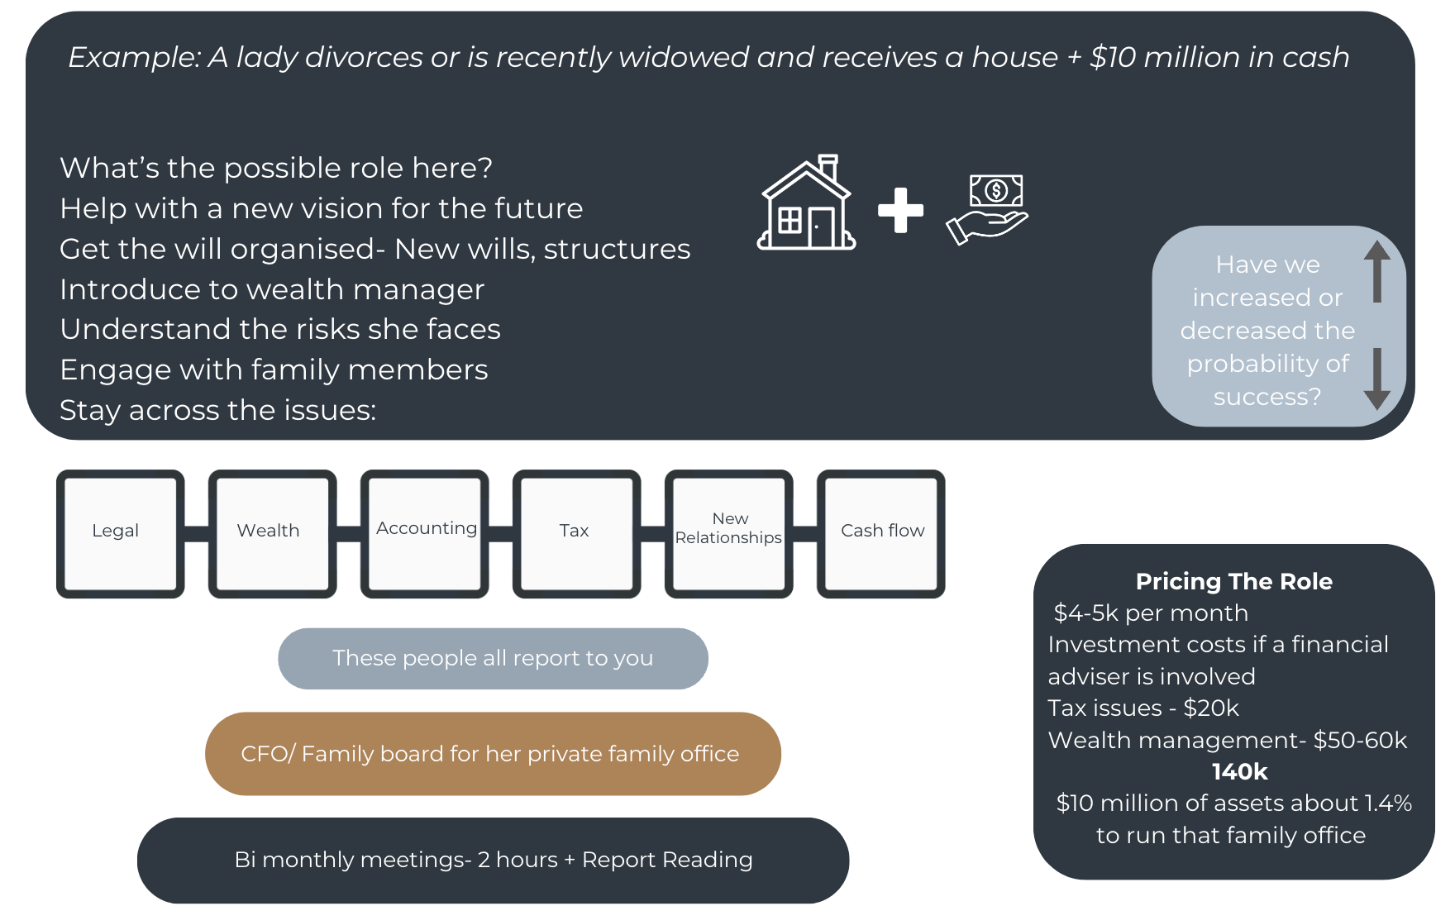
Stewardship Role: Family Board Example

