Slide 1
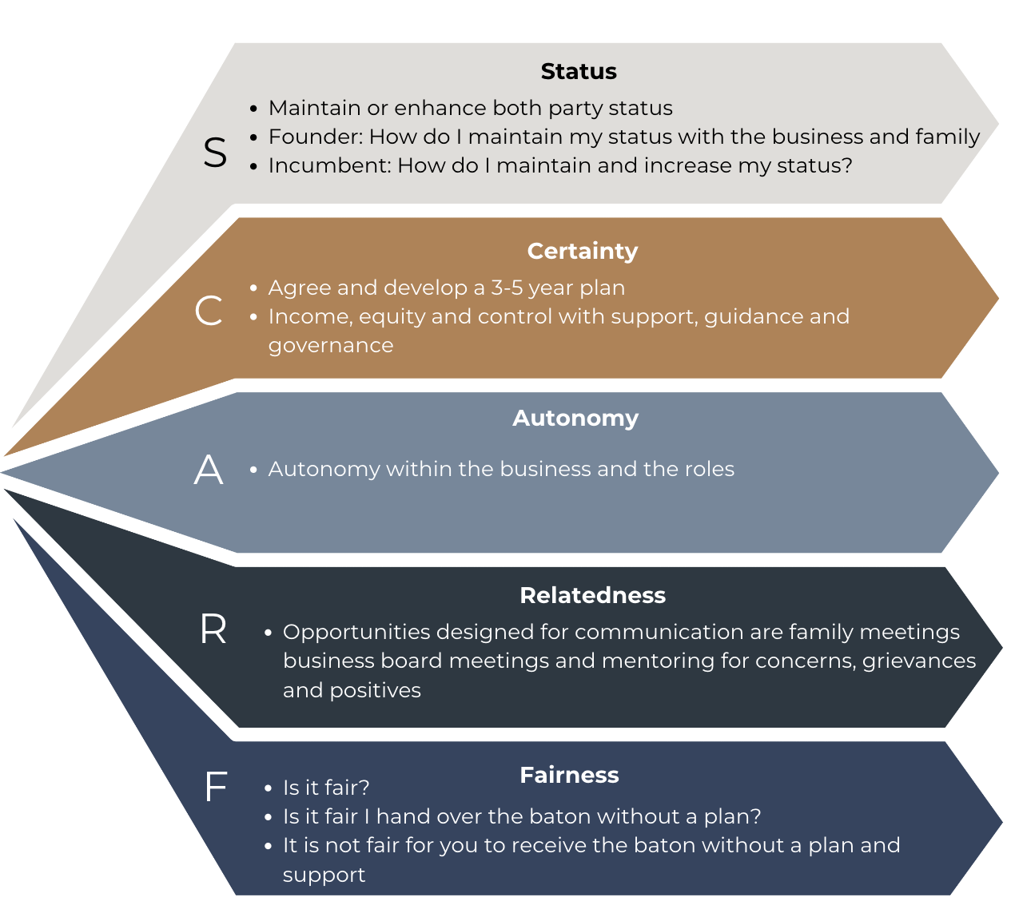
SCARF Model for Change

