Slide 1
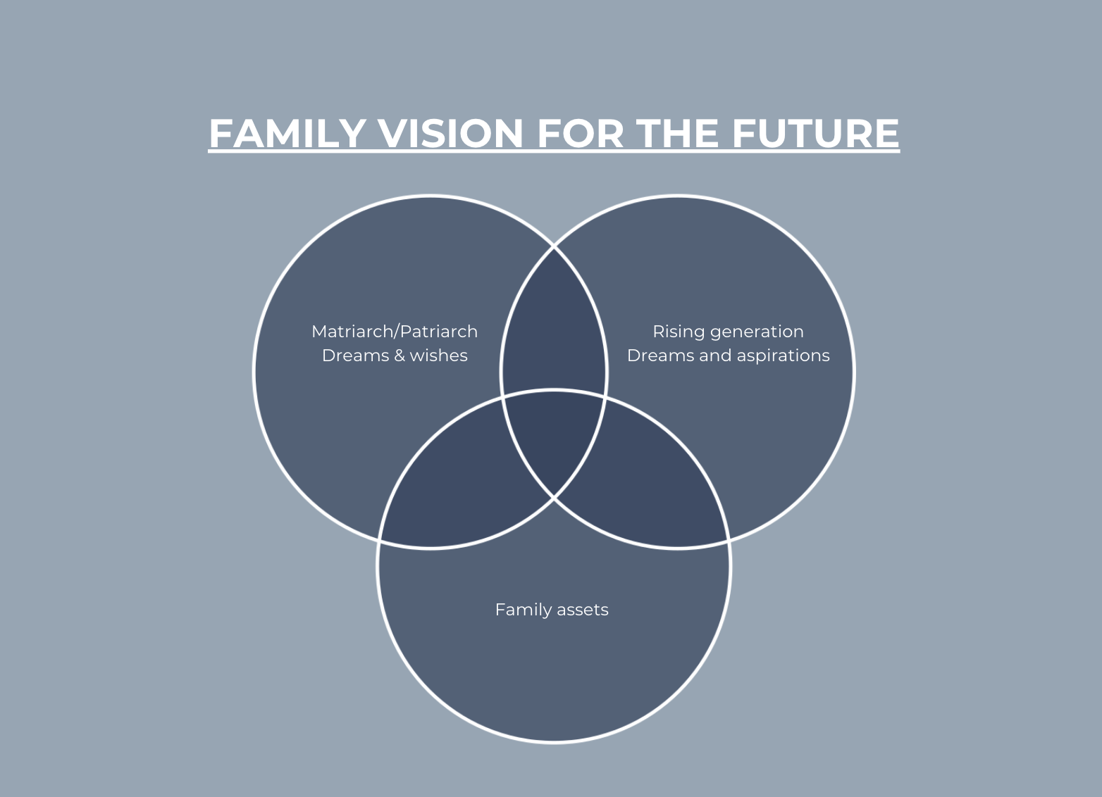

Slide 2
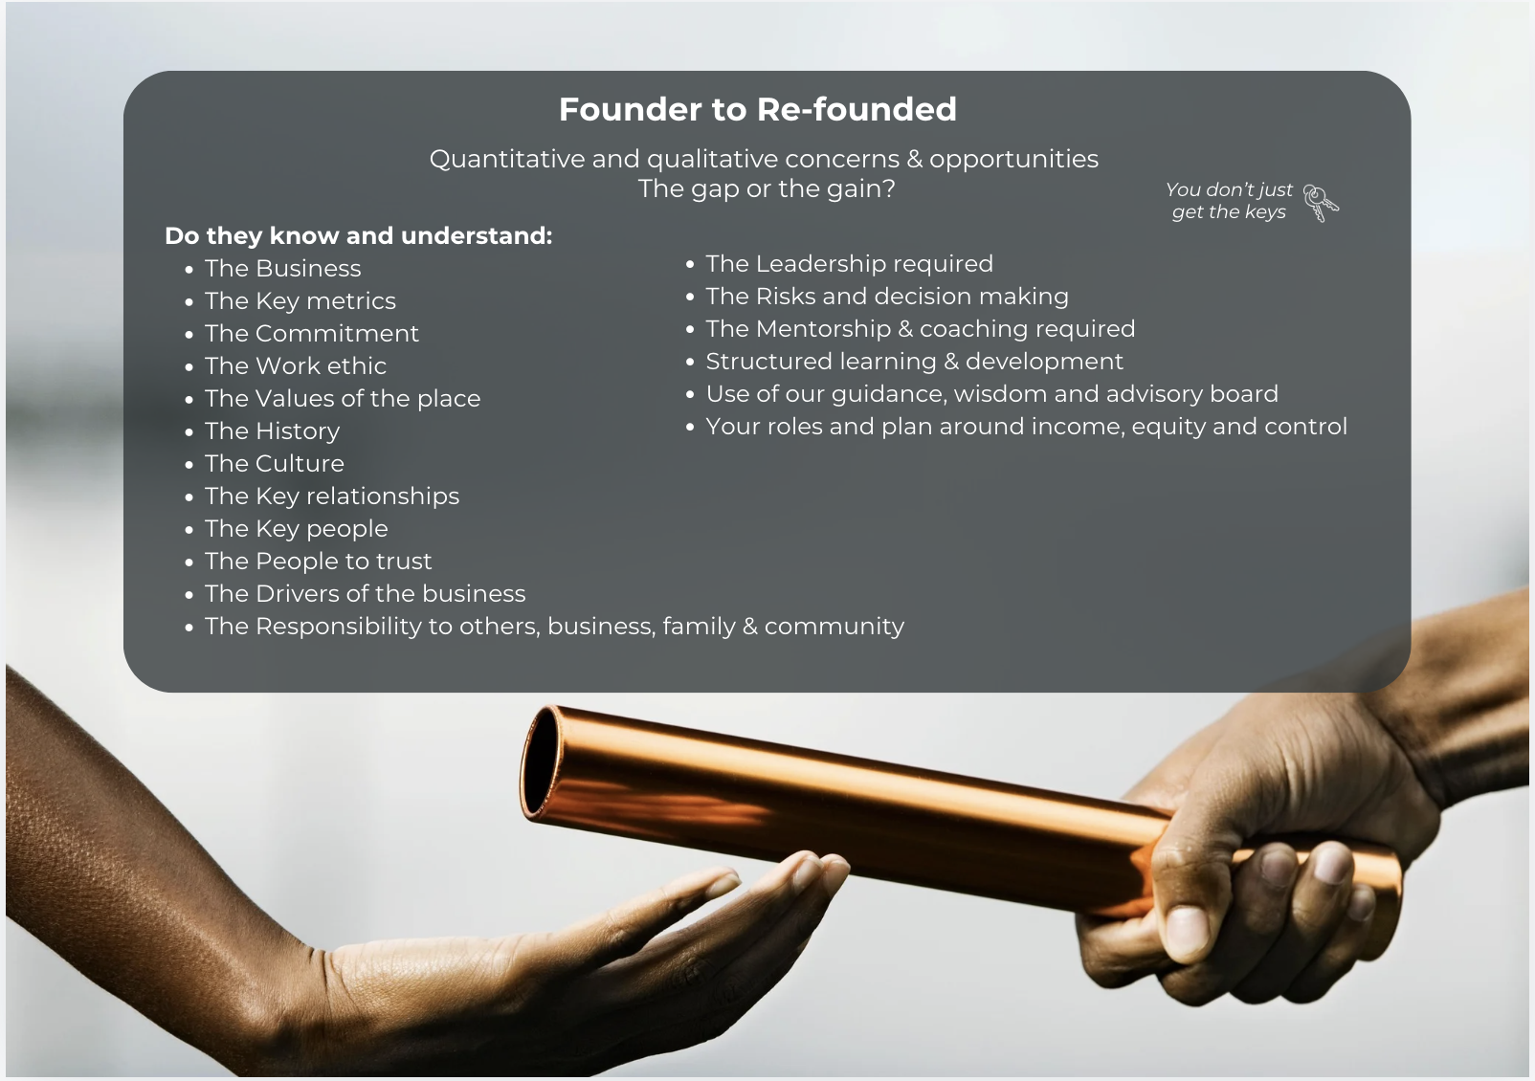
Handing Over The Baton

Slide 3
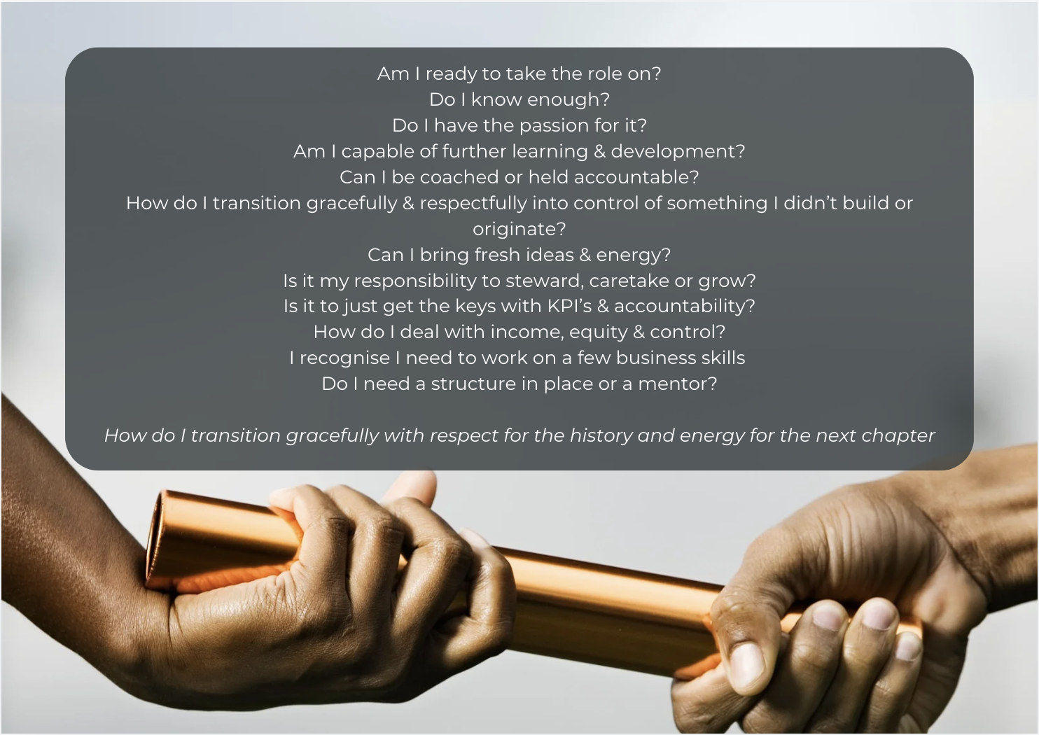
Receiving the Baton
Considerations, Challenges & Opportunities

Slide 4
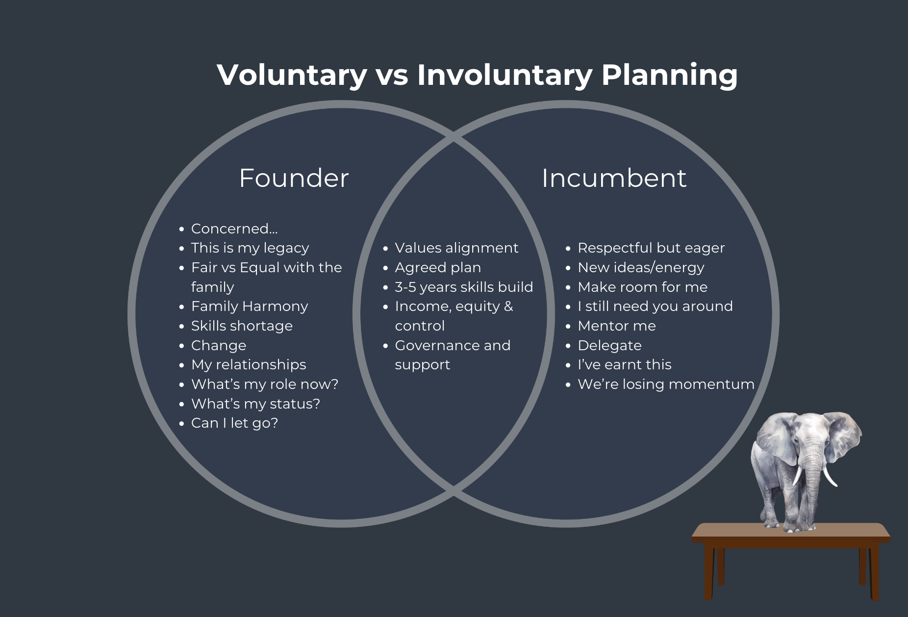
Typical A-B Conversations

Slide 5
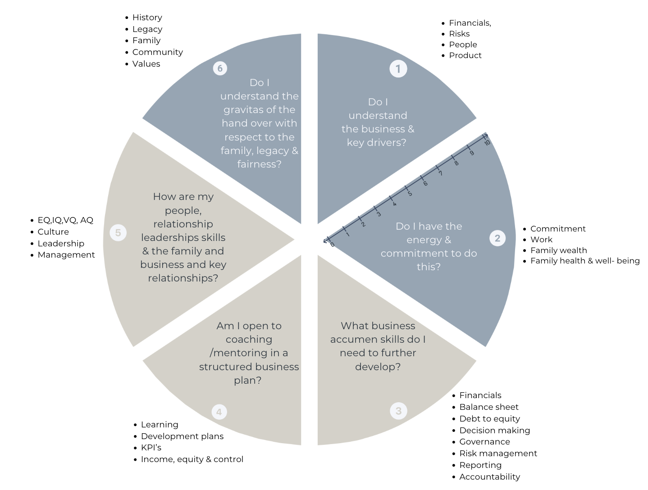
Wheel of Competency

Slide 6
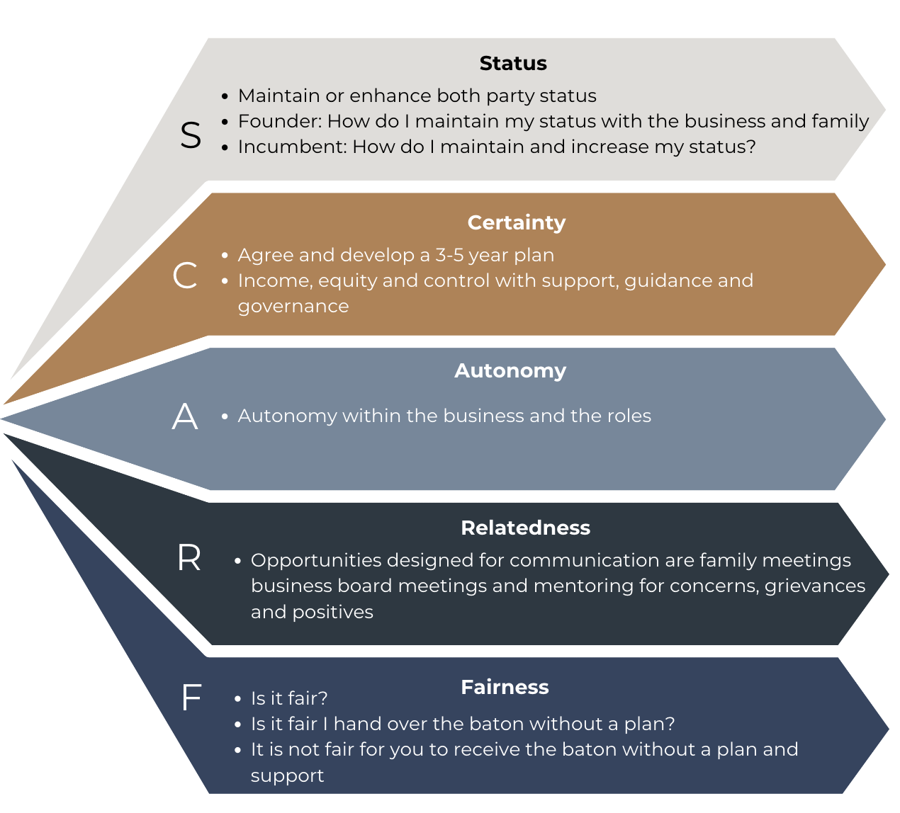
SCARF Model for Change

Slide 7
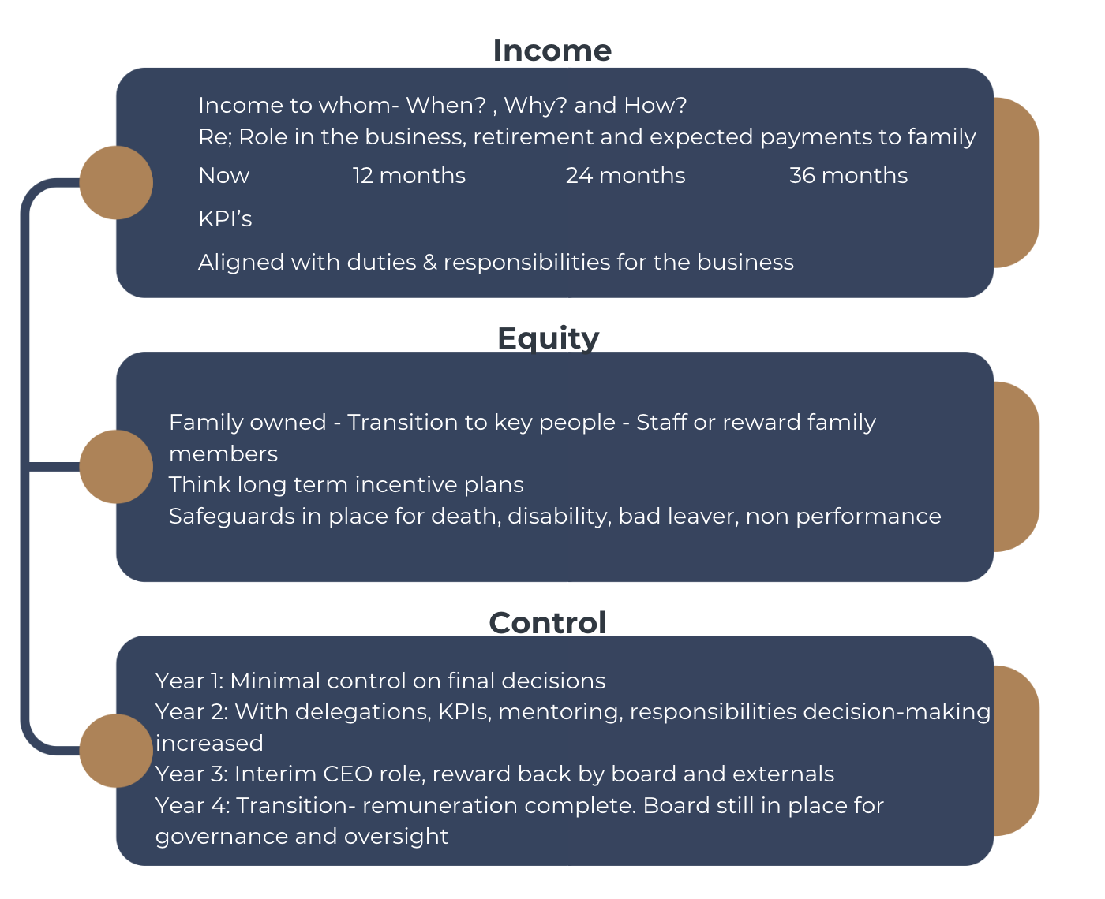
Transition

Slide 8
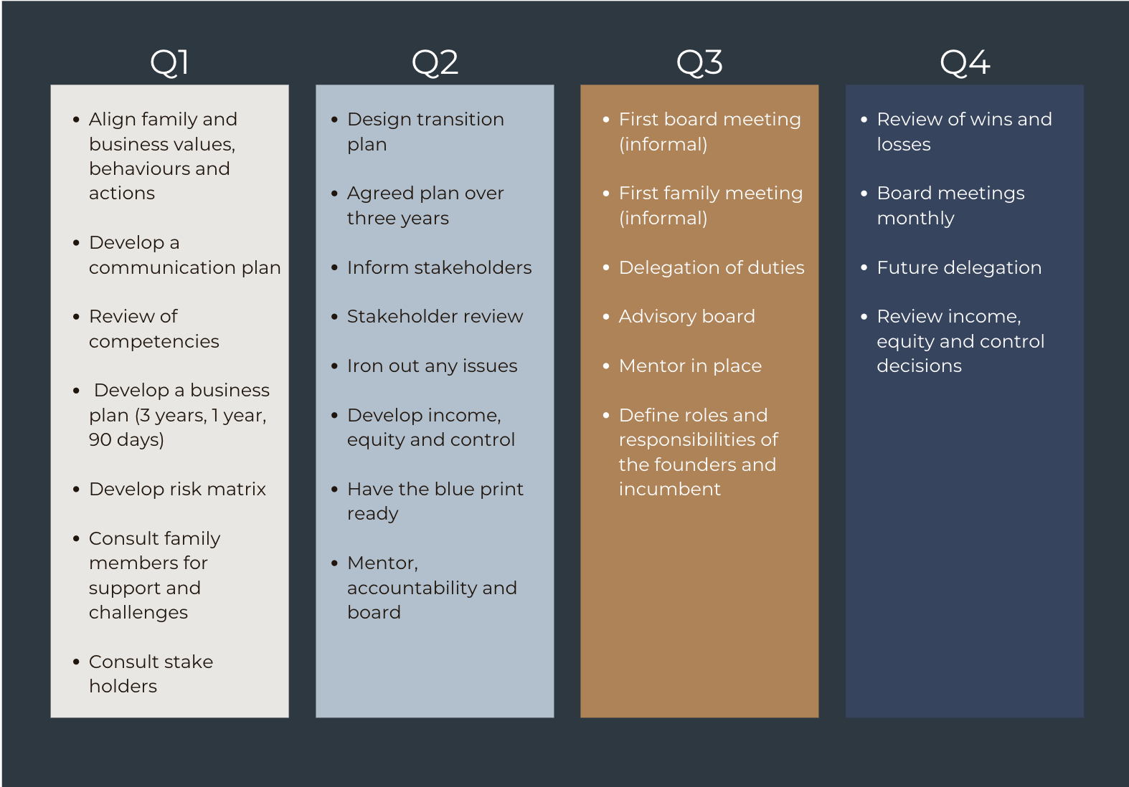
Year 1– Draft

Slide 9
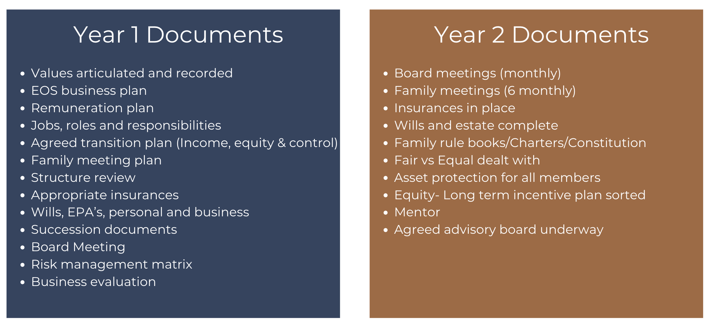
Possible Succession Documents

Slide 10
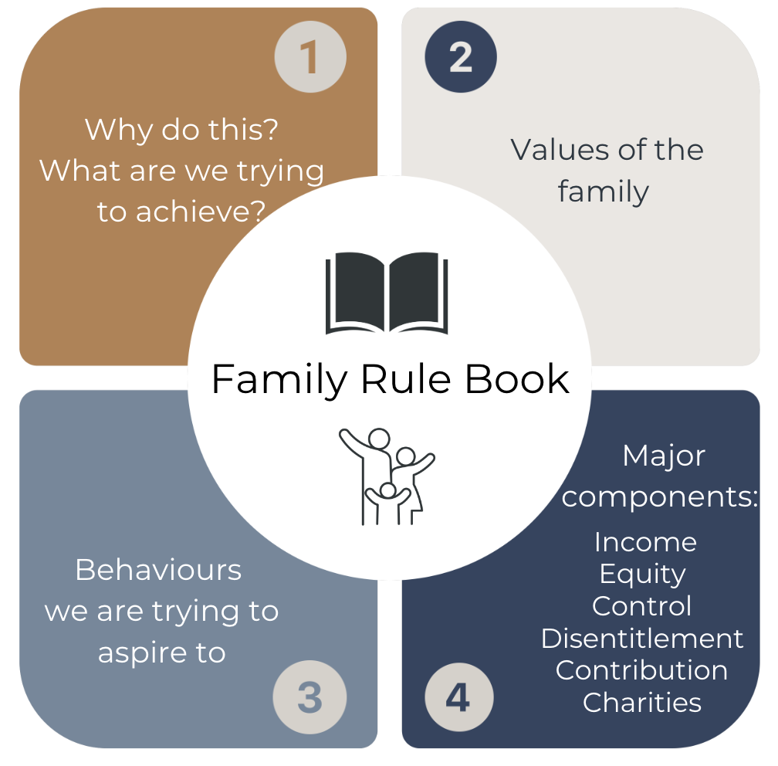
Family Rule Book

Slide 11
1
Why do you need a Family Board Adviser?
Why me?

Slide 12
Capability & Planning Issues
Where to start?
Where are we going?
Ability will articulate our future direction?
Are we committed?
Our existing advisers competencies?
Who will champion the cause?
What capabilities do we need?
What are our decision trees?
How do we make tough decisions?
Best of Breed team required across tax, legal and wealth
How do we engage & communicate?
What does success look like?
What if the kids don’t like it?
How do we manage conflict?
Are we accountable?
Who will help us?
Risk Management Lens
1 REDUCE
2 AVOID
3 TRA
4 RETAIN
REDUCE
RETAIN
People
Mum & Dad, dreams & aspirations
Adult children, dreams & aspirations
Relationship issues, divorce
Family breakdowns
Non interested children
Interested & can’t manage the money
Health Issues
Control issues
Staff issues, retaining
good people
Communication issues
Mismatch of values and trust
Family
Non alignment
Communication
Disinterest or distrust
Self-righteousness
Expectance
Participants don’t want to get involved
Financial mismatch - some have money, some don’t
Divorce
Financial
How much do Mum & Dad need
Dollars they might need for the capital required
Charities
Loans to children
Children employed in business V’s not employed
Distribution and income in he future – Fair V’s Equal
Income & capital distribution
Reporting of finances
Investment decision making now & in the future
Investment advice
Who to seek advice from
Debts, guaranties, warranties
Structural
Who owns what
Is our structure fit for purpose
Are we asset protected
& tax efficient
How does structure allow for handing over control
CGT & tax
considerations
Are our structures future proof
So they represent our wills & estate planning
Can we easily report across the group
Timing
What’s the plan on timing handover for income, equity & control
When are we ready to retire
Can I retire & still participate on the board
When does a family member/s take over
How do I know with
confidence it’s time
What happens if I die or lose capacity now
What’s the back up plan
Should we have a fire drill
I need all this in place now
How long does this take
Communication
We need to get clear first
We need our plan sorted first
How do I communicate to family
How do I communicate to extended family, spouses, partners etc
How do we keep
everyone in the loop
Do people/family need to sign a non- disclosure document
Is there a forum for people to discuss concerns & disagreements
What happens if family disagree
What happens if 1 person is seen to be favoured
How can we make this robust
Required documentation:
Wills & estate wishes
All loan documents
Revised structures
All other agreements

Slide 13
S AN
Adviser
Significant Families
Where are we going?
Now 10-20-100yr
plan

Slide 14
Adviser
Significant Families
S AN
Are the family on the journey
Where are we going?
Now 10-20-100yr
plan
Existing skills & capabilities

Slide 15
Adviser
Significant Families
S AN
Income to whom
Are the family
on the journey
Where are
we going?
Now 10-20-100yr
plan
Existing skills & capabilities
Time frames
Equity to whom
Control to whom

Slide 16
Adviser
Significant Families
S AN
Communication Plan
Income to whom
Are the family on the journey
Where are we going
Now 10-20-100yr
plan
Existing skills and
capabilities
Control to whom
Best of Breed team
Time frames
Equity to whom
A “champion”
Project plan

Slide 17



Adviser
Significant Families
S AN
Documentation Plan
Communication
Plan
Income to whom
Are the family on
the journey
Where are we going?
Now 10-20-100yr
plan
Existing skills and capabilities
Control to whom
Best of Breed team
KPI’s
A “champion”
Equity to whom
Project plan
Time frames

Slide 18
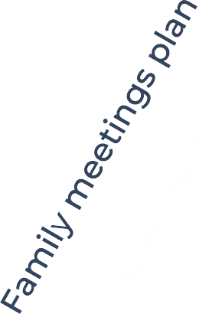



Adviser
Significant Families
S AN
Advisory Board
Documentation Plan Communication
Plan
Income to whom
Are the family on the journey
Where are we going?
Now 10-20-100yr
plan
Existing skills and capabilities
Control to whom
Best of Breed team KPI’s
Accountability
A “champion”
Equity to whom
Project plan
Time frames

Slide 19
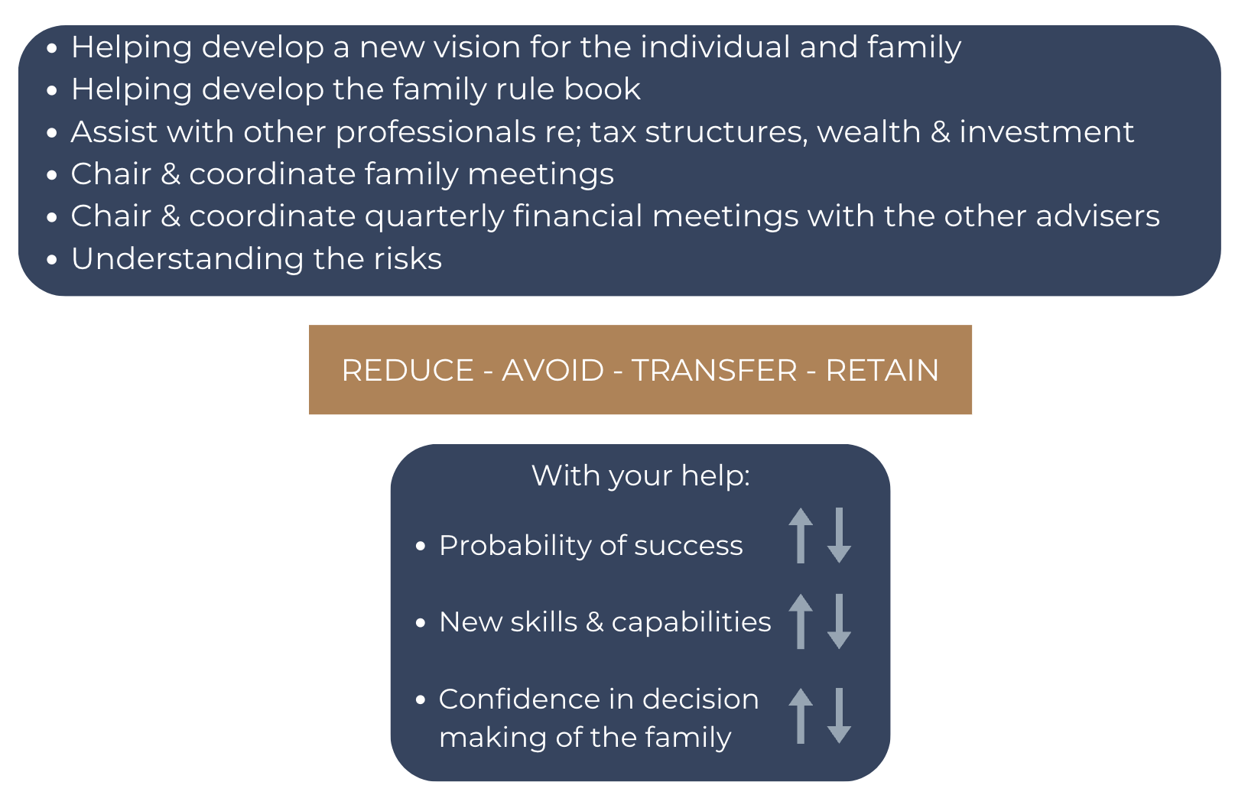
Stewardship Family Board Role

Slide 20
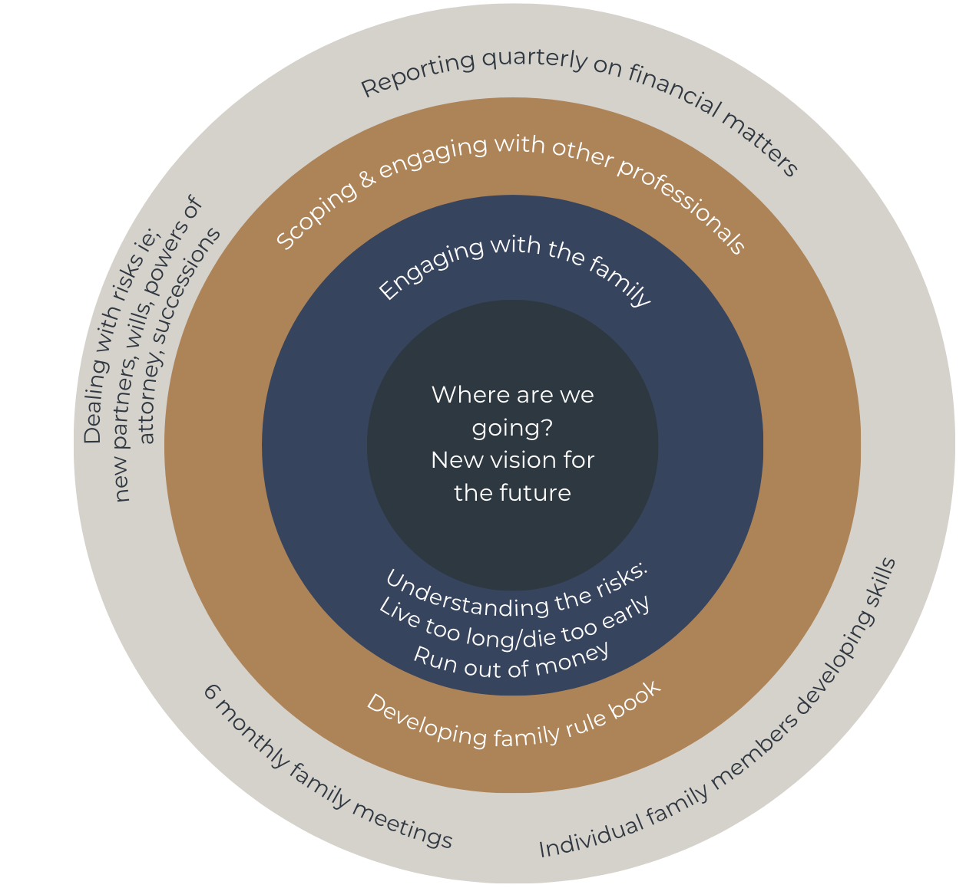
Advocacy
Family Board
Stewardship

Slide 21
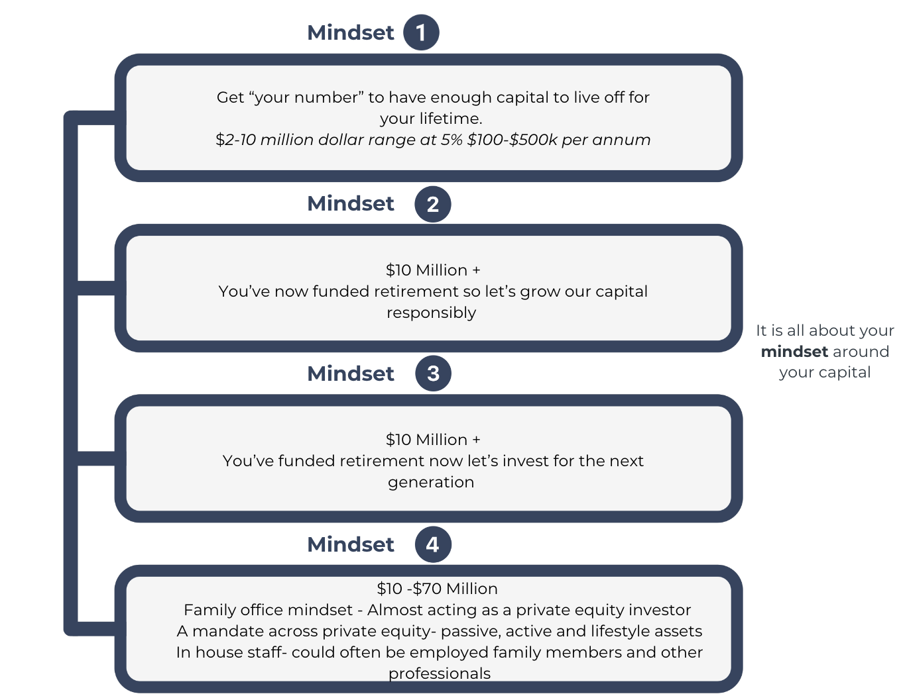
How to think about your capital

Slide 22
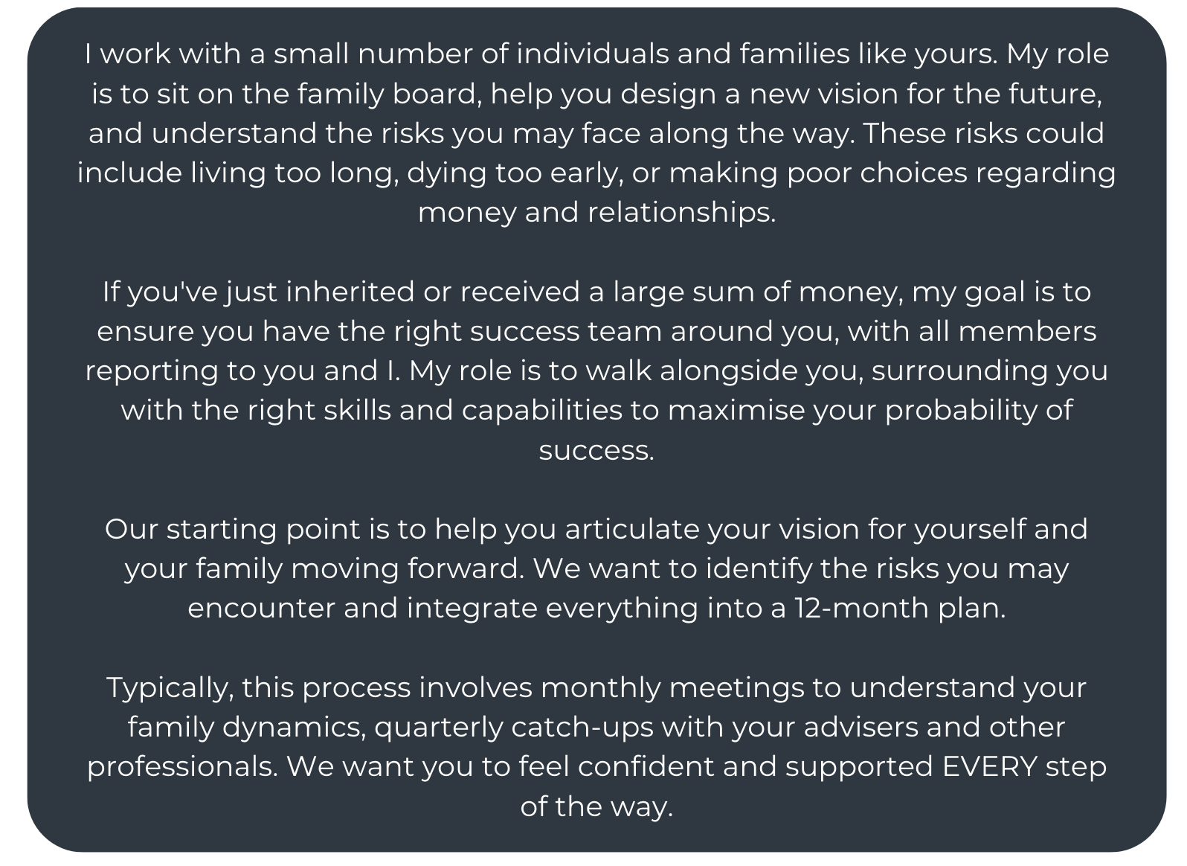
Advocate Role: Script

Slide 23
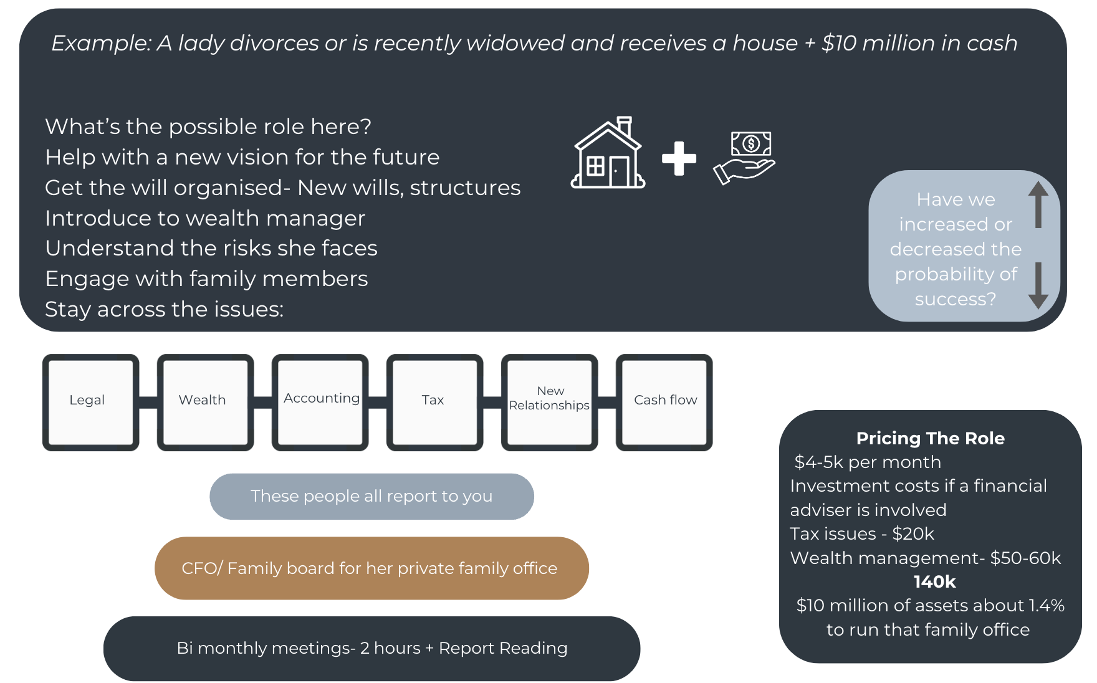
Stewardship Role: Family Board Example

