Slide 1
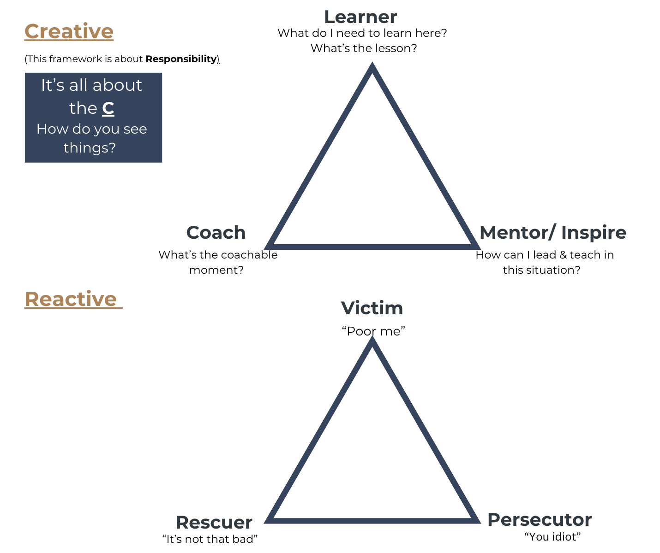
The Empowerment Triangle

Slide 2
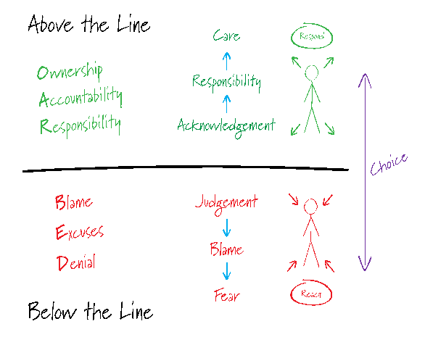
The Empowerment Triangle - mindset
Remember,
we cannot always control our environment, but we do have a CHOICE on how we respond to it.

