Slide 1
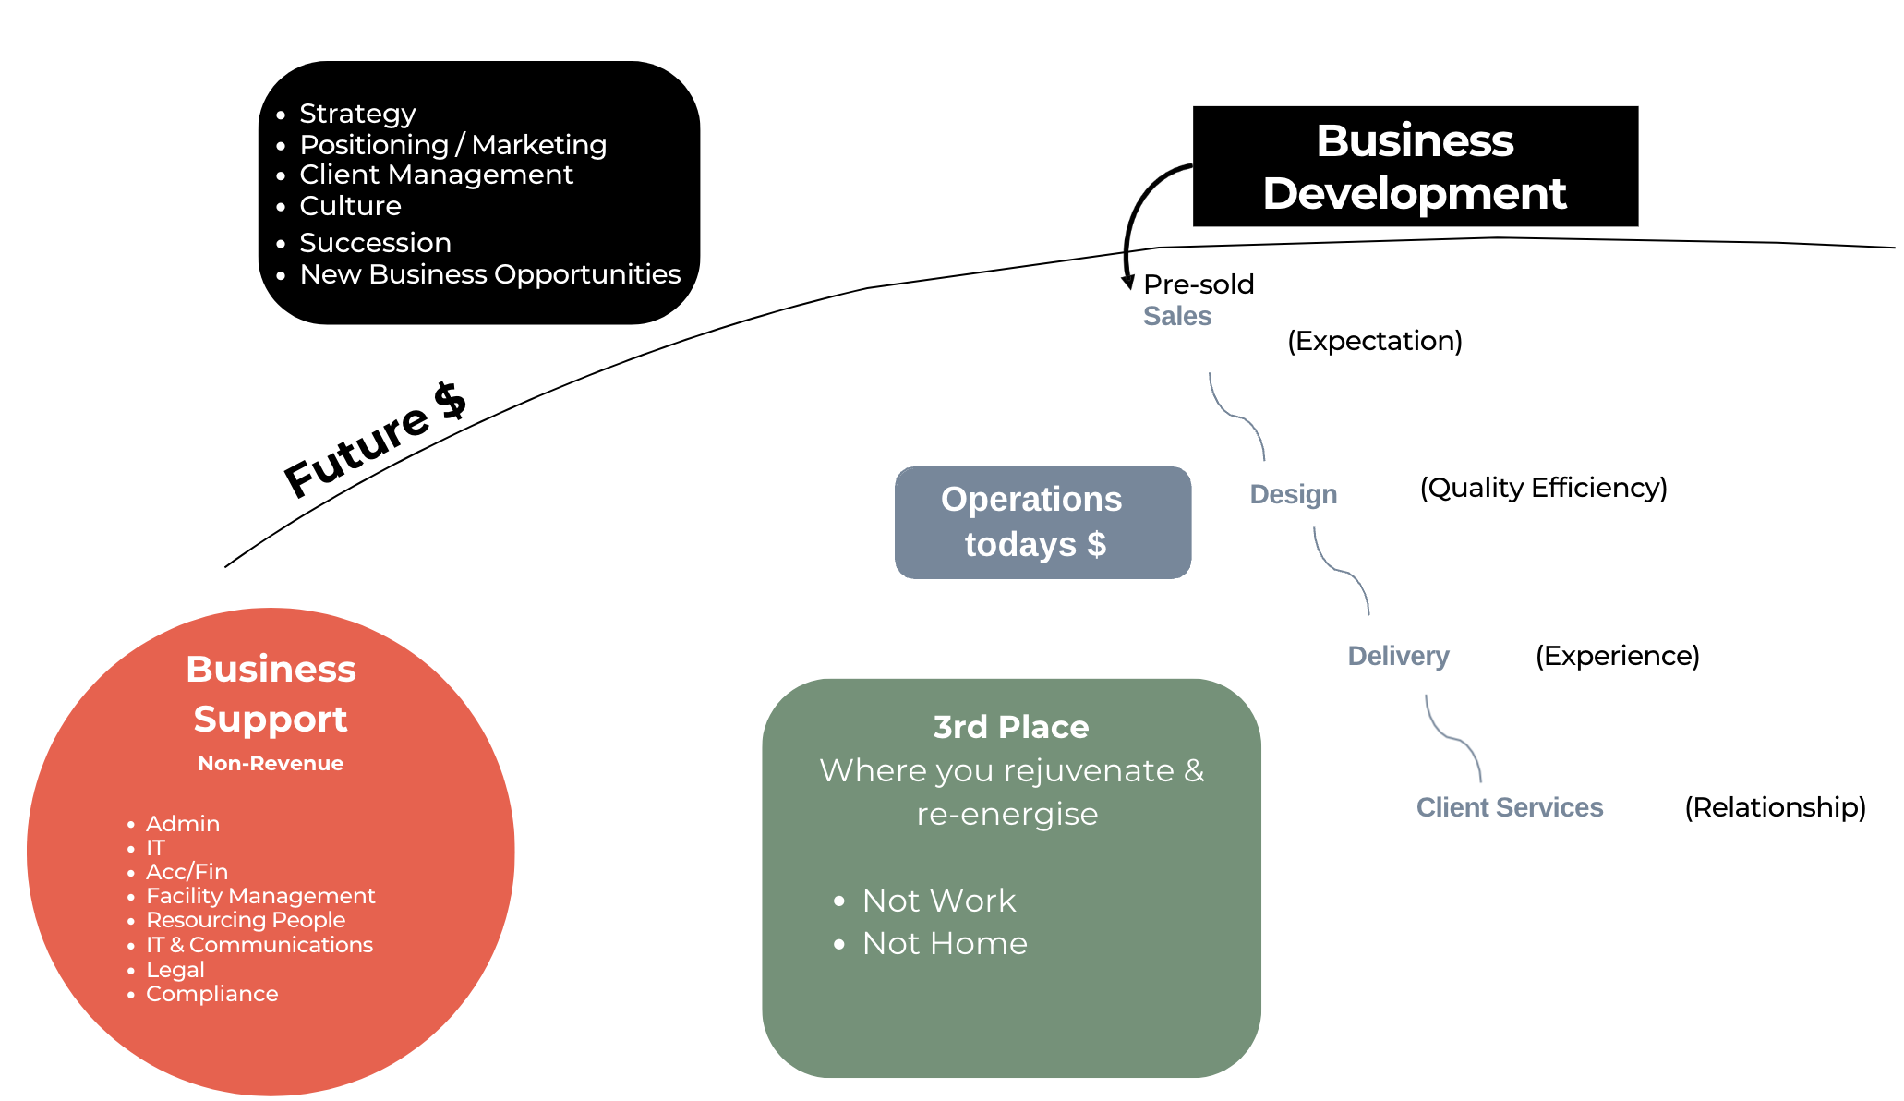
RED, BLUE, BLACK, GREEN

Slide 2
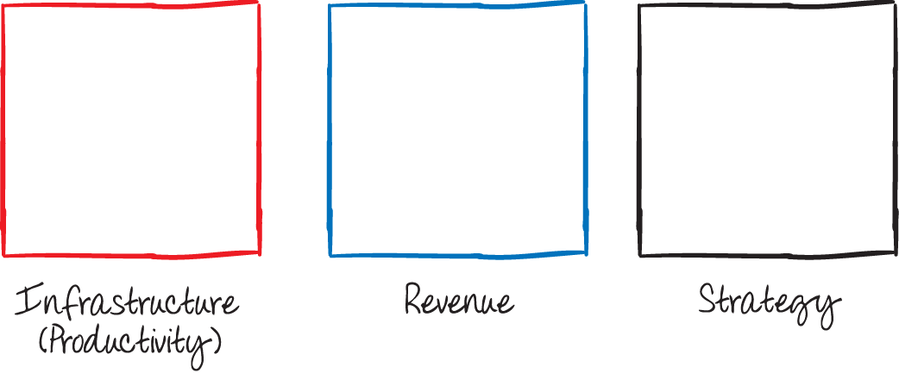
Red Blue Black : Green - Responsibility
Non Revenue
Todays Revenue
Future Revenue =
Increased margins =
Profit =
Increased valuation
Don’t forget to put GREEN time into your calendar – your personal Big Rocks
Activities that energise you (“fill your cup”)
Examples – time with friends & family, exercise, music, reading, being in nature, holidays
Put these in first rather than get to the end of the year with no breaks & low energy.
We all have the same amount of time; however few people manage their energy to be more effective & impactful. You cannot manage time but you can manage energy!

