Slide 1
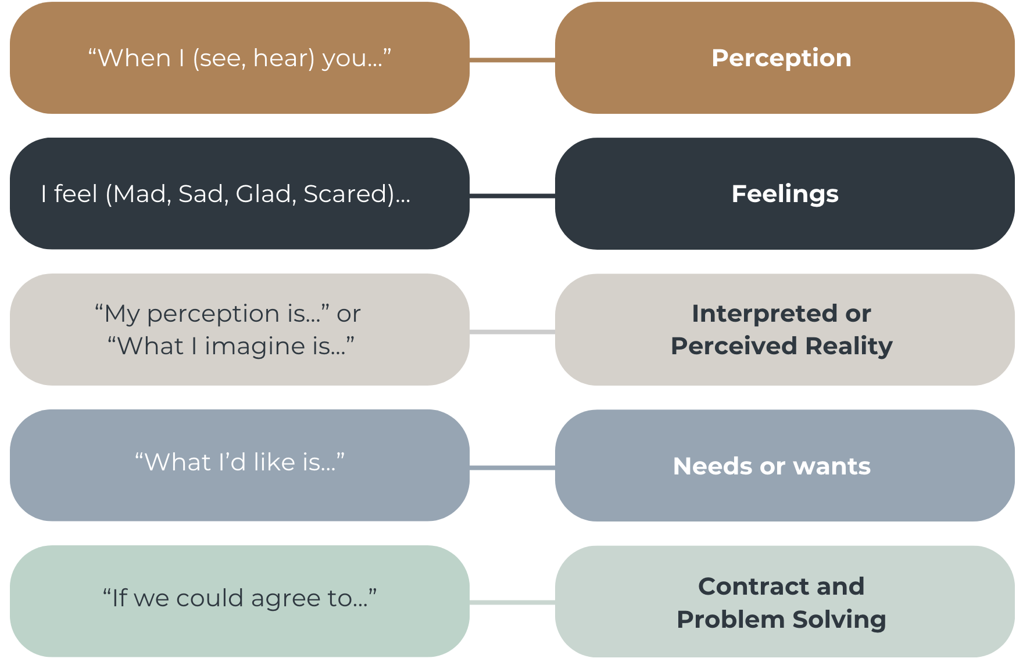
Essential Conversations Context- Clean Energy

