Slide 1
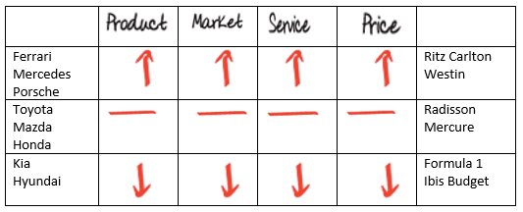
Positioning - expectations
Where are you positioned,
Are your arrows aligned ?

