Slide 1
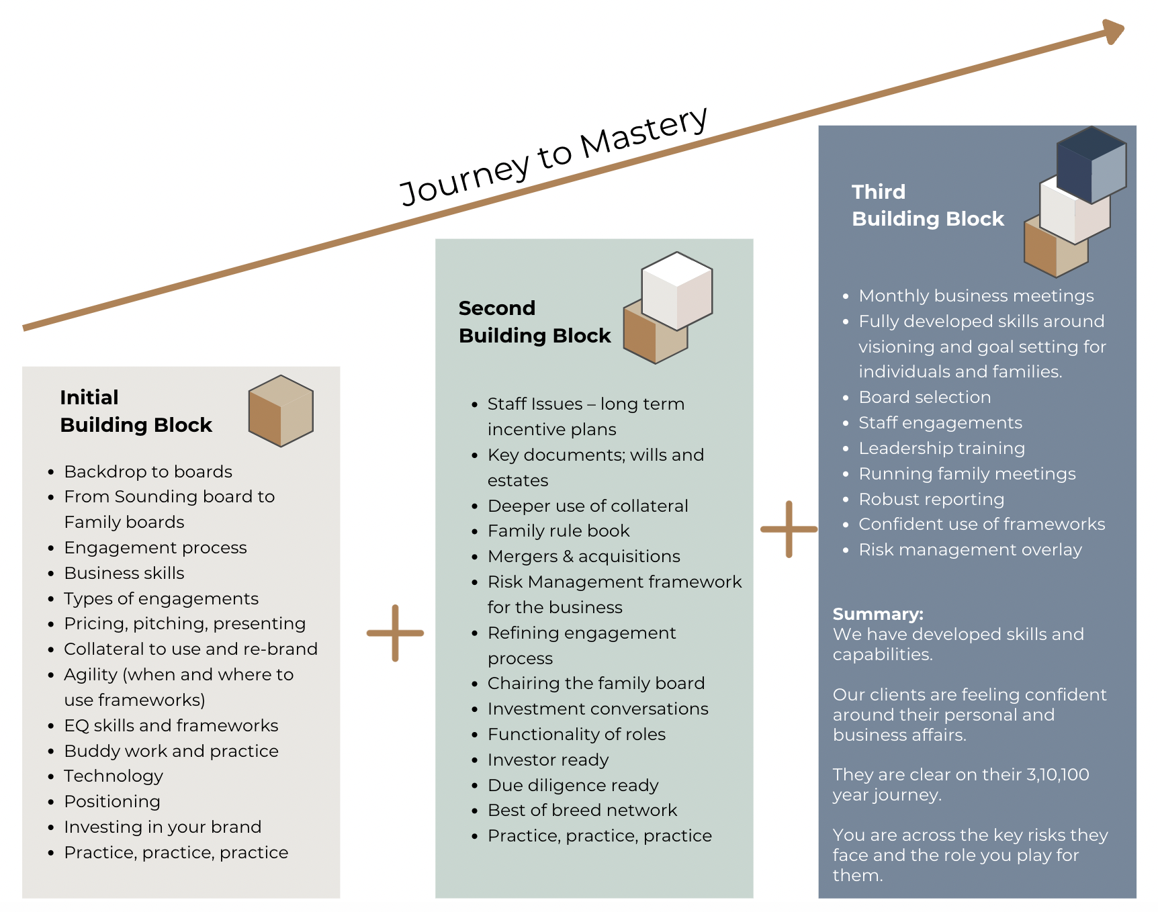
The SAN Learning Curve

