Slide 1
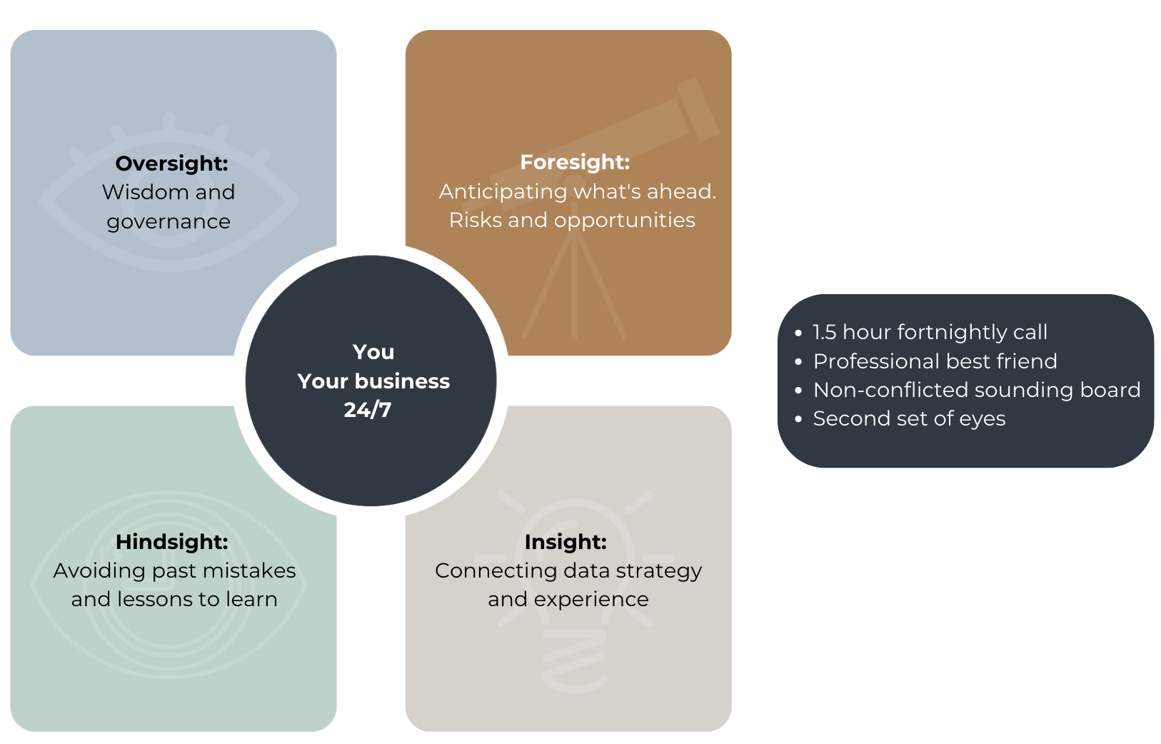
Business- 4 Sight Program

Slide 2
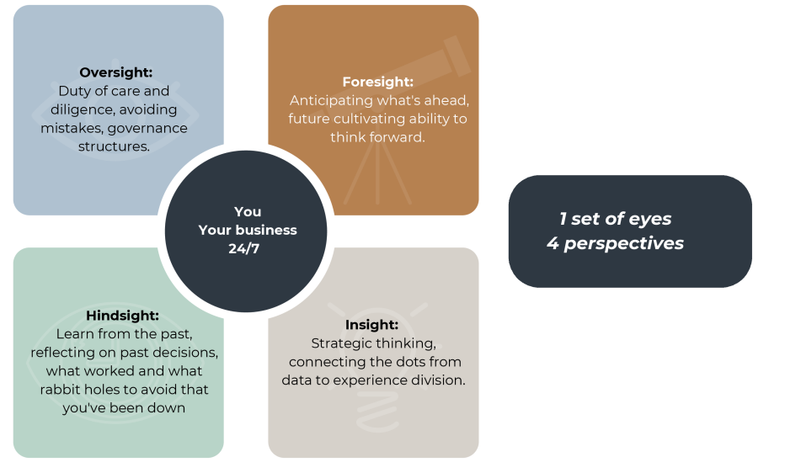
Why an Advisory Board- 4 Sets of Sights

Slide 3
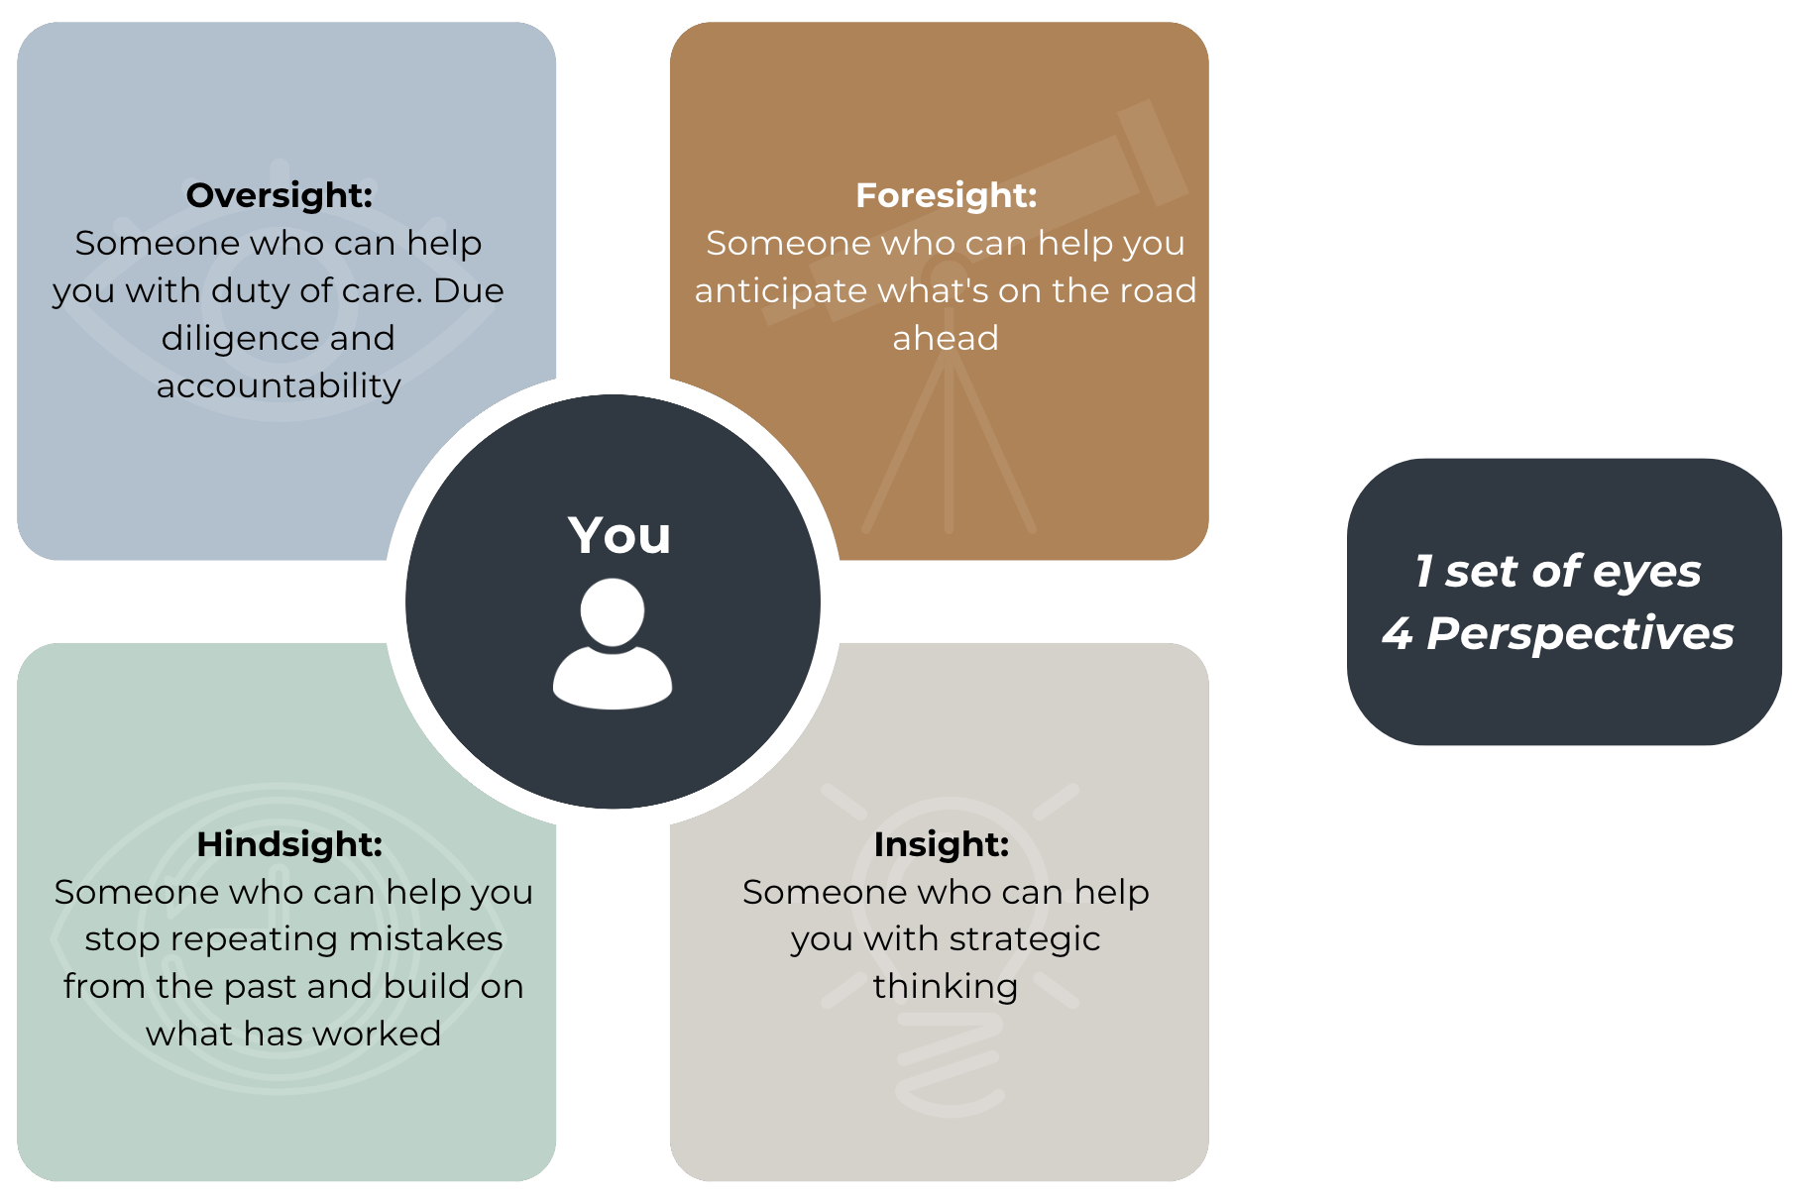
Why an Advocate?

