Slide 1
Advocacy Pack

Slide 2
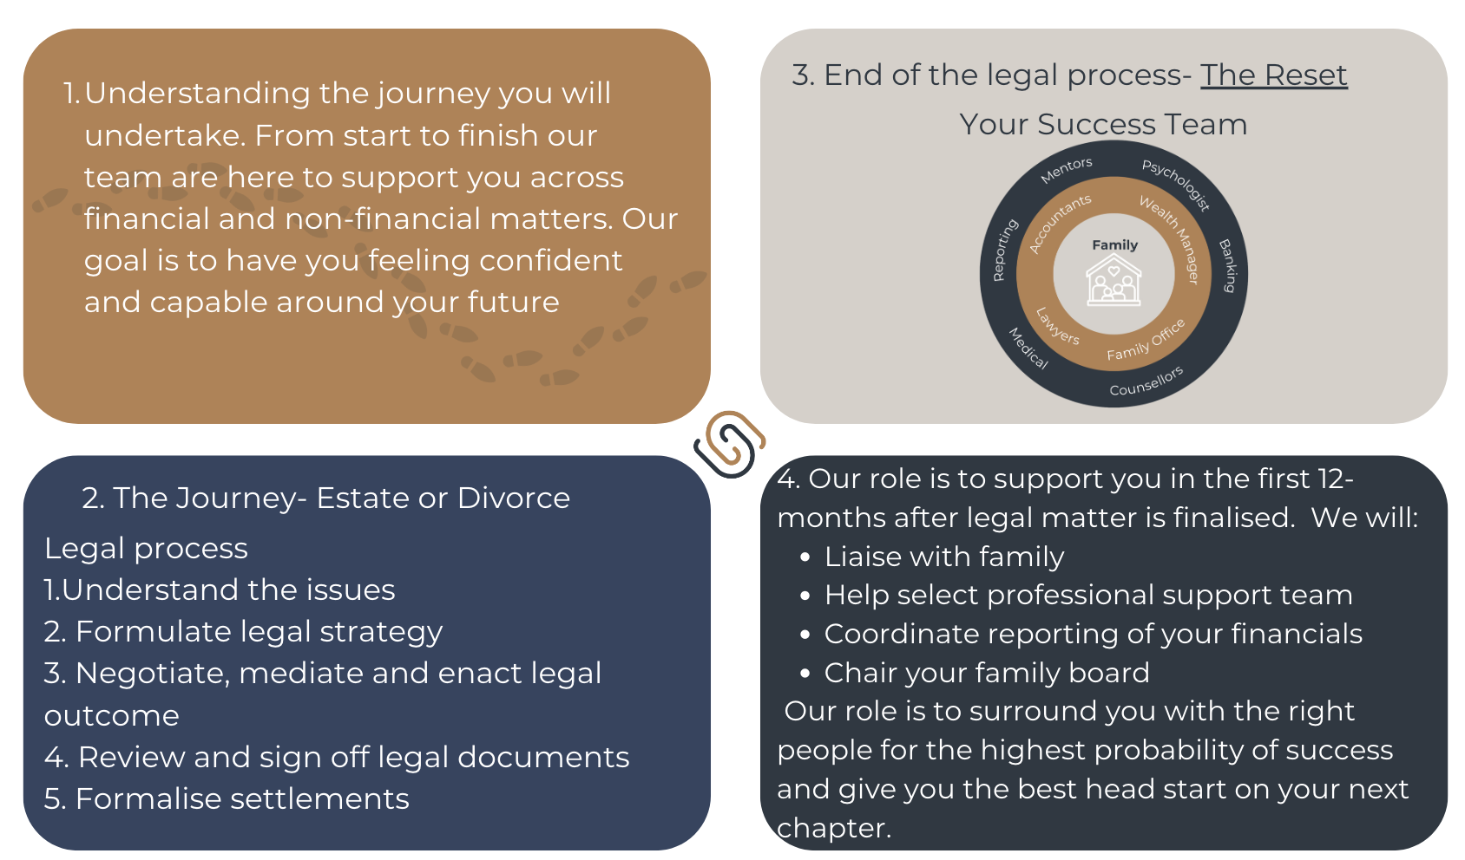
Advocacy Program

Slide 3
Stewardship Family Board Role

Slide 4
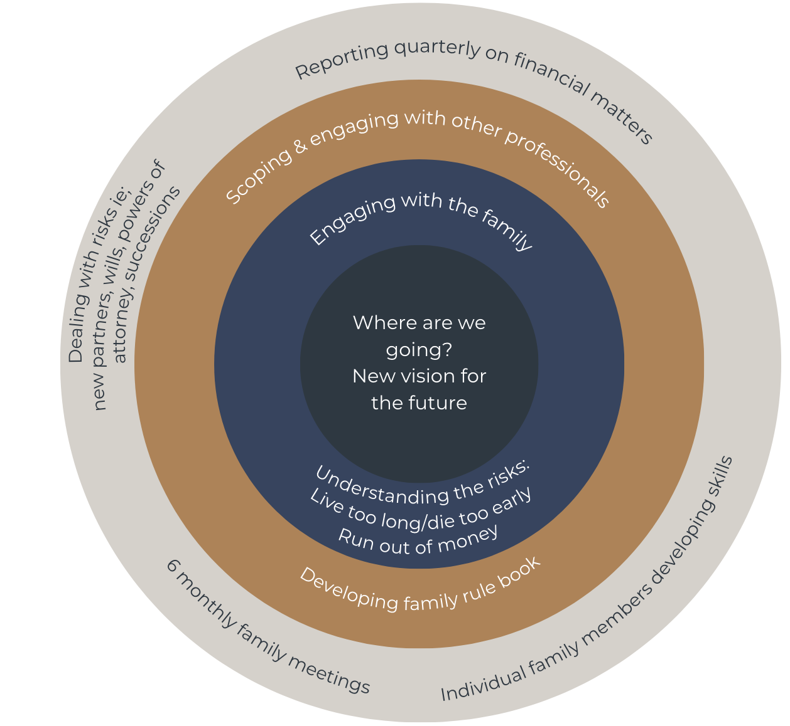
Advocacy
Family Board
Stewardship

Slide 5
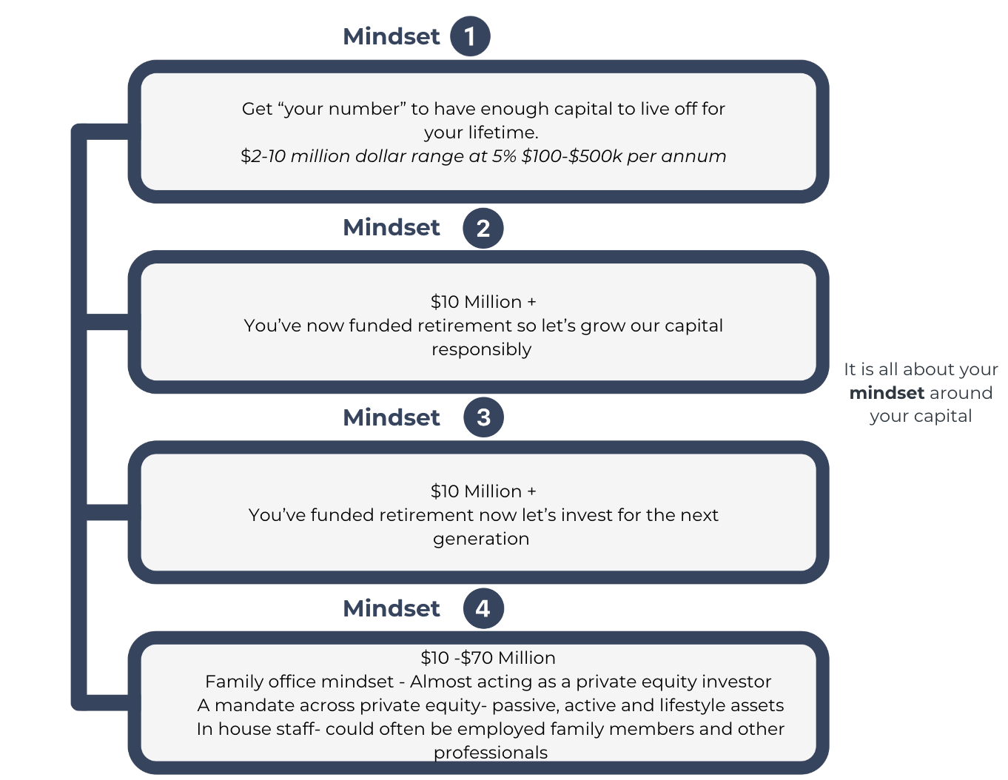
How to think about your capital

Slide 6
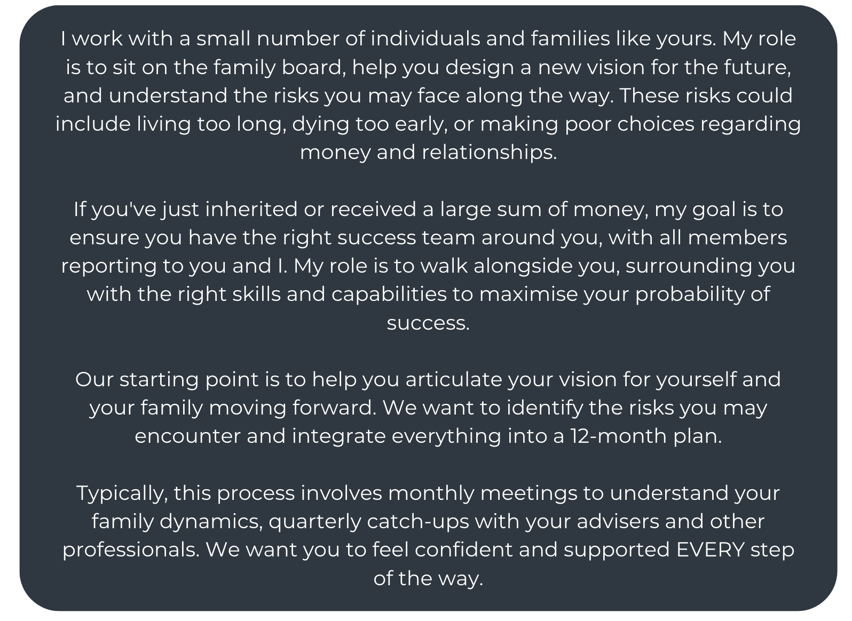
Advocate Role: Script

Slide 7
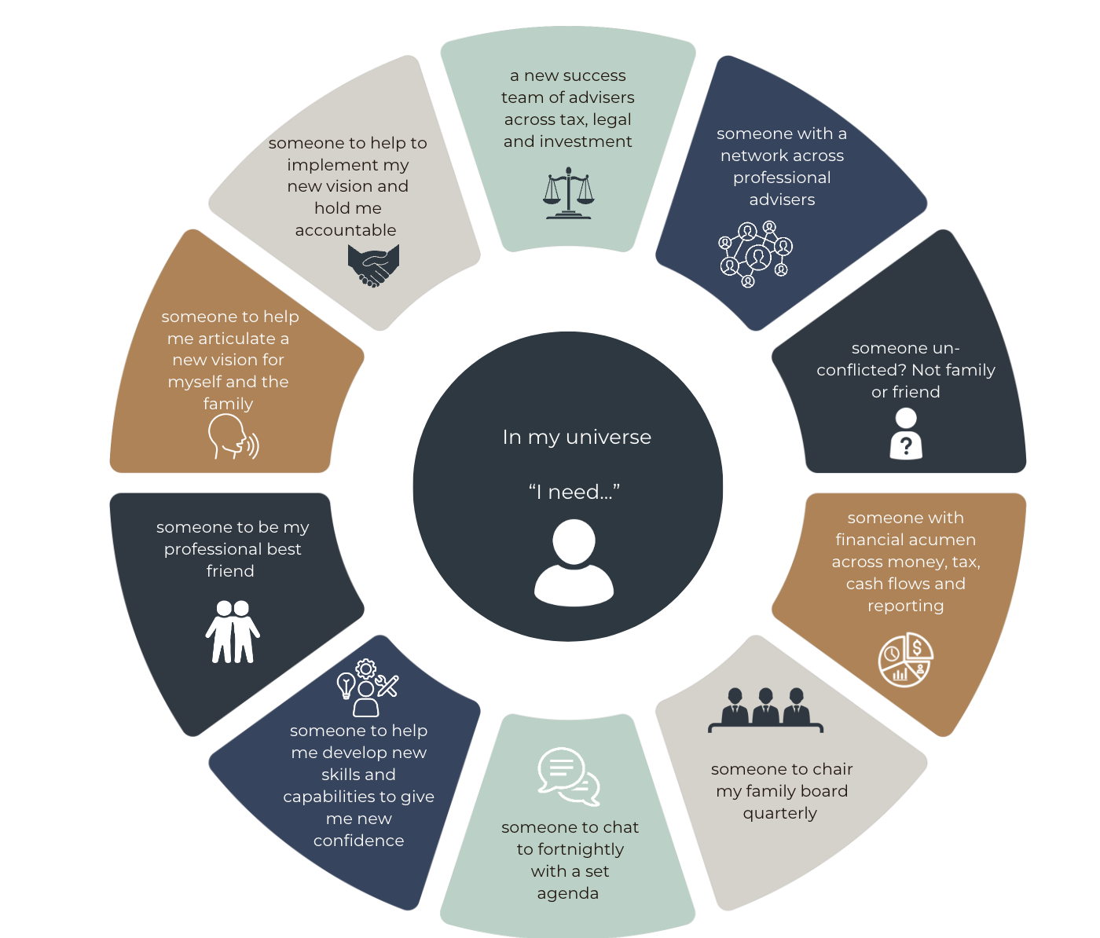
Why an Advocate?

Slide 8
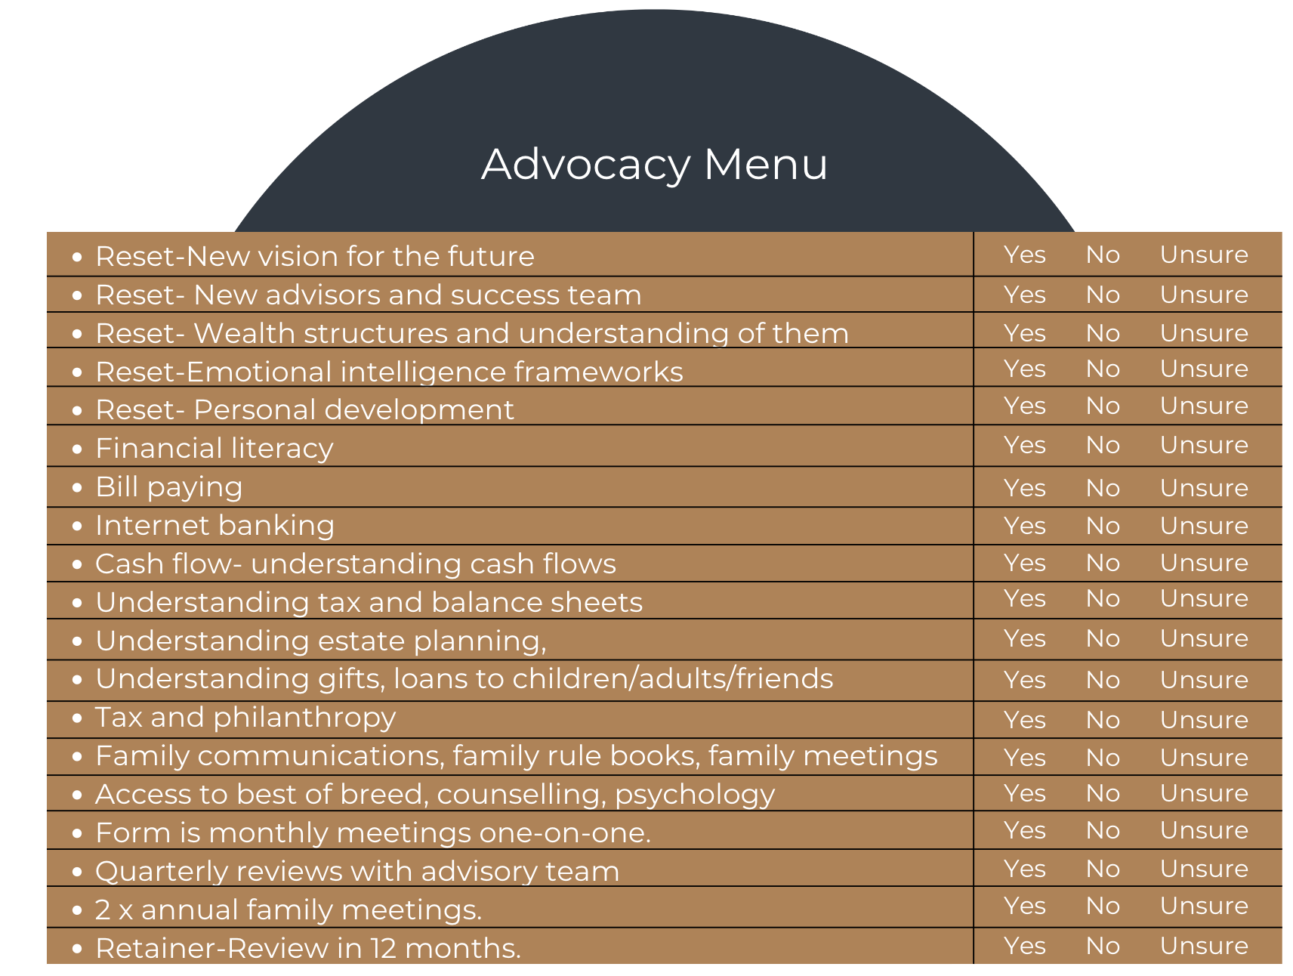
Confidence & Capability

Slide 9
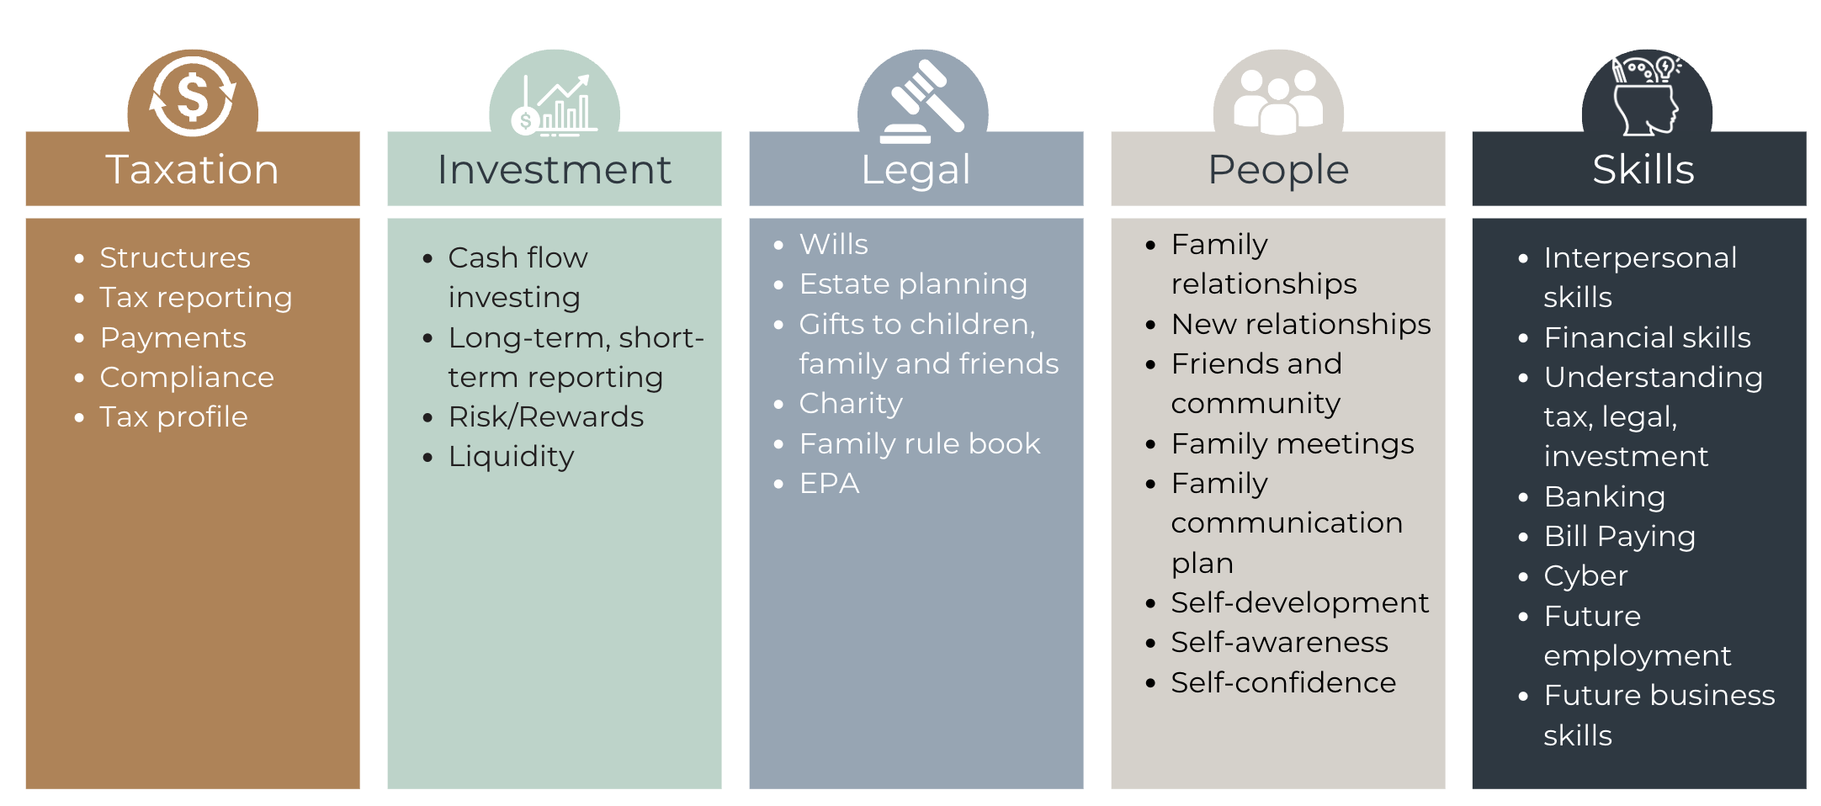
Advocacy-Risk management
1 REDUCE
2 AVOID
3 TRANSFER
4 RETAIN

Slide 10
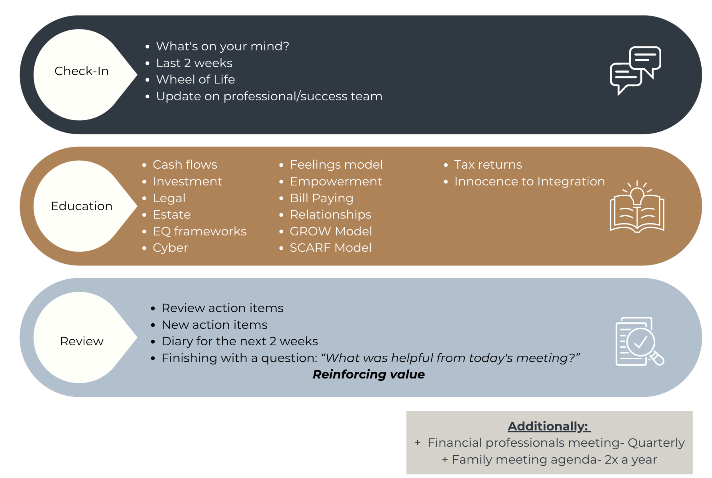
Advocacy 1.5 Hour Fortnightly Agenda

Slide 11
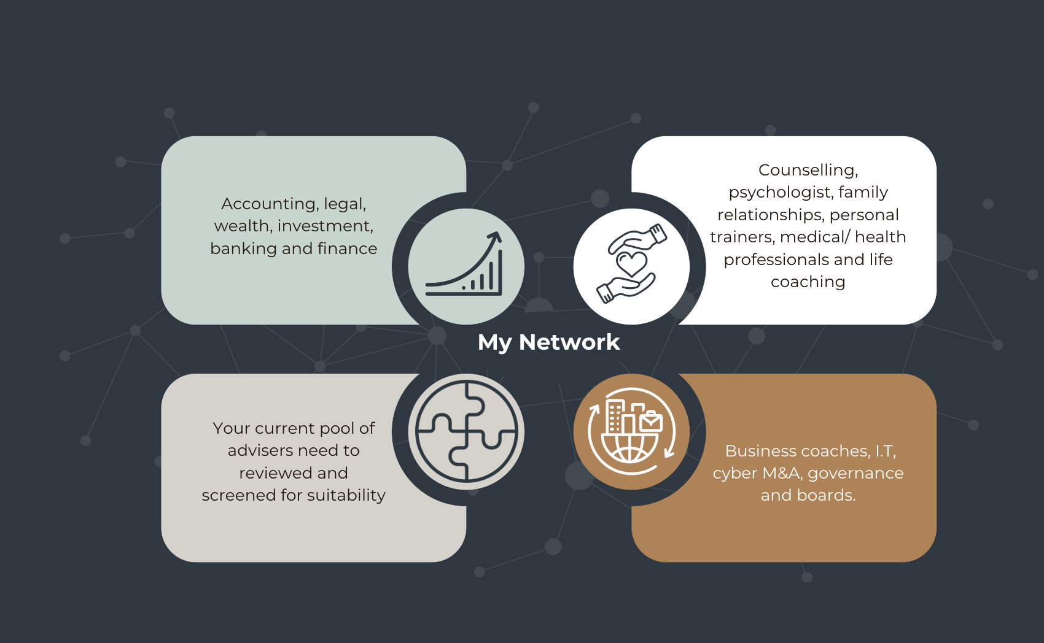
Build Your Success Team

Slide 12
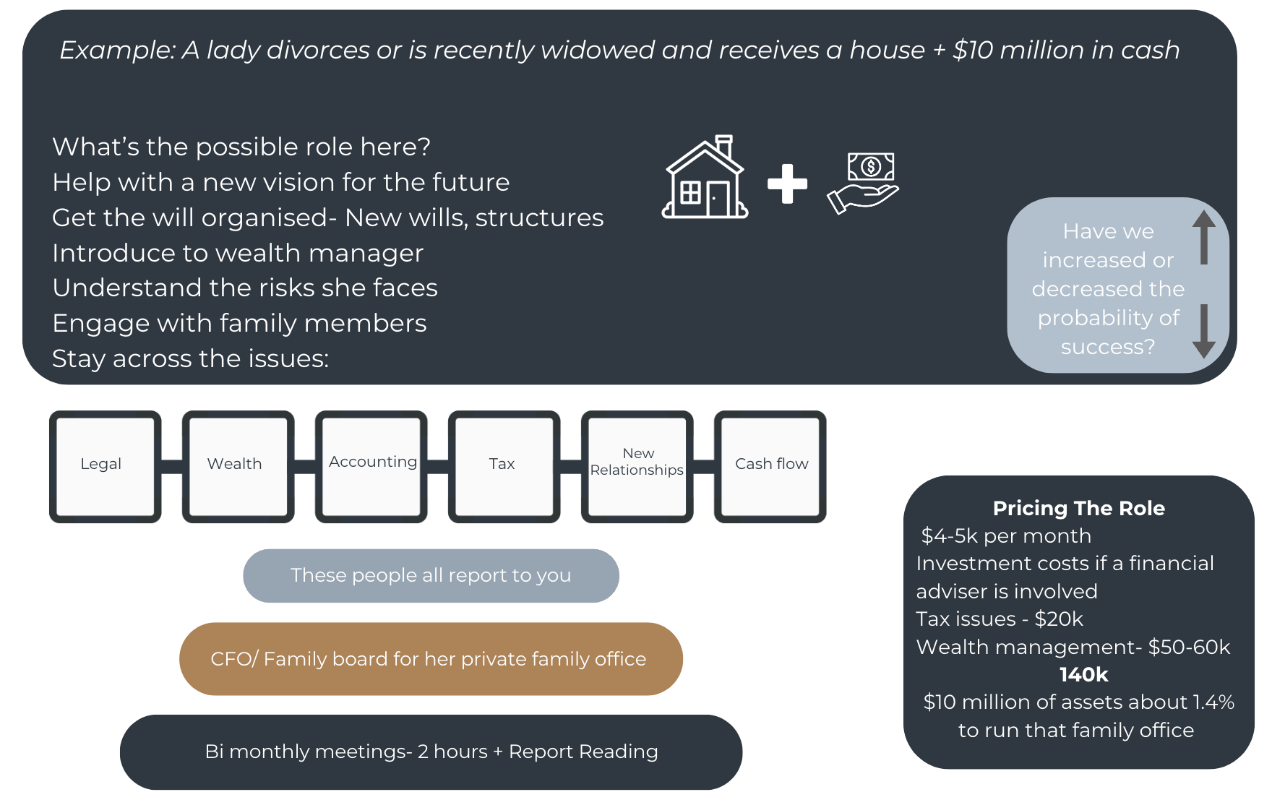
Stewardship Role: Family Board Example

Slide 13
Yearly Agenda- Advocacy Program

