Slide 1
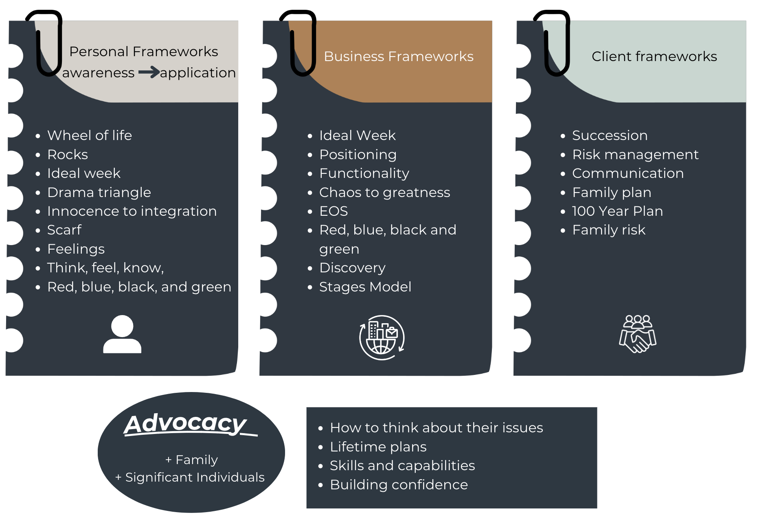
Skills & Competencies in all areas of life

