Slide 1
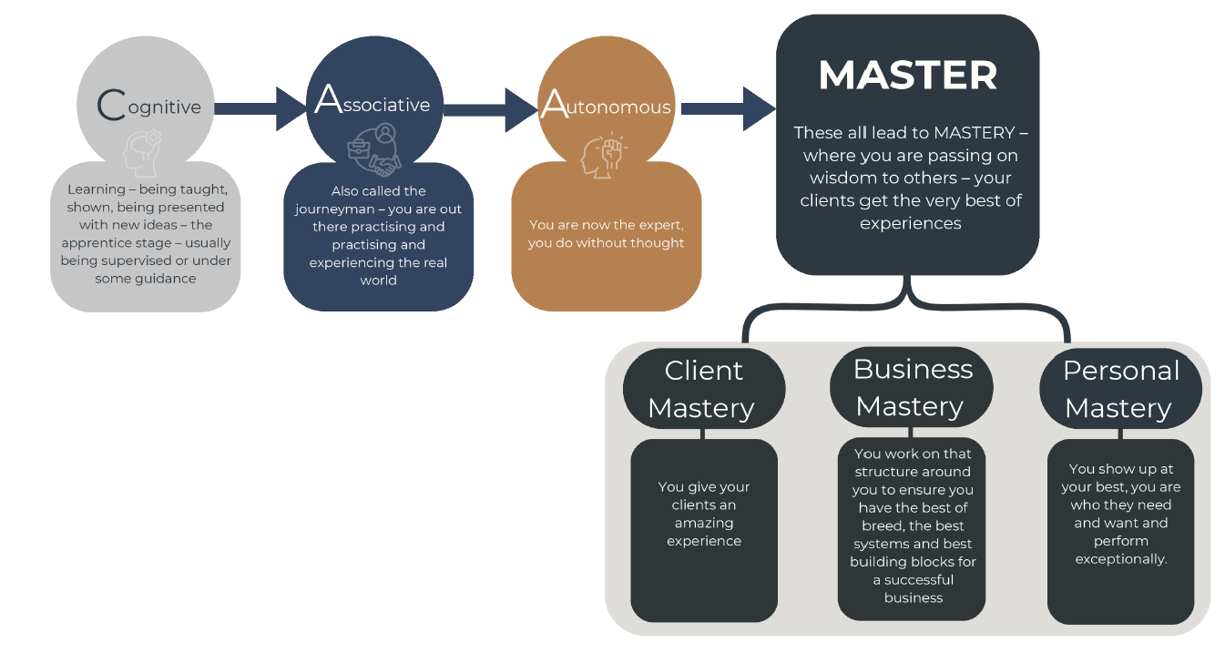
The Journey to Mastery We endeavour to train/coach/mentor professionals to become Masters split over three areas:

