Slide 2
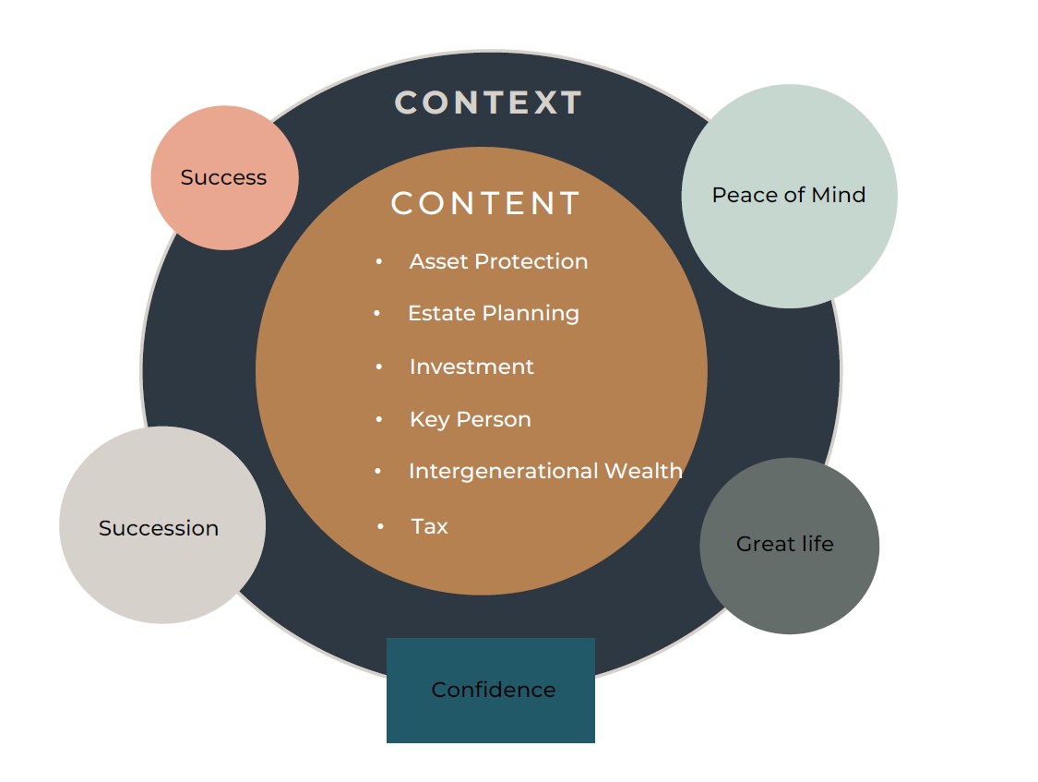
- Content/Context

Slide 3
Stages of Development
Stages
3. Advanced Growth
Position
Network
Functionality
Capability
Succession
‘feelings’
4. Plateau
Skills
5. Decline
2. Growth
1. Start-Up
day 1
frantic
invest
stress
lost
time
excited
good times
payback
frustration

Slide 4
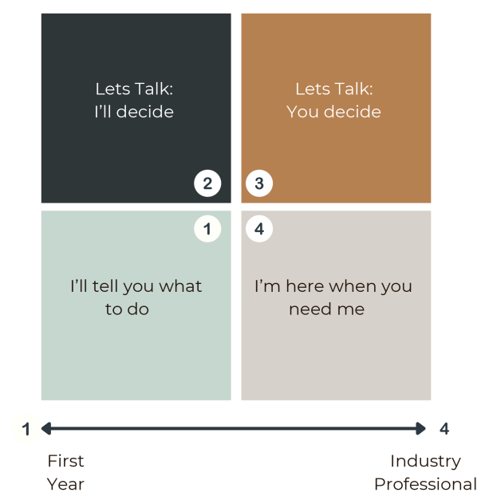
Situational Coaching

Slide 5
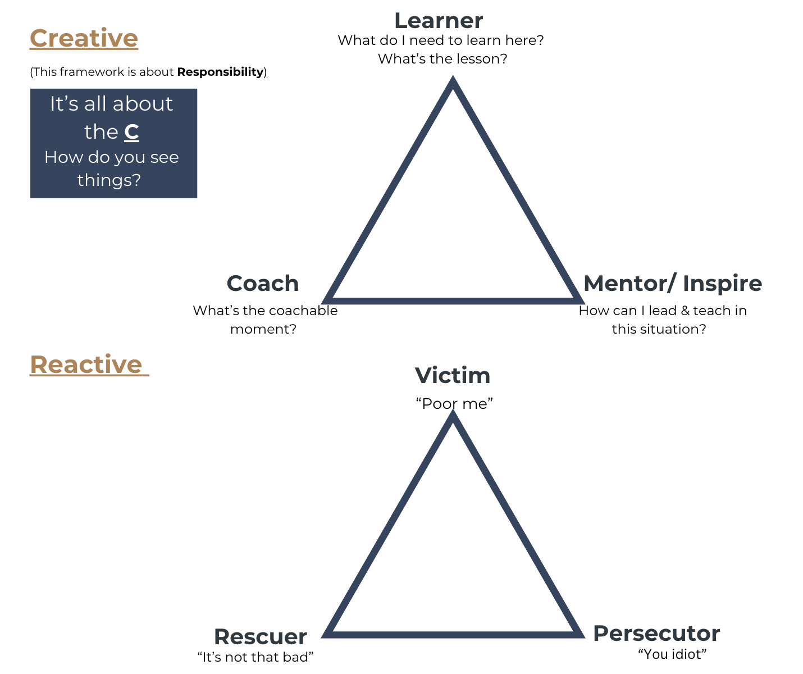
The Empowerment Triangle

Slide 6
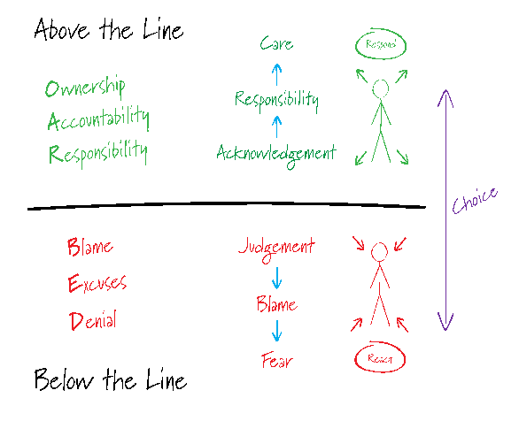
The Empowerment Triangle - mindset
Remember,
we cannot always control our environment, but we do have a CHOICE on how we respond to it.

Slide 7
Think Feel Know – Communication Skills
Think – data – Where? When? Who? How?
Feel – energy – What?
Know – gut instinct – Why?
RULES –
No one Style is better than the other &
We all use all 3

Slide 8
The TFK Styles – How to Identify
 |  | THINK
 |  | DATA
Written |  | detail, 3rd party wording, numbers, spreadsheets
Email |  | screen fulls - Multiple of them, loads of detail and questions and attachments
Text |  | screen fulls, questions, lots of info, could be lots of spelling errors etc due to being so long
Physical Gesture |  | Focus, Lean in, looks serious, looking upwards
Body Part |  | Head
Language |  | Detailed
Colour |  | Blue
Learning |  | reading, experiencing, 2nd opinion, references
Speech |  | Lots of questions, very enquiring
Behaviour |  | Ask a lot of questions, requires proof
Characteristics |  | Analytical, thoughtful, challenging
FEEL
FEELINGS
Pictures, graphs, stories
Colour, emojis, links, graphs etc
emojis , pictures, links colour
eyes can go down, flushed, softer tone in voice
Hear/Upper body
speak of feelings
Red
stories and experience
soft
reacts physically, listens intently, may be scribbling
Emotional, sensitive, passionate
KNOW
INTUIT
Bullet point, brief Context
Bullet point, brief Context
short sharp little to no grammar
Peaceful,
Gut
short/sharp
Green
Doing it
Direct
impatient, quick to decide, sees the opportunity
Driven action orientated, direct

Slide 9
Think Feel Know – Communication Skills
Strong Think client
Provide acknowledgement & detail
Have a detailed agenda for meetings or timetable
Be well prepared and allow more time for meetings, they will ask questions
Send information before a meeting if a decision is required (they need time to
process before deciding)
- Often seek a second opinion – don’t take it personally
Strong Feel client
Share experiences
Be aware of language
Draw pictures, diagrams and utilise colour
Understand their interests & passion
Engage & explain with stories or analogies?
Strong Know client
Shorter time frames
Provide Context before going into detail (content)
More direct conversations
Be prepared to challenge them & make sure that you both agree what success
looks like
They often have very high expectations (ensure that they are realistic)

Slide 10
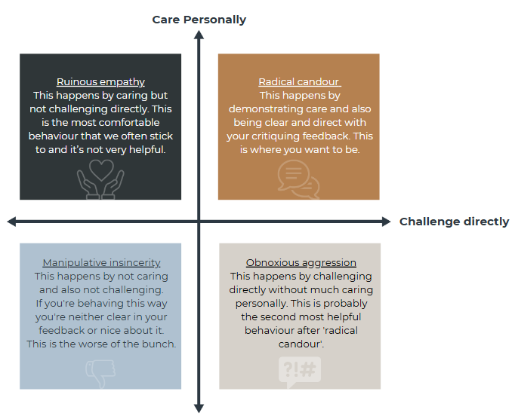
Ruinous Empathy -V- Radical Candour

Slide 11
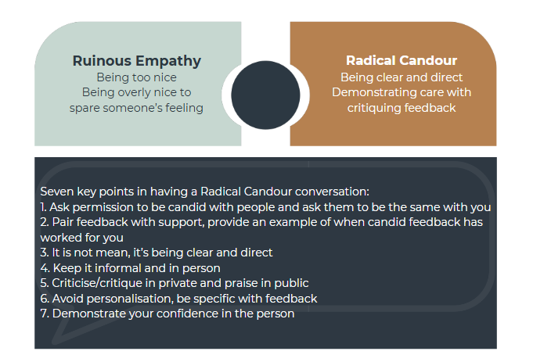
Ruinous Empathy -V- Radical Candour

Slide 12
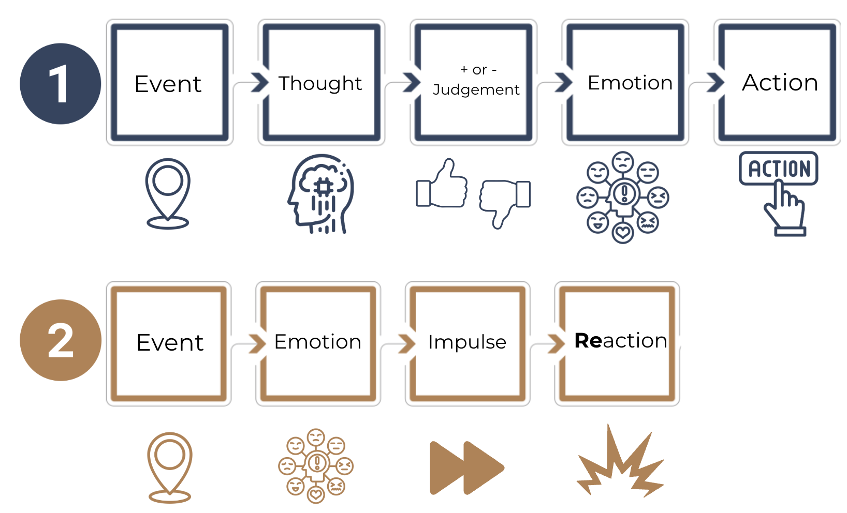
The Feelings Model

Slide 13
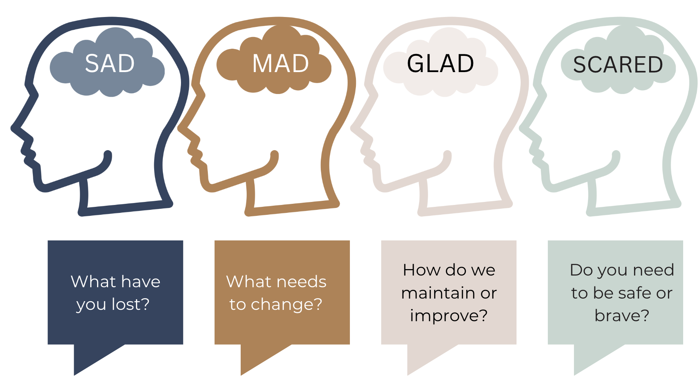
The Feelings Model

Slide 14
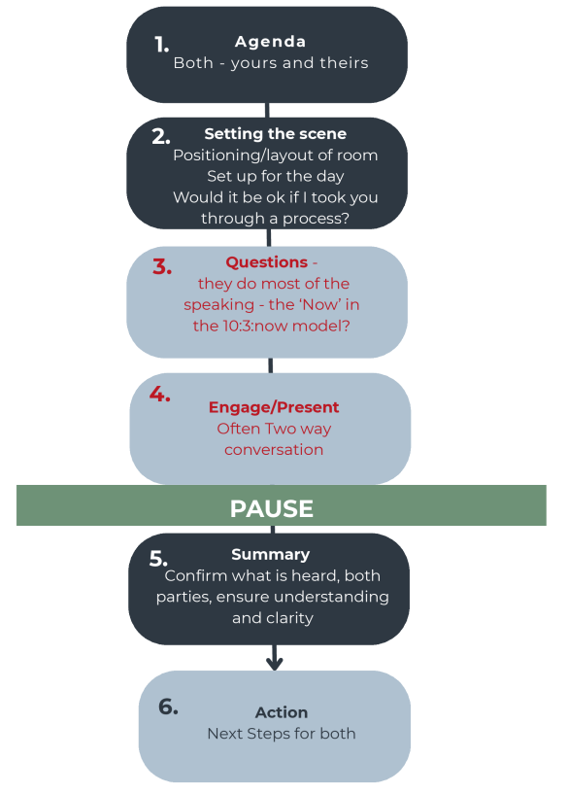
Meaningful Conversations - six steps
Notes:
Basic Meaningful conversation model – or 6 steps – Think Feel Know overlayed on this

Slide 15
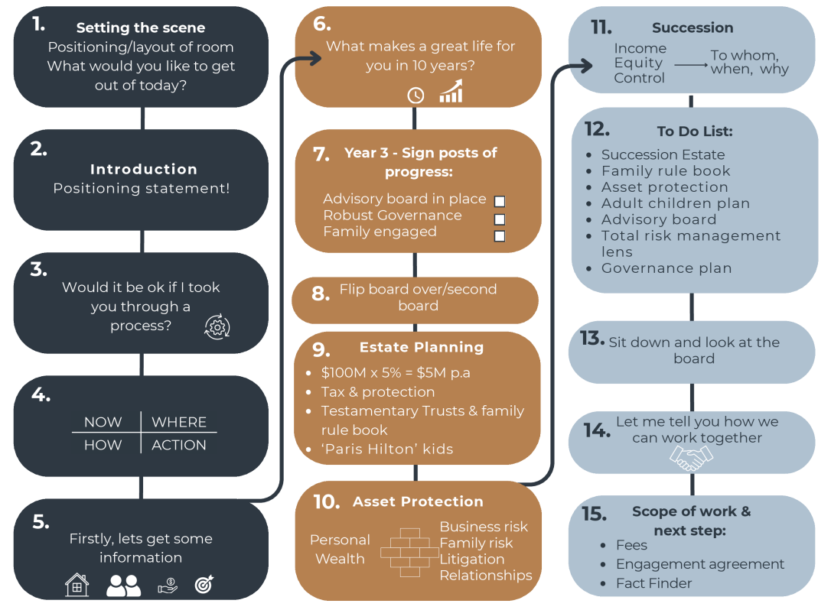
Meaningful Conversations – The Client Presentation
Notes:
Meaningful Conversations put into a presentation
NB the order can be changed – main point is the PAUSE (sit down and reflect)

Slide 16
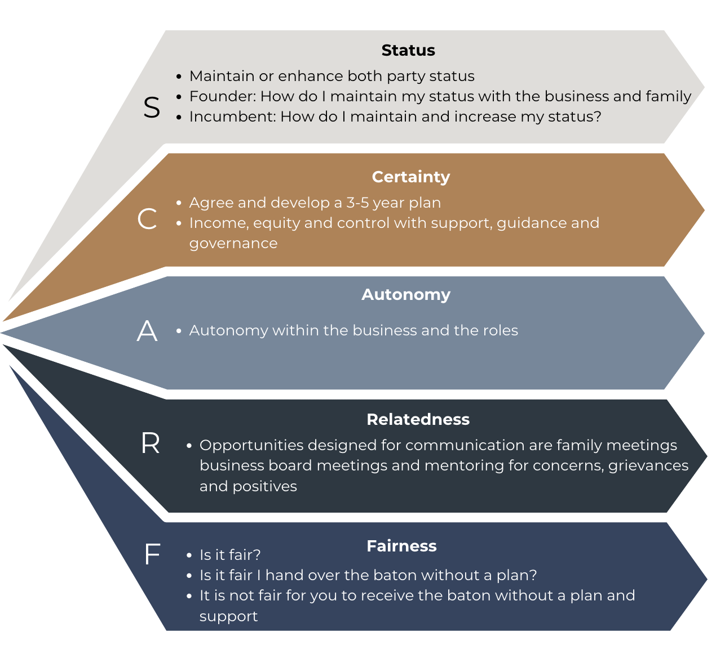
SCARF Model for Change

Slide 17
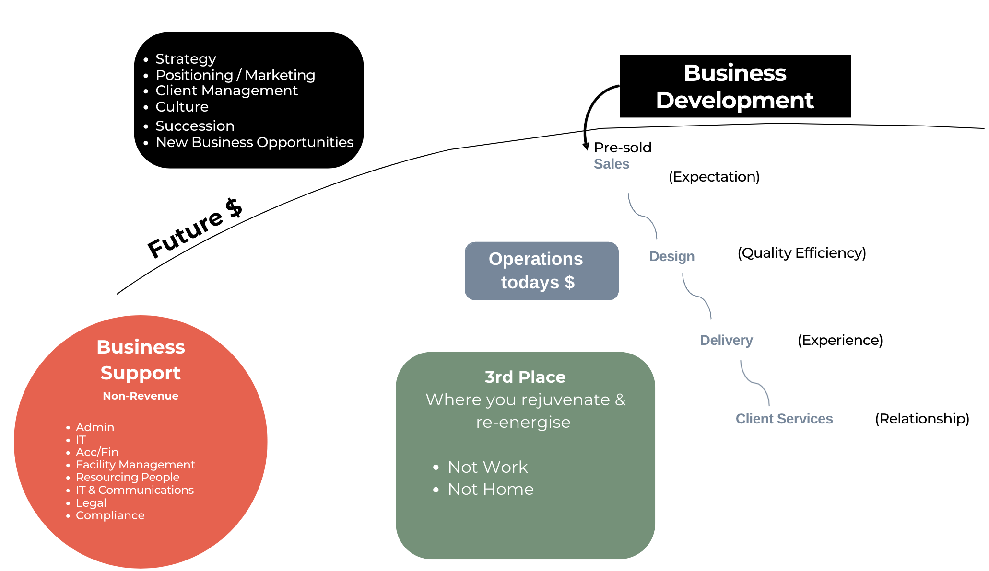
RED, BLUE, BLACK, GREEN

Slide 18
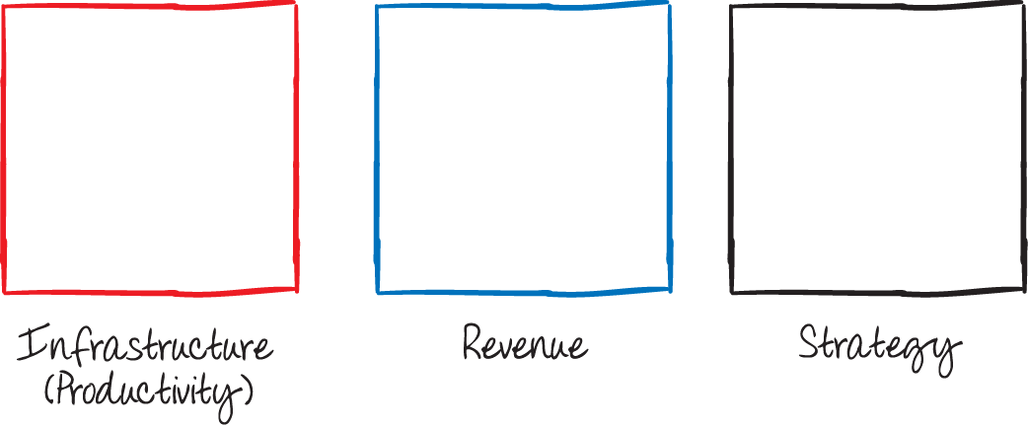
Red Blue Black : Green - Responsibility
Non Revenue
Todays Revenue
Future Revenue =
Increased margins =
Profit =
Increased valuation
Don’t forget to put GREEN time into your calendar – your personal Big Rocks
Activities that energise you (“fill your cup”)
Examples – time with friends & family, exercise, music, reading, being in nature, holidays
Put these in first rather than get to the end of the year with no breaks & low energy.
We all have the same amount of time; however few people manage their energy to be more effective & impactful. You cannot manage time but you can manage energy!

