Slide 1
Pitch Price and Present
3rd June 2025
Barton White – Professional Best Friend

Slide 2
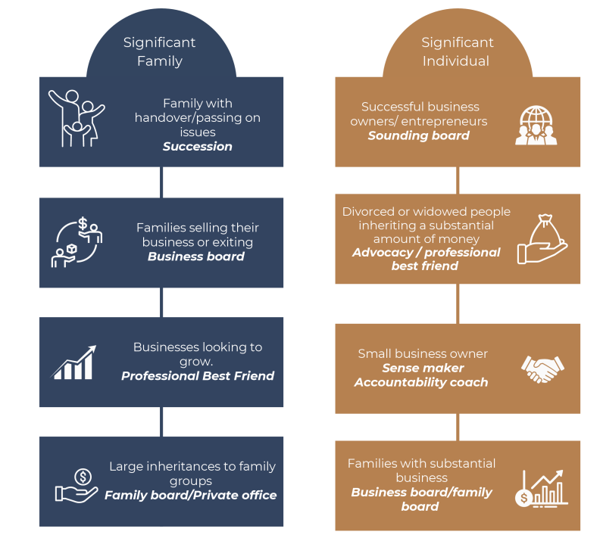
SAN Adviser- Possible Roles – Professional Best Friend

Slide 3
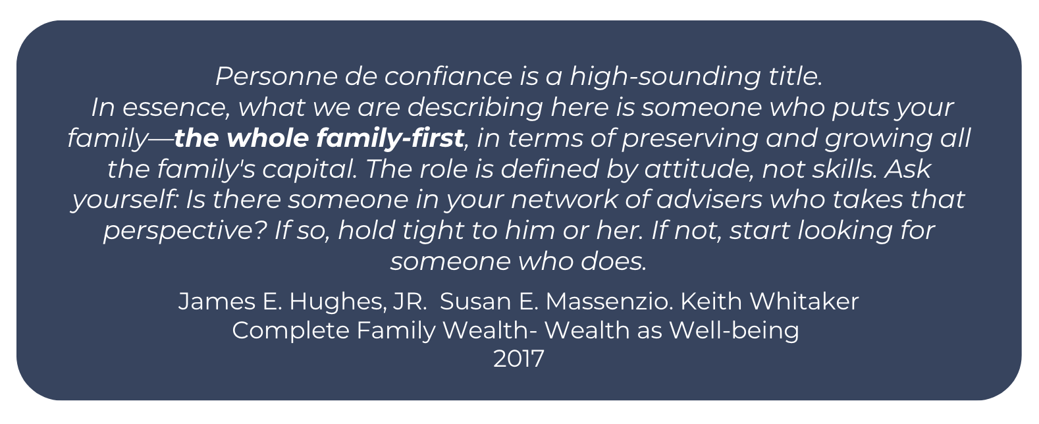
Personne De Confiance

Slide 4
Product Distributor
Background Client 1 - Motivated to Grow & Exit
TIME
INTRO BY COI
Professional Best Friend - Potential Client
COFFEE CATCH UP
Collateral Used
Chaos to Greatness
RBBG
Buy Back Rate
Stages
Output Created
10 : 3 : Now - Limited to do List
12 MONTHS
PRESENTATION
All above Models Completed
Detailed 10 : 3 : Now with To do List
Role outline
ENGAGEMENT
Fortnightly 1 ½ hour meetings
Scope 1
SAN Business Advisor - $4k/month
Topics include; staff, WOL, financials, New BR, family, ideas
Future Scope 2
Financial Advisor - $1k/month
¼ yearly inclusion with SBA meeting
2024 - Now

Slide 5
LIVE LIFE ON
PURPOSE
IT’S TIME TO MAKE A LIFE PLAN

Slide 6
Helping successful families navigate complexity
CONTEXT OUR ROLE
Help develop business:
Help you articulate the families and business goals and aspirations
People
Vision
Business Game Plan
Strategy
Accountability
Design and implement a game plan to bring clarity and confidence across business succession plan & strategy
Act as accountability coach and sounding board to business
Increase Probability of Success
Decrease Risk
Develop Advisory Board
Surround you with appropriate best of breed professionals to achieve your desired outcomes and objectives
CONTENT
CHAOS | MEDIOCRITY | EMERGING BUSINESS | GREAT BUSINESS | LASTING GREATNESS
Take Any Client No Systems / Processes Profit Negligible Run Around Like A Headless Chook Owner Doing Everything Family Member Doing Books Owner Doing Lots Of Red Activity Tax Issues No Business or Marketing Plan Putting Out Fires & Reactive Decisions Made On Price Office Looks Cheap | Some Systems Owner On The Tools Cash Flow Inconsistent Beige Unclear Positioning & Pricing Possible Low-Level Staff Unclear Job Roles Duplication Things Getting Missed Profit Low Owner In Red/Blue Key Person Dependent First Brick Wall | Systems In Place & Functional Roles Some Black Activity Branding & Positioning Referrals Clear Client Value Proposition Outsource/Insource Red Cash Flow Steady Less Owner Dependent Owner Free To Go Part- time Owner Has Coach/Mentor Business Debt Second Brick Wall Values Identified | Systems Clear And Followed Functionality Clear & Owner Freed Up Positioning Known & Branding Recognisable Clear Value Proposition Strong Distribution Pricing & Packaging High-Level Staff Employer Of Choice Financial Systems & Reporting Mature Business with Team Ethos Advisory Board Values Lived | Exceptional Systems Inspiring Vision & Strong Culture Higher Purpose Mentoring / Coaching Development Plans For Staff Strong Profit & Cashflow High Performing Team Talent Magnet Saleable Succession Plan Implemented Debt Free Full Board Governance Contribute To Society

Slide 7
10 : 3 : Now – Committed Future
Live
Love
Learn
Legacy
Now (April 2024) | To Do List | 1-2 Years (April 25/26) | 10 Years (April 2034)
Owners– ages 55 & 50 Children – 3 kids, teenagers Pets – 2 dogs. Residence – $2M value, ~$700k debt, joint names. Business – $6 – 7M p.a. revenue, $170k profit last year, previously profit was ~$1M p.a., 8 staff. Group restructured in 2021. Inventory – ~$1.6M. Cash reserve – $1.35M across group (excl. super). Warehouse – owner - company, value $2.6M, purchase price $2.05M, debt $1.4M. SMSF – $350k cash, may have a small super account in addition. Business– needs another $500k spent. Invested $800k so far ($400k equity & $400k loan). 50/50, patriarch & matriarch entity with other party. No loan agreements. Shareholders agreement not signed. Personal insurance cover – have some cover in place, needs reviewing. Estate – simple wills – 2 yrs ago. PoA – unsure. No PoA for entities. FBT personal liability - ~$500k. Div 7A liability | Identify funding options Access ‘Best & Breed’ team Maintain focus Recruitment plan Strategies to keep LT employees Strategies to maximise profitability Wealth succession check JV or equity purchase evaluation Business to be ‘sale’ ready Improve risk management & governance Mentoring / coaching team | Business autonomous. Great business Not stressed, secure, on track | Both retired; dabbling in business – (~5 years time) Living on the water apartment - $??? (maybe rent, maybe own) Current house maintained. Elderly parents may be living with us – secondary dwelling – sooner than 10 years. Travel. Live overseas for a few months Boating Learning Supporting kids – setup for success. Legacy – kids Debt free Income $360k p.a. Freedom, have a life, live everyday
Not possible & not sustainable to keep going as we are.

Slide 8
“WHO – not how” - Dan Sullivan – Strategic Coach

Slide 9
A Best of Breed Team Approach
Client - CEO
Advisory Board
Vision
Accountability
Governance
Confidence & capability
Strategy
Confidant
Connections
Accountant
Lawyer/s
Insurance Broker
Banker / Broker
CFO
Business Coach
Tax structures
Compliance
Tax planning
Risk management
Strategy
Tax structures
Asset protection
Agreements
Terms of trade
Risk management
Right policies
Risk management
Finance facilities
Bank accounts
Strategy
Financial controller
Assist with business plan
Cashflow forecasting
Projections
Enhance skills for team members & director/s
Assist with implementing business plan
Connections
Sense maker

Slide 10
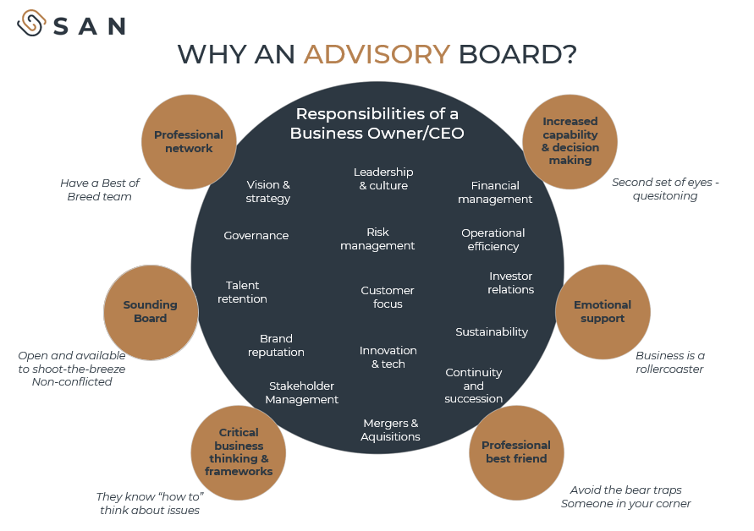
WHY AN ADVISORY BOARD?
Responsibilities of a Business Owner/CEO
Increased capability & decision making
Professional network
Leadership
& culture
Second set of eyes - quesitoning
Have a Best of
Breed team
Vision &
strategy
Financial management
Governance
Risk
management
Operational efficiency
Talent retention
Investor
relations
Customer focus
Sounding Board
Emotional support
Brand reputation
Sustainability
Open and available to shoot-the-breeze Non-conflicted
Innovation & tech
Business is a rollercoaster
Continuity and succession
Stakeholder Management
Critical business thinking & frameworks
Mergers & Aquisitions
Professional best friend
They know “how to” think about issues
Avoid the bear traps Someone in your corner

Slide 11
Time & Financial Investment
Option C – Private Wealth Program + Business Advisory & Sounding Board
Option’s A’s services plus
Project management to your committed future, refer to draft 12-month financial game plan.
10-3-Now financial roadmap
Total balance sheet management
Family sounding board service
Understand family group structures
Estate planning
Asset protection
Tax planning
Debt management
Identify risk management plan
Analyse cash flows
Scenario modelling
Financial strategy optimisation
Collaborating with other professionals
Implementation management
On track & ok
Ad-hoc family financial & planning matters
Four to six meetings p.a.
$8,000 P.M.
Option B – Business Advisory & Sounding Board
Fortnightly meetings with you to help move needle on achieving desired business optimisation plan
Project management of SME projects
Option A – Business Advisory & Sounding Board
Monthly meetings with you to help move needle on achieving desired business optimisation plan
Project management of SME projects
$4,000 P.M.
$3,000 P.M.

Slide 12
Global Manufacturer / Wholesale / Retail
Background Client 2 - Complex Issues (Family & Business)
INTRO BY COI
Group Meeting Arranged
May 2024
MEETING 1
3 Professionals (2x SAN, 1x existing + other)
Outcome:
Lots of content
Unstructured information gathering
6 steps meeting process not followed
MEETING 2
3 Professionals (2x SAN, 1x existing + other)
Outcome:
More structured, positive discussion - but no meeting close / where to from here discussion
Lots of content
6 steps not completely followed
6 MONTHS
1:1 SAN ADVISER / CLIENT
Collateral Used
10 : 3 : Now
Where will my business be discounted model
Chaos to greatness
Stages
ENGAGEMENT
Fortnightly 1 ½ hour meetings
SAN Business Advisor - $6k/month
Topics include; business uplift, exit strategy, staff, WOL, financials, business stakeholders, family, ideas
Identified Future Scope (after business sold)
Family Advisory Board
Nov 24 - Now

Slide 13
LIVE LIFE ON
PURPOSE
IT’S TIME TO MAKE A LIFE PLAN

Slide 14
Personne De Confiance

Slide 15
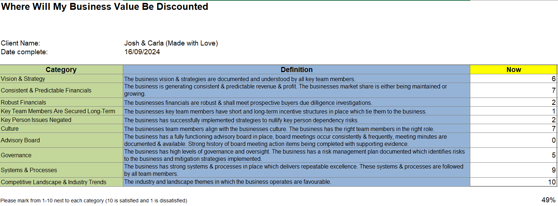
September 2024

Slide 17
Helping You Manage your Balance Sheet Risks – Risk Management
REDUCE
AVOID
TRANSFER
RETAIN
BUSINESS RISKS | WEALTH SUCCESSION & OTHER RISKS | INVESTMENT & TAXATION RISKS
Key person dependency Economic downturn / recession US & beyond political / trade risks Competition Supplier Commercial arrangements & relationships with stockists / siblings Financial reconciliations with stockists Double handling / control Strategy Governance Professional indemnity, public liability and general business Insurance policies reviewed & current? Exit plan clear & in place? A team staff in place? Liquidity & currency management plan in place Financial reporting / profit per product line / cashflow forecasting etc. Cyber security Founder risk Blindspot checking - strategy, people, decisions Culture Family first business vs family in business Business vision, goals, culture understood by all & frequently communicated Leadership vs management | Estate planning documents current? Estate adequately funded? Beneficiaries protected? Powers of attorney in place for tax structures? Assets appropriately structured? Litigation risk What assets are at risk in the event you were sued? What personal guarantees and warranties have been provided? Directorship risk Appropriate business succession agreements in place? Relationship risk Relationship risk - family (both sides) Health Burnout Distraction Are all professionals we work with A Grade and meet our current needs? Sounding board? No plan | Clear on what amount of passive investment capital require to exit business with confidence? Investment return required / risk tolerance Diversification Consolidated performance reporting Concentration Outlive investment capital Liquidity Leverage Tax Risk profile Appropriate tax structures in place? Tax plans Inter entity loans

Slide 18
Helping successful families navigate complexity
FAMILY GROUP
CONTEXT OUR ROLE
Help develop family:
Values Goals
Family Rule Book
Help family articulate goals, aspirations
Develop 12 month plan to bring clarity and confidence across personal, business, family and financial resources
Family & Business Sounding Board
Act as a gate keeper and executor of family wealth
Develop Family Board
Serve as a financial confidant to the family group
CONTENT
TAX & ESTATE DEVELOPMENT | STRATEGIC WEALTH MANAGEMENT | INVESTMENT PLANNING | PEOPLE & LEADERSHIP | PHILANTHROPY
Understand Wealth Plan Trustee development & education Develop succession plan Legacy planning Fair V Equal Who, why, when, how | Total Balance Sheet 'Lens' Identify financial resources Develop wealth transfer Co-ordinate with professionals Facilitate information flow Risk Management framework | Understand Total Balance Sheet Reports Mandates Risk budget Skills transfer & education | Support & develop people Guide & promote Governance Form a functional group Legacy issues Develop Family Board Succession & integration plan | Develop gifting program Role & responsibility Who, Why, When, How
Goal – Confidence and Clarity

Slide 19
Acting as ‘Your Family Board’
WE ADOPT A COLLABORATIVE APPROACH WITH SUBJECT MATTER EXPERTS TO GET YOUR LIFE SORTED.
Client, CEO
CAN BE SEEN LIKE THE CONDUCTOR OF AN ORCHESTRA
SAN Adviser
Accountant
Lawyer
Insurance
Investment
Finance
Tax
Structures
SMSF admin
Succession planning
Structures
Estate Planning
Wealth Preservation
Succession planning
Right amount
Right policies
Succession planning
Estate planning
Right risk
Right ownership
Right structure
Wealth creation
Debt management
Debt structures

Slide 20
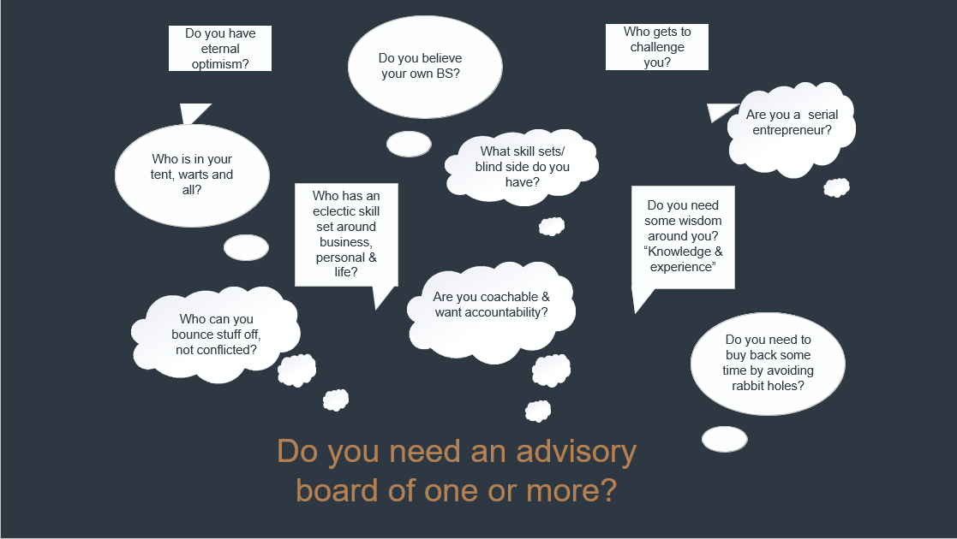

Slide 21
10 : 3 : Now – To Do List
Live
Love
Learn
Legacy
Now | To Do List | Dec 2025 | 10 Years
Owners – ages 37 & 36. Two children, ages 5 & 3. Residence – Joint ownership, Value $10M, mortgage ~$1.36M. Business – Profit ~$15M p.a. on average, anticipate this FY to be ~$10-12M, operate through a company structure. Investment Properties – ~13 different investment properties held via differing ownership structures. Share Portfolio – share portfolio held too. Tax structures – have a number of tax structures in place including companies, trusts and self-managed superannuation fund. Estate planning – wills in place, not sure if powers of attorney documented, need reviewing. Not sure if have power of attorney in place for companies etc. | Comprehensive understanding of current position Business sale readiness & succession plan Risk management framework (business & personal balance sheet) & governance uplift Wealth succession & asset structuring review Estate & legacy planning Form business group Insurance cover review (business, properties & personal) Debt review (business & personal) Address business key person issues Ideal week & year framework Book holidays for 2025 Establish advisory board Next CEO plan Professionals review Patriarch next chapter Time & energy audit for business owners Tax minimisation strategies Capital allocation plan Investment plan Superannuation review Sounding board & project management role | Patriarch director only, monthly board meetings. Matriarch design, only big meetings, 3 days pw. Group formed by EOFY 25. Engaged buyer. 7-10 days of each school holidays (going away) starting 2025 calendar year. | Owners – ages 47 & 46 Children – teenagers Children attending private school Travel with kids. Europe 1x p.a. weeks in duration. White Christmas. (Context – experiences & freedom). Passive Wealth Beach block Toys Golf Take patriarch’s family on a nice holiday Kids with jobs early. Business Sold Patriarch – still working a little Help family Guitar Start more businesses Haven't changed as people Good dad, good husband, present.

Slide 22
Learnings from Client 2
SAN Process
Saves everyone’s time
Ensures clarity & understanding for ‘potential’ client
Provides clear direction for all meetings
Ensures client understands the value of the work (avoid expectation gaps & negativity)
Learnings
Ensure one SAN professional takes / leads the process & follows the 6 steps
Meet client ‘alone’ initially (or second meeting)
Be patient, sometimes it can be a long runway before engagement
Start with engagement where highest demand – delay additional scopes until headspace allows & have runs on the board

Slide 23
Engagement Process
Coffee catch-up,
positioning use of
collateral
Pricing, Risk management,
12 month agenda
1.
5.
Office visioning 10-3-Now or
100-3-Now, use of collateral,
menu, wheel of life
Build the success team,
Reviewing other professionals
2.
6.
3.
Advocacy proposal
developed
7.
Possible family meeting or
with significant others
5.
4.
Pitch / Present / Role
In person
8.
Commence agreed
12-month plan

