Slide 1
Connecting Significant Advisers
“Refiring” advisers for next level advice
The Hub for resources and IP
Training and education on Family Board style advice
Conference
14 & 15 May 2025

Slide 2
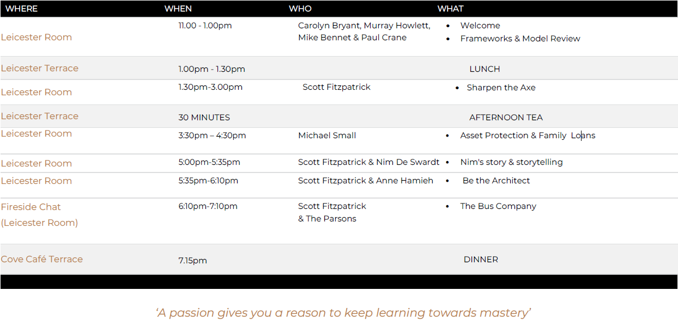
AGENDA DAY 1:

Slide 3
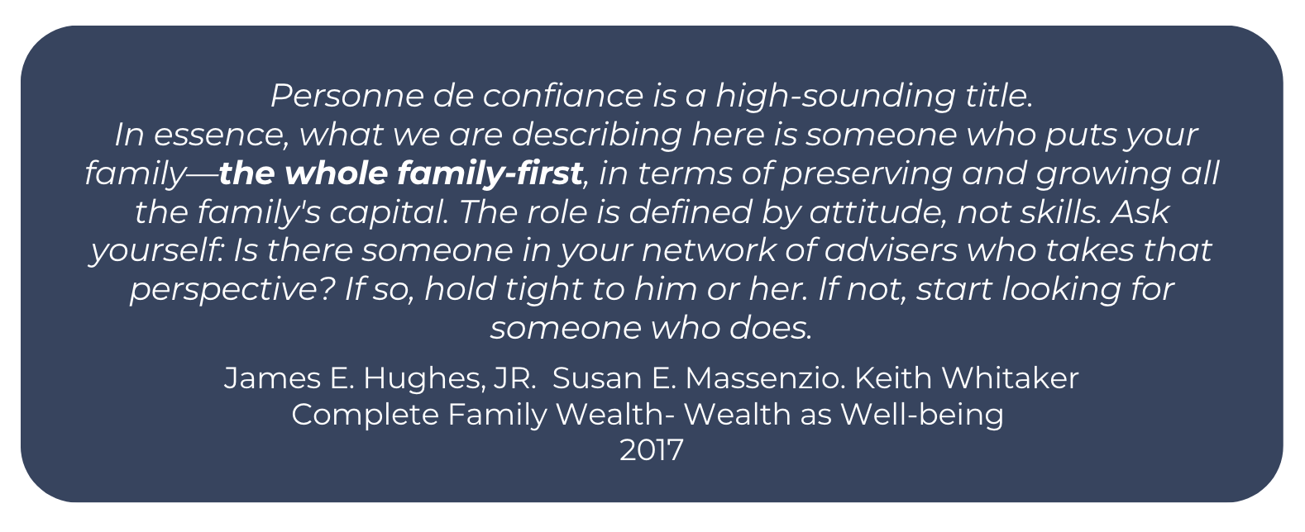
Personne De Confiance

Slide 4
SAN Adviser
Knowledge/Skill Set | Generalist Adviser | Significant Adviser | Competent | Needs Work
Superannuation | ü | ü
Pensions | ü | ü
Cash Flow Analysis | ü | ü
Investment Decision Making | ü | ü
Risk & Investment Analysis | ü | ü
Estate Planning – BASIC | ü | ü
Business Valuations | ü | ü
IQ | ü | ü
EQ - BASIC | ü | ü
Tax – BASIC | ü | ü
Balance Sheet | ü | ü
Negotiation skills | ü | ü
Visioning skills | ü | ü
Intergenerational mindset | ü | ü
Insurance | ü | ü
Understanding
Highly skilled
Business Sale Preparation |  | ü
*Family Rule Books | ü | ü
*Family Constitution | ü | ü

Slide 5
Knowledge/Skill Set | Generalist Adviser | Significant Adviser | Competent | Needs work
Capital Mindset | ü | ü
EQ – ADVANCED | ü | ü
*Identify and understand different roles | ü | ü
Tax - ADVANCED | ü | ü
Estate Planning - ADVANCED | ü | ü
Succession | ü | ü
Governance | ü | ü
Leadership Skills | ü | ü
Family Structures | ü | ü
Family Boards & Meetings | ü | ü
Family dynamics | ü | ü
Business Drivers | ü | ü
Conflict Mediation | ü | ü
Long Term Incentive plans | ü | ü
Short Term Incentive plans | ü | ü
Understanding
Highly Skilled
Coaching Skills | ü | ü
Mentoring Skills | ü | ü

Slide 6
Introducing: Nim De Swardt www.nimdeswardt.com
Nim has spent 20+ years in communications, exploring the intersection of narrative psychology, narrative therapy, social science, and intergenerational connection to develop unique frameworks that spark transformation.
Curiosity and relational intelligence are Nim’s greatest strengths.
Living across four continents and travelling to over 64 countries has given Nim a global lens on human connection.
Nim has seen firsthand how narratives shape perspectives, deepen understanding, and bridge divides. Travel has been Nim’s greatest classroom, revealing the universal power of story.
Whether working with families, brands, or boards – Nim’s North Star remains the same:
Stories = Connection
Connection = Health, Growth, and Belonging

Slide 7
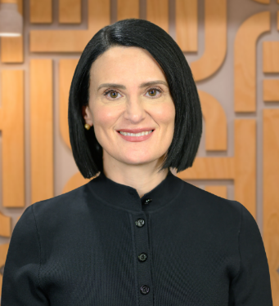
Introducing: Anne Hamieh e: Ahamieh@hub24.com.au
Head of Broker & Private Wealth Distribution at HUB24.
Anne Hamieh leads the Broking and Private Wealth team at HUB24 and has over 25 years’ experience in financial services across funds management and platforms, primarily in distribution leadership roles. Anne was previously Head of Distribution and Marketing at Xplore Wealth and was also Intermediary Sales Manager, Northern at Vanguard Investments where she led the sales team’s distribution and growth of Vanguard’s managed funds and ETFs over five years. Prior, Anne was at Centuria Capital as Head of Distribution Financial Services and held sales roles in her early career at Next Financial and AMP. Anne has Economics degree from Macquarie University, Graduate Diploma in Management from MGSM and a Graduate Diploma in Applied Finance and Investment from SIA (now KAPLAN).

Slide 8
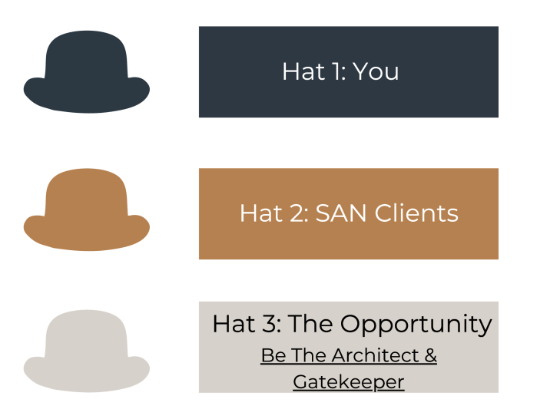
Protect, Preserve & Enhance Wealth – For All

Slide 9
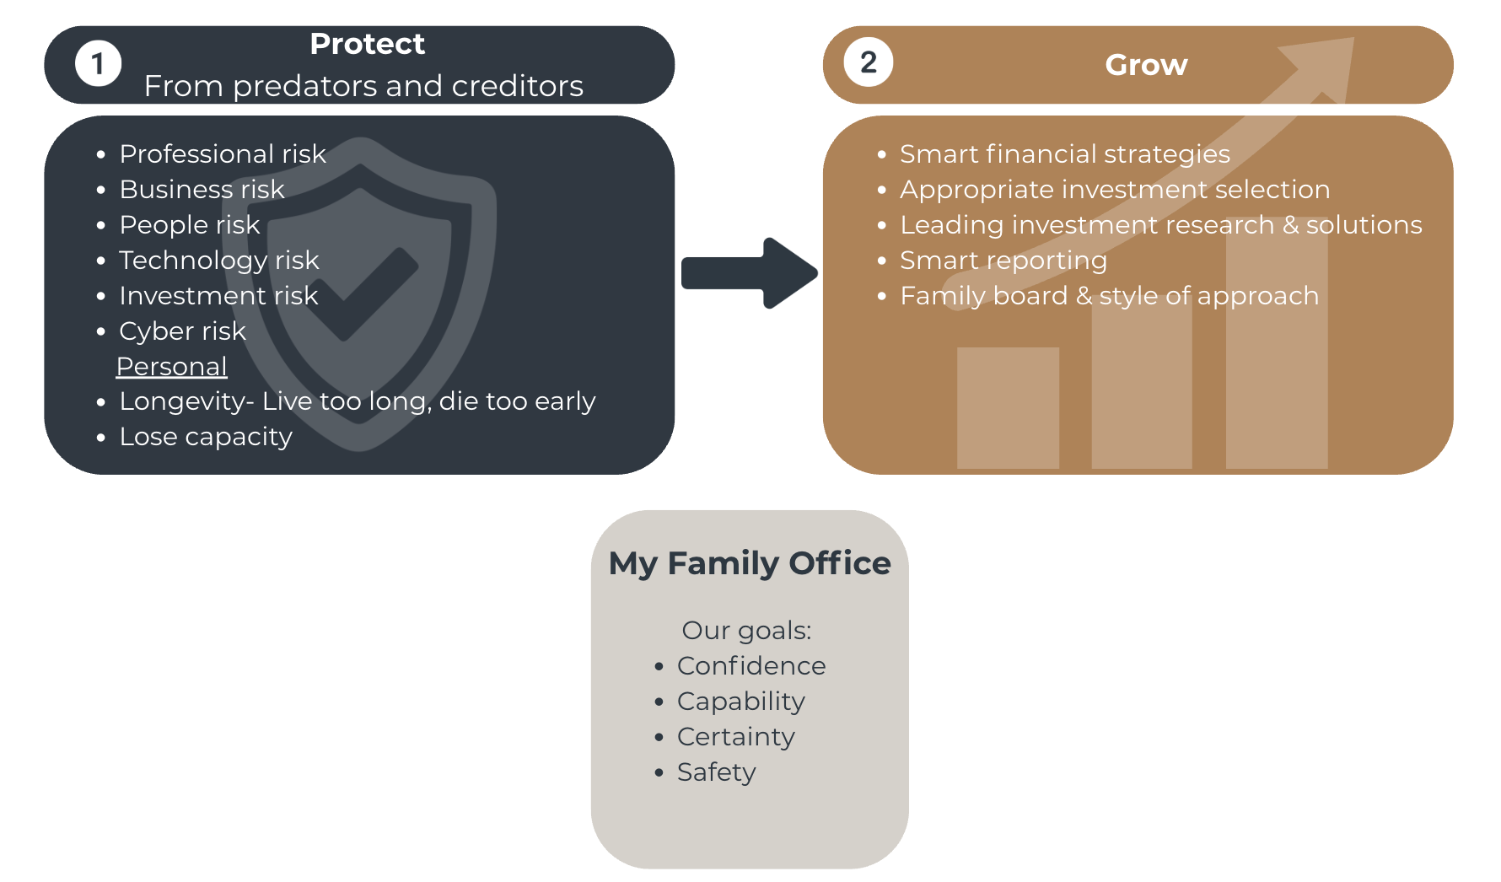
The Role of The Adviser is to: Protect and grow your family wealth

Slide 10
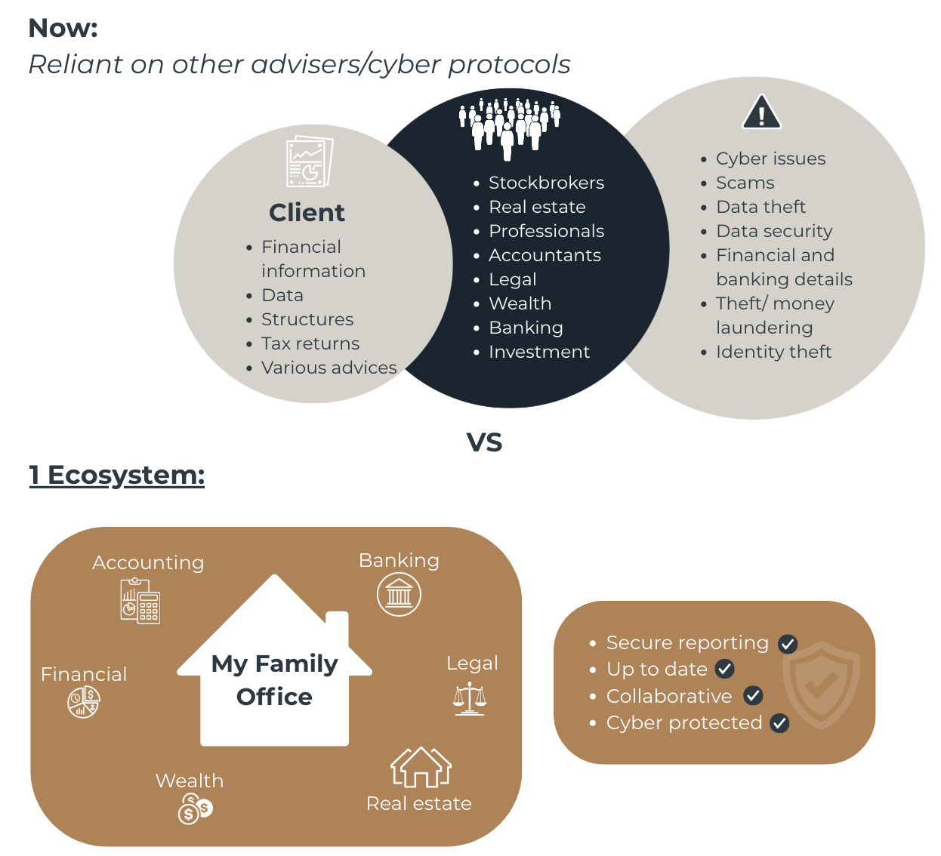
The SAN Client - Ecosystem

Slide 11
What do these companies have in common?
The Plastic Bag Company – October 2024
eVisa Indonesia – October 2024
The Internet Archive – October 2024
Meshworks – October 2024
Western Sydney University – October 2024
MoneyGram – Oct 2024
Internet Archive – Oct 2024
The Plastic Bag Company – Oct 2024
Perfection Fresh – Oct 2024
Qantas – Oct 2024
Road Distribution Services – Oct 2024
Strike Bowling – Oct 2024
Deloitte – Oct 2024
Fortinet – Sep 2024
Bloom Hearing Specialists – Sep 2024
I-MED – Sep 2024
digiDirect – Sep 2024
Nikpol – Sep 2024
Dell – Sep 2024
Temu – Sep 2024
Total Tools – Sep 2024
Compass Group – Sep 2024
Power Diary – Sep 2024
Fortinet – Sep 2024
BSG Australia – Sep 2024
Avis – Sep 2024
Protecta Australia – Sep 2024
White Mountain Backpacks – Sep 2024
Swinburne University – Sep 2024
Australian Cancer Research Foundation – Sep 2024
Bloom Hearing – August 2024
Regent Caravans – August 2024
All Parks Insurance – August 2024
Meli – August 2024
Myelec Electrical Wholesalers – August 2024
Engedi – August 2024
Adreno – August 2024
Evolution Mining – August 2024
FlightAware – August 2024
Hudson Civil Engineering – August 2024
Kempe Engineering – August 2024
Life360 – August 2024
Western Sydney University – August 2024
Early Settler – August 2024
McDowall Affleck – August 2024
Insula Group – July 2024
Wattle Range Council – July 2024
Healthed – July 2024
City of Ballarat/OracleCMS – July 2024
Roblox – July 2024
Royal Brighton Yacht Club – July 2024
MediSecure – July 2024
Optimum Allied Health – July 2024
Harry Perkins Institute of Medical Research – July 2024
Evolve Bank & Trust – June 2024
Team Viewer – June 2024
Levi’s Strauss & Co – June 2024
Victorian Auditor-General’s Office – June 2024
Victoria Racing Club – June 2024
Legrand CRM – June 2024
Patties Food – June 2024
Panasonic Australia – June 2024
Shell – May 2024
MediSecure – May 2024
SUMO – May 2024
Monash Health – May 2024
Data Breach Tsunami Hits Australia
SSS Australia – April 2024
Ambulance Victoria – April 2024
Aussizz Group – April 2024
Smoke Alarm Solutions – April 2024
Pandemonium Rocks – April 2024
Roku – April 2024
Suncorp Bank – April 2024
Diabetes WA – April 2024
Motorcycle Holdings – April 2024
Aussizz Group – April 2024
Nova Employment – March 2024
Vans – March 2024
Fujitsu – March 2024
IMF – March 2024
McDonald’s – March 2024
ACT Container Deposit Scheme – March 2024
OAIC Notifiable Data Breaches Report – March 2024
Royal Australian College of General Practitioners – March 2024
GaP Solutions – March 2024
ZircoDATA – February 2024
The Department of Communities – February 2024
Hacker offers the personal details of 25m Aussies for sale – February 2024
Microsoft – February 2024
Microsoft Azure – February 2024
Villis Bakery – February 2024
Tangerine Telecom – February 2024
Kadac Australia – February 2024
Balmain – February 2024
Australian Human Resources Institute – February 2024
AnyDesk – February 2024
Elite Supplements – February 2024
Cloudflare – February 2024
Europcar – February 2024
Central Coast Council – February 2024
Football Australia – February 2024
Canberra Medical Centre – January 2024
LinkedIn, Adobe, Twitter and More – January 2024
Quantum Radiology – January 2024
Nissan Australia – January 2024
Hal Leonard Australia – January 2024
Binge, Dan Murphys, Guzman y Gomez, The Iconic -January 2024
Labour – January 2024
The Iconic – January 2024
Inspiring Vacations – January 2024
Court Services Australia – January 2024
Yakult Australia – January 2024
Eagers Automotive – January 2024
CellOPark – December 2024
WACER & University of Sydney-Based Fresh Produce Safety Centre Australia & New Zealand – December 2024
Waverley Christian College – December 2024
Ainsworth Game Technology – December 2024
Thanks for the Help (TFTH) – December 2024
Nicholsons Solicitors – December 2024
Equinox – November 2024
Amazon – November 2024
Finsure – November 2024
Telstra – November 2024
Snow Brand Australia- November 2024
ASIC/Waive – November 2024
ADT Freight Services – November 2024
Micon Office National – November 2024
JewishCare – November 2024
Followmont Transport – November 2024
Schneider Electric – November 2024
CISCO – November 2024
Goodline – November 2024
Nokia – November 2024
ANU Enterprise – November 2024
Australian Nursing Home Foundation – November 2024
IBM – October 2024
Ultra Tune – October 2024
NAB, Vodafone and Microsoft – October 2024
Notes:
One reaction: it won’t happen to me, I’m too small / niche / regional /
Mix of businesses on this list, and a range of severity of incidents

Slide 12
The real risks of cybercrime
$97,200
Business email compromise (BEC)
Financial
Cybercrime average cost for medium businesses
Operational
*
Top 3 cybercrime types for business:
Reputational
23%
Email compromise
Online banking fraud
Legal
rise in cybercrime reports
*
Emotional
*
ASD Cyber Threat Report 2022-2023
Notes:
ASD Research from the Australian Government.
Acknowledge the rise of cybercrime, posing significant risks to financial professionals due to their reliance on sensitive personal information.
Small and medium businesses, often lacking resources and specific cybersecurity knowledge, are particularly vulnerable to attacks.

Slide 13
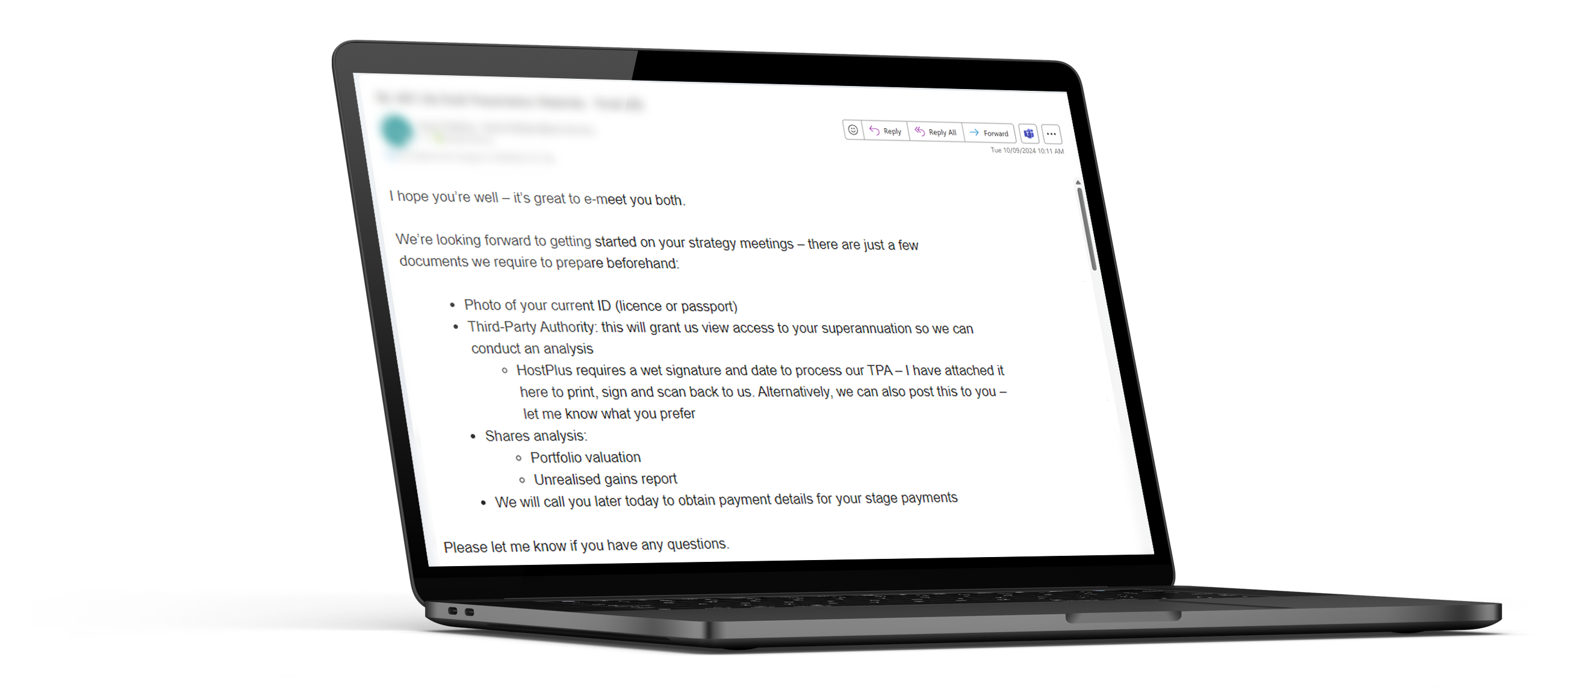
Anyone can be fooled…
The only option was to respond by email
Client returned photocopy of driver's license, bank statements and unprotected Excel documents with full asset valuations, HIN information and account numbers.

Slide 14
Why do I need a client portal…
53%
74%
of financial customers say they would switch providers for better digital experiences.¹
of businesses still email sensitive client documents direct to clients (such as SOAs).⁴
Client engagement
Security
Email compromise and business email compromise are the top sources of cybercrime in Australia.²
The use of digital signatures reduces customer onboarding times by 41% the time to contract completion by 68%.³
Efficiency
1. Salesforce, The Connected Financial Services Report, 2023. 2. ASD Cyber Threat Report 2022-2023. 3. Statistics provided by DocuSign - Digitising to meet the needs of today’s wealth management clients, 2023. 4. Statistics collected via responses to Finura Advice Tech Health Check as at 2024.
Notes:
Client portals are becoming the go-to solution to combat cybercrimes
Driving secure digital interactions with clients and their data
Securely share documents and reports with their clients, instantly reduce a businesses exposure to cyber threats.

Slide 15
Become the Architect of the Ecosystem
How can you transform client engagement?
Today – disparate solutions, complexity, inefficiency
Future proof your value proposition
Secure Online Client portals - central location for collaboration between clients and their financial professionals.
Single touchpoint
Professionals rely on a range of software/tools to generate the client experience.
Portfolio position & performance
$
CRM
Document storage
ATO
Platforms
Administrators
Banks
$
Secure document sharing and signing
Accountant
emails
Accountant
HOUSEHOLD
Digital forms
Real Estate
Individuals
Adviser
Tax checklists
F2F
Illustrative software
CRM
Platforms
Banks
Advice tools
Document storage
Entities
CLIENTS
To Do Lists
Platforms
Other Professionals
Financial, Investment and estate planning advice
Portals
Adviser
Motor Vehicle
Family Members
Other software systems, processes
Personal goals
Communication & collaboration
Lawyer
Total view of ‘My Family Office’
Enabling efficient collaboration
Secure exchange of personal information
Notes:
Security
Document sharing (both ways), signing
SVOW
experience

Slide 16
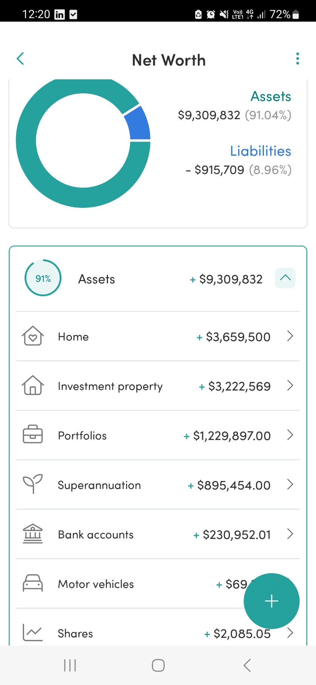
Protect and Grow
Collaboration
Drive efficiencies
Securely collaborate with other finance professionals to achieve any client goal.
Integration with digital signature capabilities, digital fact finds and questionnaires.
A secure environment
Connected, branded experiences
Eliminate reliance on email when interacting with your clients and their data online.
Data integrations reduce double handling of data​ and deliver clients a whole of wealth view.
Notes:
Provide a secure environment for client interactions and a single view of wealth
Eliminate double handling of data and streamline communication, enhancing overall client experience

Slide 17
The Architect view

Slide 18
The Client view

Slide 19
HUB24 - leveraging capabilities to lead industry change
Be the best provider of integrated platform, technology and data solutions
To enhance productivity for financial professionals though
One way of doing business with
access to market-leading solutions
Single view of wealth for financial professionals and their clients
Lead today
Delivering customer value and growth
Efficient access to ecosystem partners
Create tomorrow
Creating integrated wealth technology and platform solutions
Client experience
Applications
Flexibility for advisers and insights
for networks
Data & infrastructure
HUB24
Platform
Reporting and insights for businesses
Build together
Collaborating to shape the future of the wealth industry
And deliver solutions to meet needs across the customer lifecycle
Be future ready
Developing our people, capabilities and infrastructure to support our future growth strategies
27

Slide 20
HUB24 Group – market leading capability driving customer value & growth
Platform
Tech Solutions
PLATFORM
PARS
myprosperity
Technology & Data Services
> 300 data integrations
Cloud-based software
Custodial administration
Non-custodial administration
Client portal
Platform FUA $98.9b
PARS FUA $22.0b
Advice/ accounting firms >500
HUBconnect Broker
Customer management & operational support for stockbrokers
HUBconnect Licensee
Database insights to support advice licensees with business management & compliance obligations
Class Super
SMSF administration
Class Trust
Trust administration
Class Portfolio
Investment Reporting & Administration
NowInfinity
>5.6k firms
Corporate compliance & documentation
No. of accounts
210,414
>1,600 firms
4,886 Advisers using the platform
PARS accounts 8,634
Households ~86K
Total FUA $120.9b
Document orders 200,440
Record FY24 net inflows $17.9b
Managed Account FUM $40b
No. of companies 818,486
Data as at 31 December 2024 unless otherwise stated

Slide 21
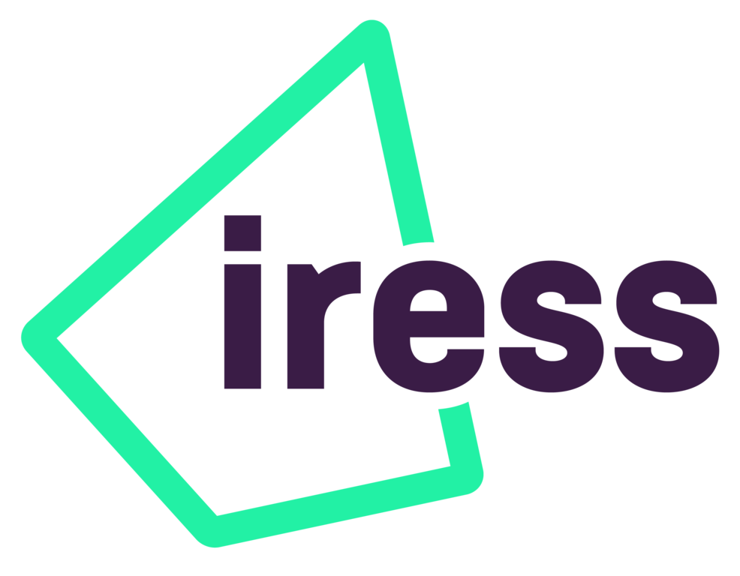
myprosperity
Accounting Practice Management
Dark web scanning
ID verification
Financial Advice Practice Management
Document signing
Credit score
Document library
Portfolio
Data
Fact find
Open banking
ATO
data
ASIC
data

Slide 22
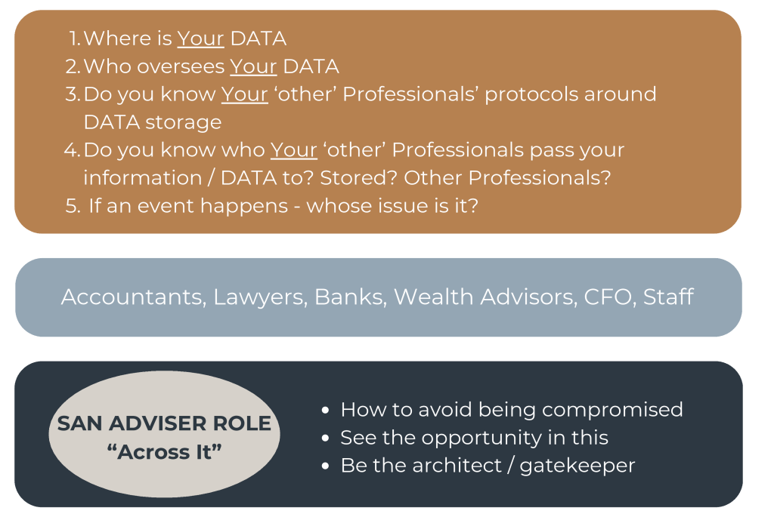
Protect & Grow/Maintain Your Wealth

Slide 23
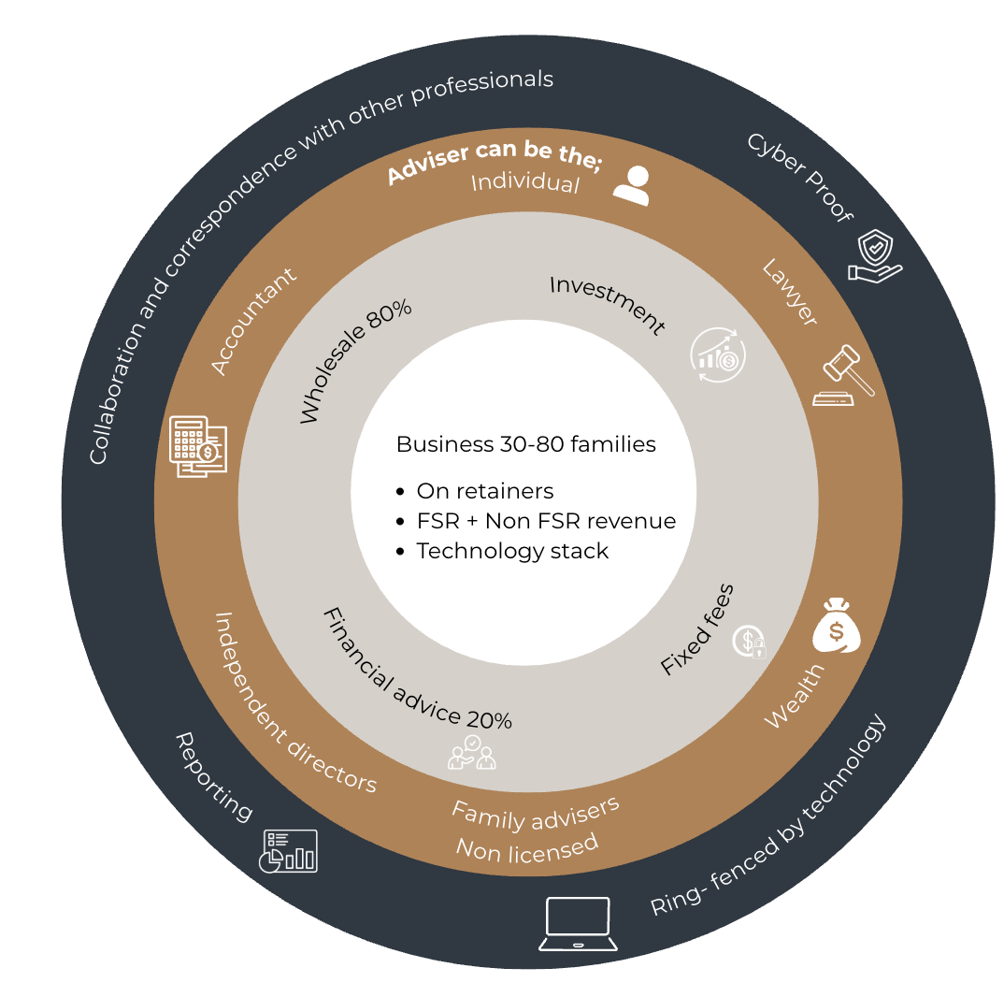
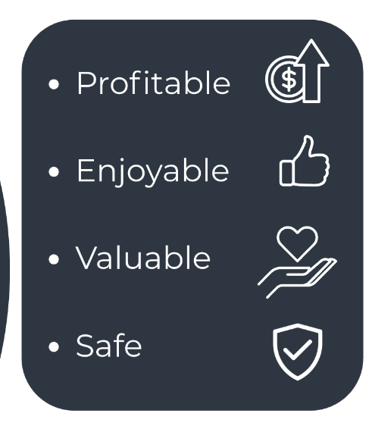
Family Wealth Business for the Future

Slide 24
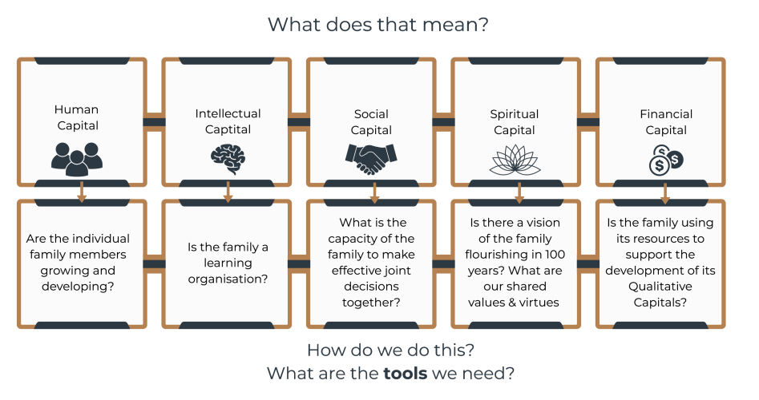
Protect & Grow The Family Wealth

Slide 25
SAN Family Wealth Adviser - Tools

Slide 26
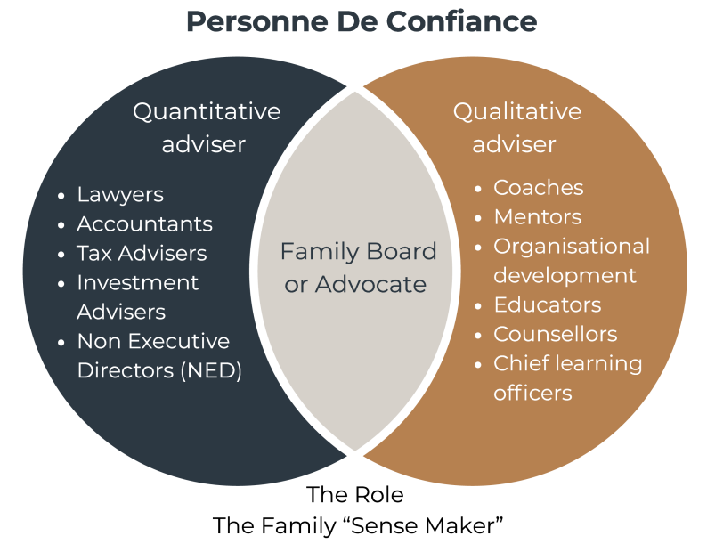
Advising Significant Families

Slide 27
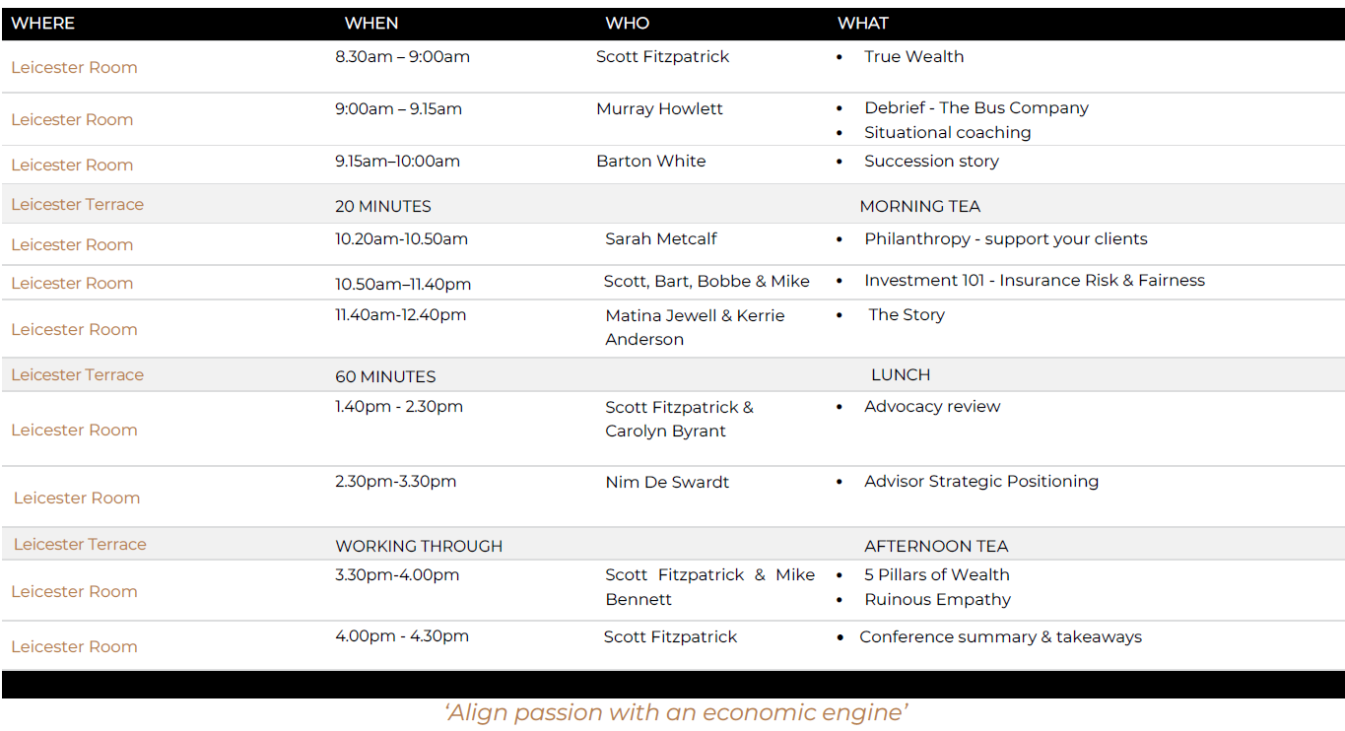
AGENDA DAY 2:

Slide 28
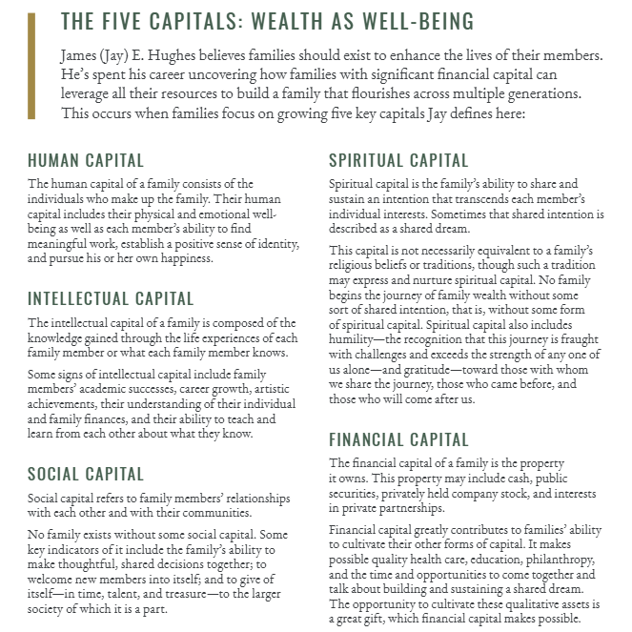
Wealth – James E Hughes

Slide 29
True Wealth – Quantitative & Qualitative
Spiritual
Purpose
The ‘WHY’
Intellectual
Learning, Sharing & Teaching
FINANCIAL CAPITAL active & passive assets
Social
Relationships within the community/family
Human
Physical & Emotional Wellbeing

Slide 30
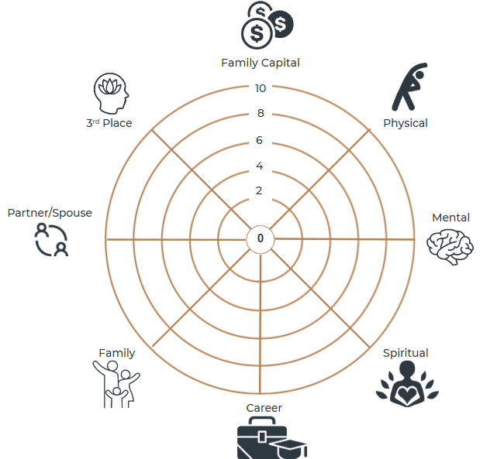
Wheel of Life

Slide 31
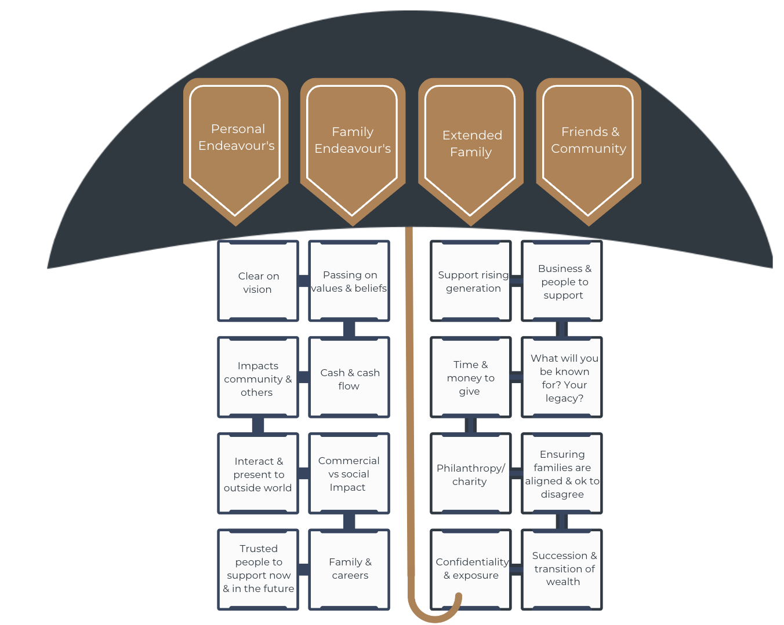
Be a Great Family- 100 Year Plan

Slide 32
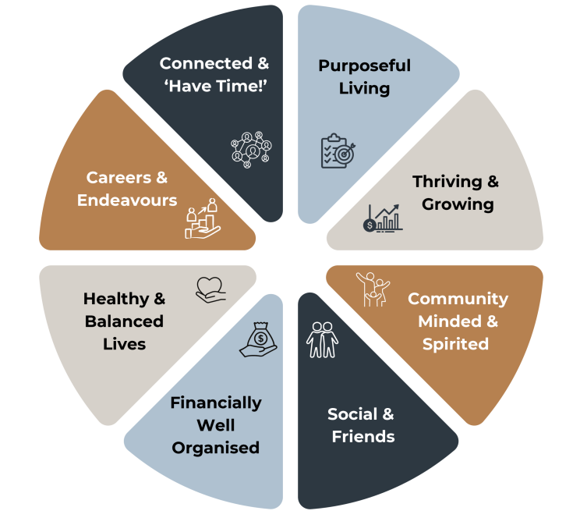
True Wealth – Our Family

Slide 33
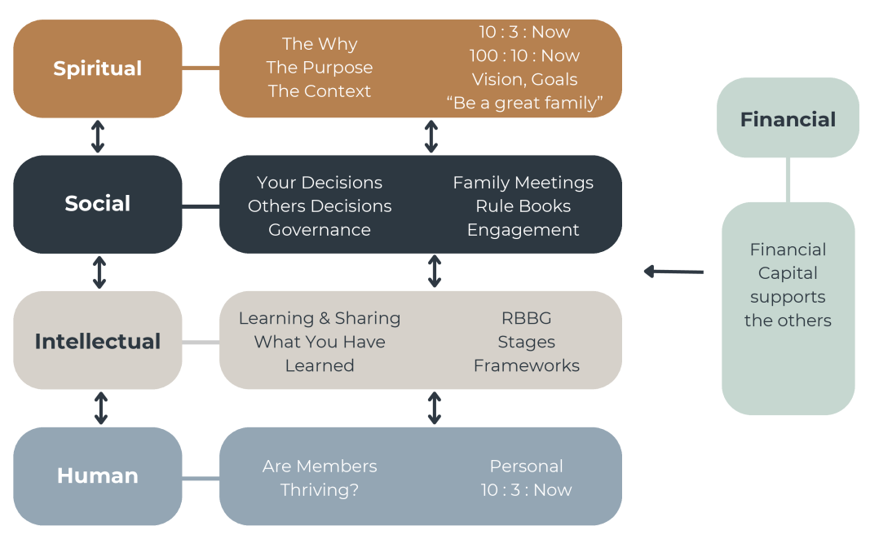
Can The Family Live The Plan ?

Slide 34
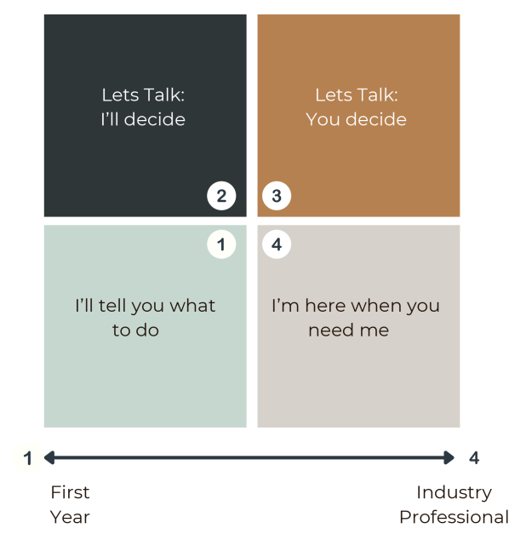
Situational Coaching

Slide 35
The Client: McDonald Brothers
The brief: Brothers want to prepare for succession properly, avoid the mistakes of their parents
McDonald Brother #1: age 60
McDonald Brother #2: age 57
5th gen farming family
Been in business ~30 years.
Staff 120+ (~50 permanent, remainder casual).
Revenue ~$20M p.a. (group)
Several revenue lines
Profit ~$1-1.5M p.a. (group)
Property assets $ (group)
Debt $ (group)
Debt repayments $400k p.a.
Drawing for McDonald Brothers
Life insurance policies in place
Yearly commitments to supermarket chains.

Slide 36
Strategy Day agenda
Welcome & introductions
Why we are here – agree on what the context of the day is and what we plan to achieve from the day
Succession Slides -
Innocence to Integration
Where are we now
3 1 Now
Chaos to Greatness
Business Wheel of Life
Voluntary v Involuntary Slide (Part of Succession) [Elephant]
Wheel of competency
Where are we trying to get to in the future and why
3 years
15 years
Risk Matrix
1 Year
90 days
Income Equity & Control

Slide 37
Strategy Day agenda
Agree upon 12 Month action plan moving forward
Next steps
Monthly check-ins
Governance structure
Income Equity Control – Due Diligence
Business priorities (debt -v- capital replacement)
Forecasts
Management accounts
Skills Gap Analysis
Skill Plan
Financial Planning
Estate Planning

Slide 38
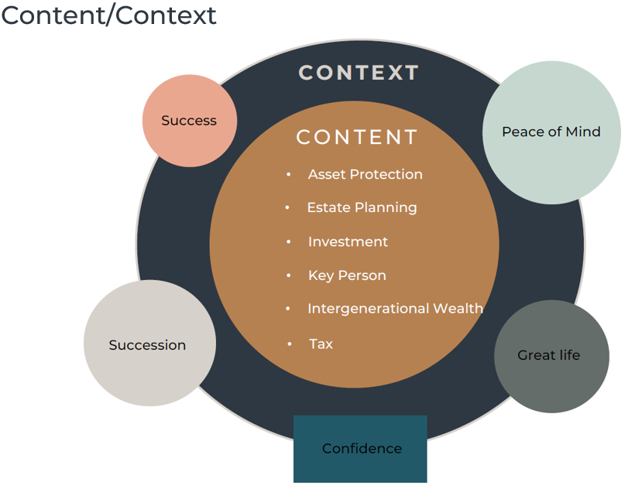
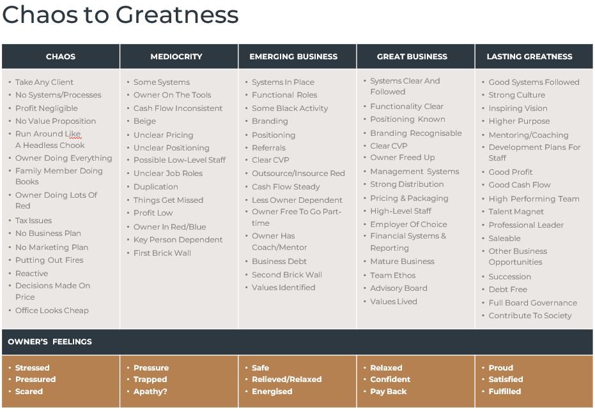
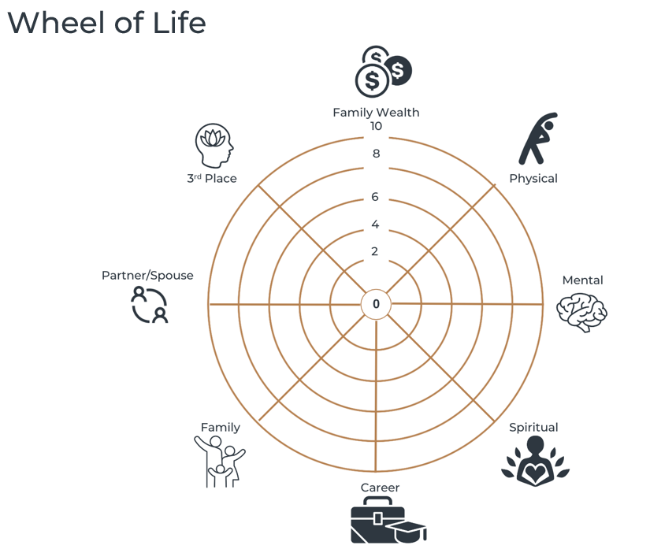
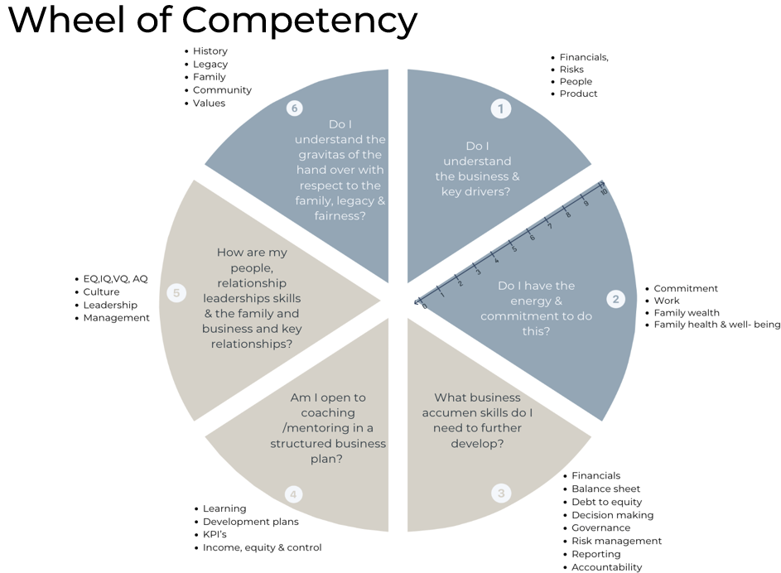
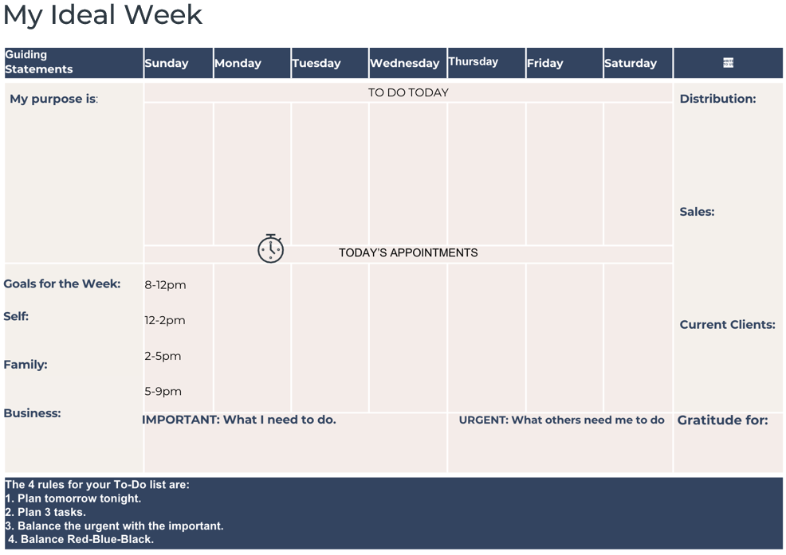
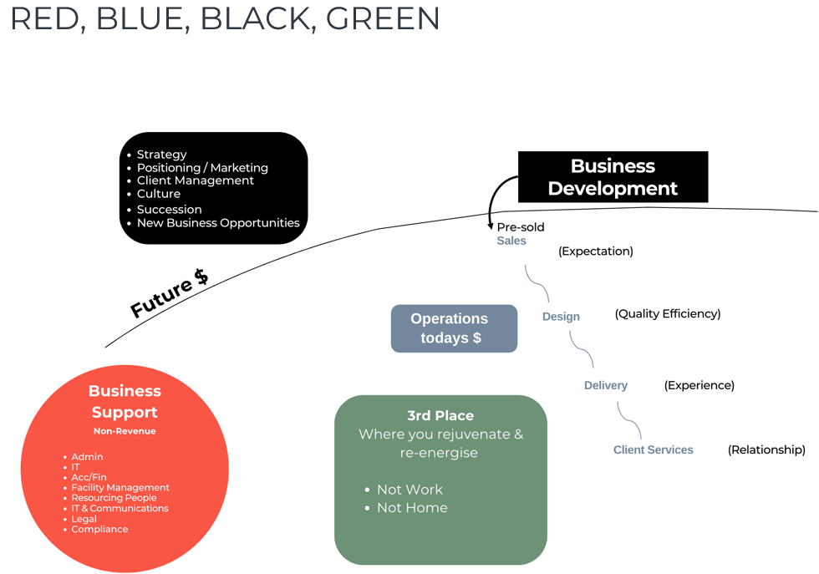
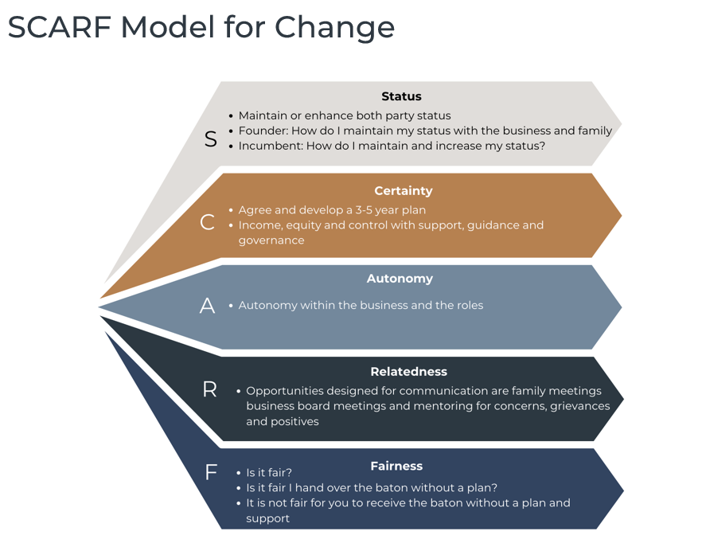
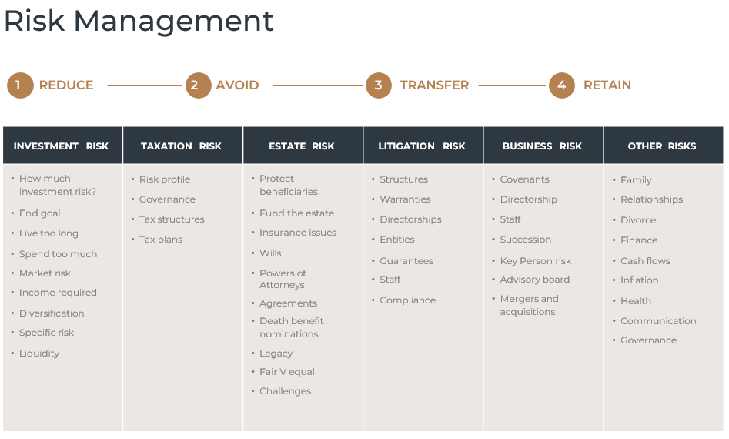
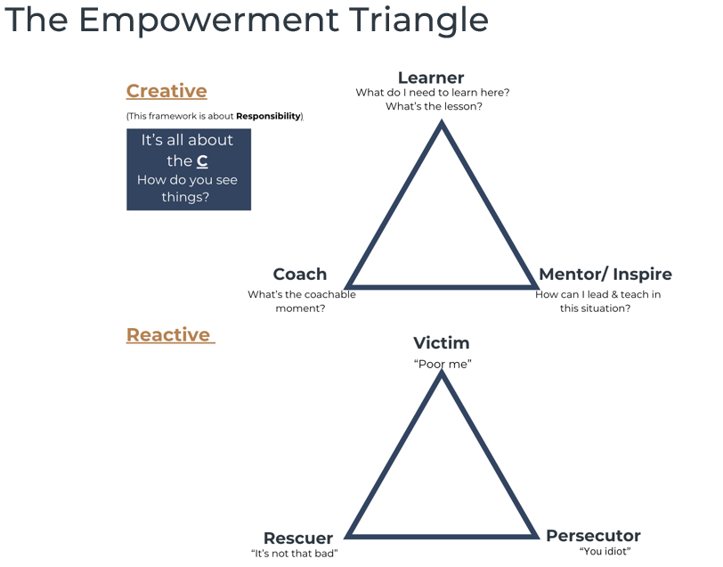
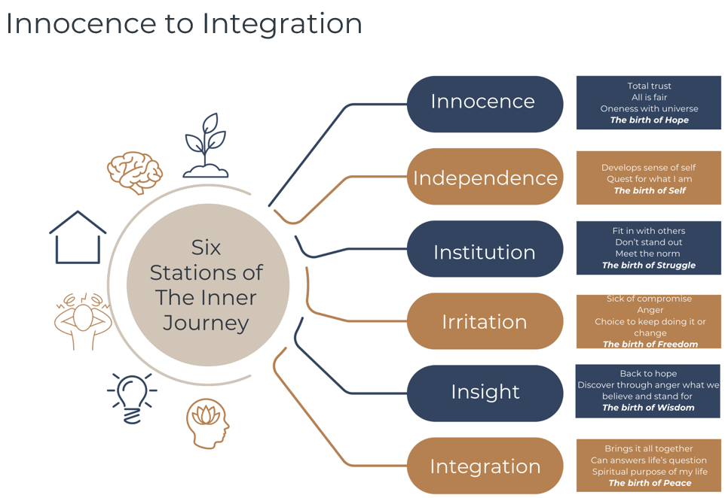
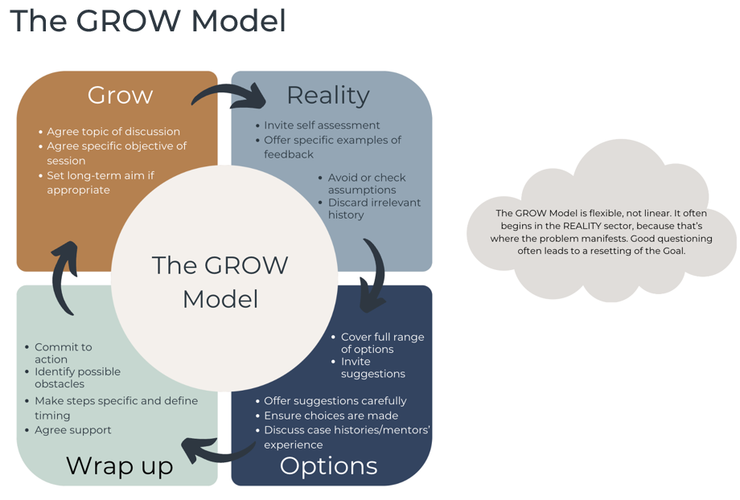
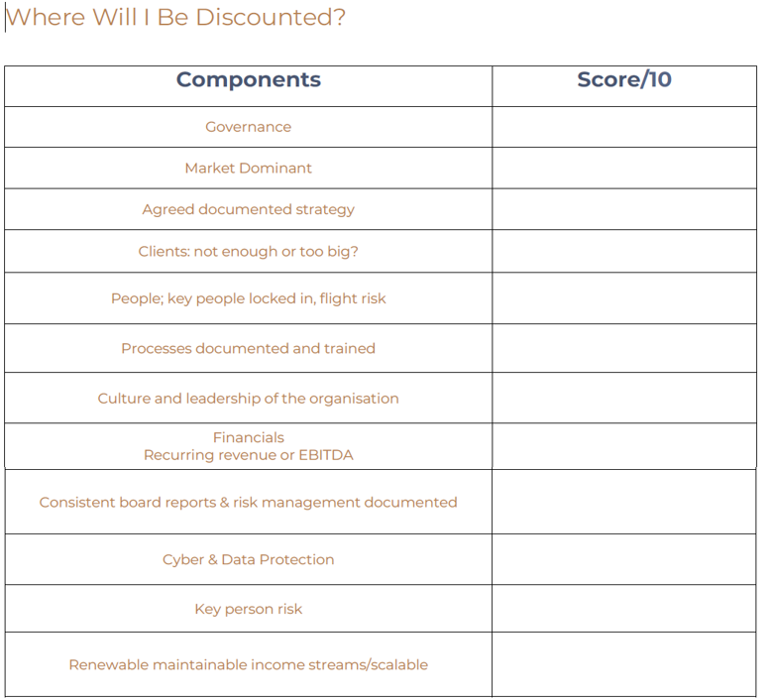
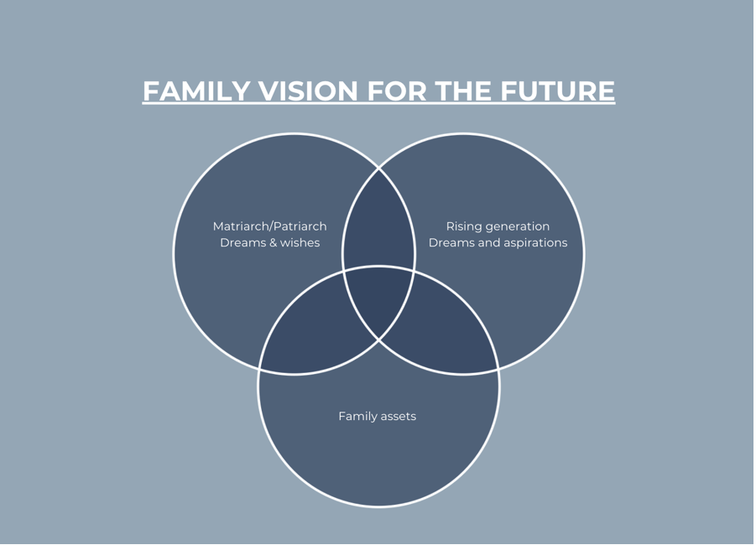
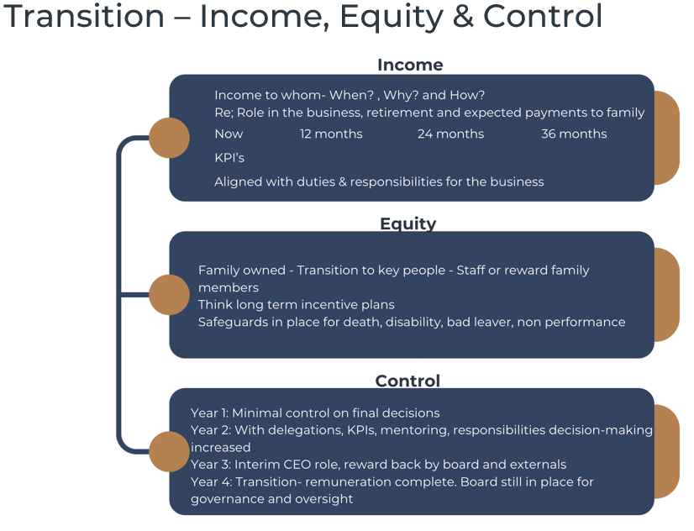
Framework Kit Bag

Slide 39
DRAFT 12 Month Plan
This document is a draft 12 Month Game Plan. It is intended to provide an overview of the areas in which we will be focusing upon over the initial 12 month timeline.
FIRST QUARTER
March to May
SECOND QUARTER
April to June
THIRD QUARTER
September to November
Income, equity & control plan implementation underway
Strong financial reporting across total business operations
Business advisory board functioning well
Risk management matrix progress check in & any adjustments made
McD Children skills & competency program check in & any adjustments made – ongoing mentoring & accountability
Family feeling confident & on track
Financial Model & Options Plan implementation underway for business to achieve succession plan
Group Structure review completed.
Key team member retention strategies
FOURTH QUARTER
December to February
Due Diligence - full picture of current income, equity & control of business and personal.
McD #2 and McD #1 to prepare Position Descriptions to determine what skills need to be passed and learnt.
McD Children to join directors meetings.
Prepare financial model for McD #1 and McD #2 to retire and understand exit financial requirements.
Commence new estate planning program for McD #1, McD #2, McD Children
Skills & competencies gap analysis for McD Children.
Design training & mentoring program for McD Children.
Consider design for Family Board
Start risk matrix assessement.
Insurance review – general, business & key person
Start Financial Model for business to achieve succession plan.
Develop financial reporting model for business with McD Children
Risk management matrix assessment finalised with McD #1, McD #2, McD children & key team members.
Group structure review – is it fit for purpose? Investigate tax costs & duty consequences associated with identified options.
Roles & responsibilities defined for McD #1, McD #2, McD Children & key team members – identify & design transition plan for future – remuneration plan
Business advisory board established – meeting cadence & standing items for discussion & decision agreed
Estate planning & business succession documents drafted & reviewed
McD Children skills & competency program check in & any adjustments made – ongoing mentoring & accountability
Income, equity & control plan design drafted – timelines discussed & agreed including plans for key staff members.
Family meeting – communicate estate & business succession plan
Estate planning & business succession documents executed
Business advisory board operating
Risk management matrix progress check in & any adjustments made
Complete Financial Model & Options Plan for business to achieve succession plan.
Personal guarantees & warranties register – design transition plan.
REVIEW

Slide 40
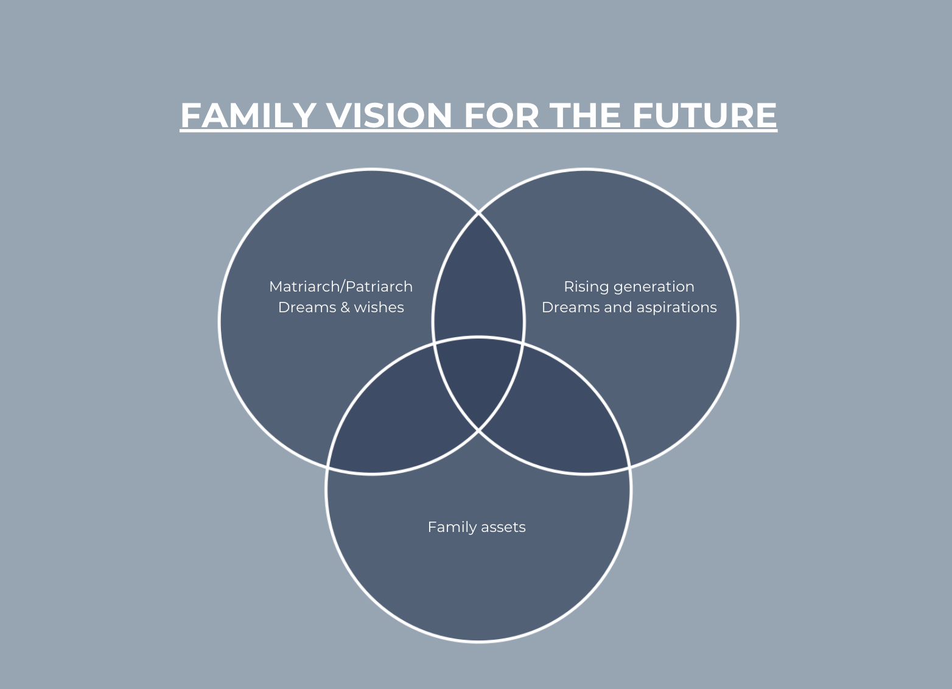

Slide 41
Handing Over The Baton

Slide 42
Receiving the Baton Considerations, Challenges & Opportunities

Slide 43
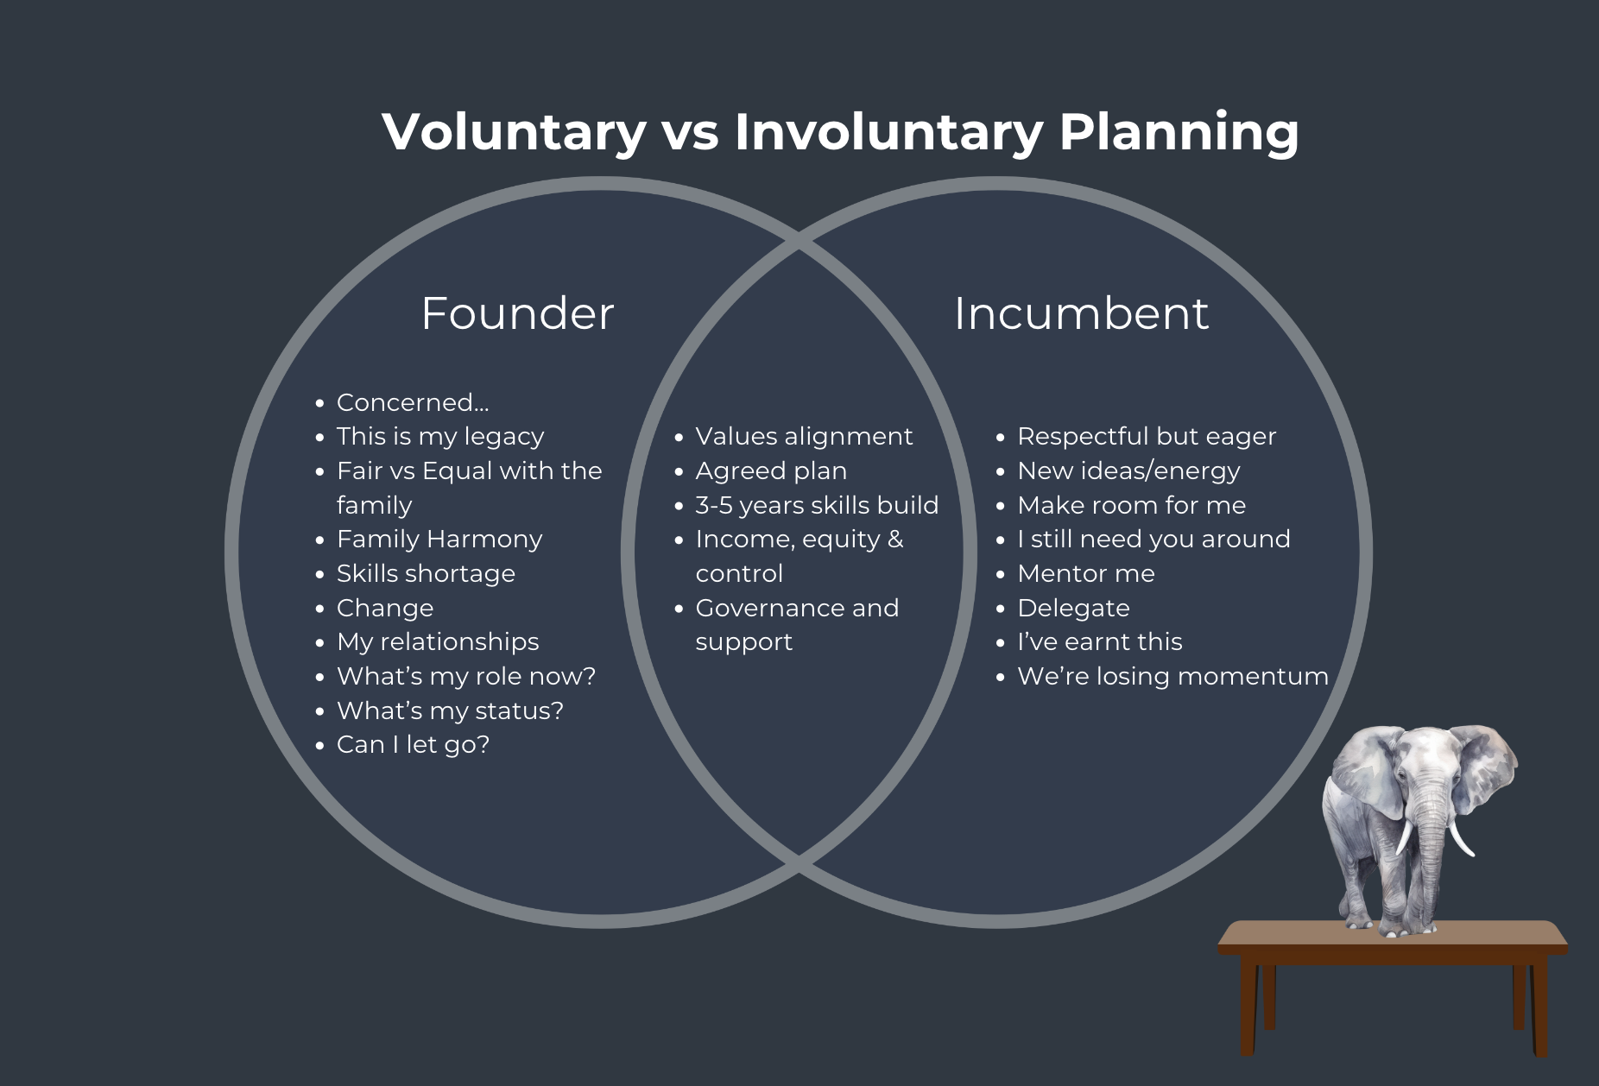
Typical A-B Conversations

Slide 44
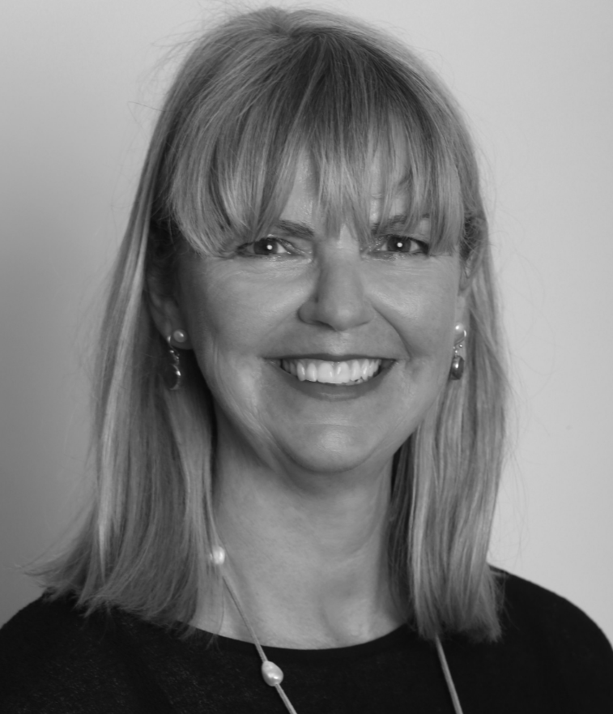
Introducing: Sarah Metcalf www.collectivemanifesto.com.au
Sarah has collaborated with some of Australia's most successful families & organisations to help them give better, & with more impact. Philanthropy goes beyond giving back. It's about shaping a legacy; fostering connectivity within families; organisations & their communities; & creating significant & meaningful impact for generations to come. With over two decades of experience in the sector gained at a 'Big 4' professional services firm, Australia's largest multi-family office & leading a charity, Sarah brings rare insights & skills that drive optimal and meaningful outcomes. Sarah partners with other professionals, such as wealth managers and accountants, to assist clients in defining the purpose of their wealth and how to use it effectively.

Slide 47
Talent, Time & Treasure

Slide 49
SAN Adviser - Insurance risk & fairness

Slide 50
SAN Adviser – Investment 101

Slide 51
Fair Vs Equal – Risk Vs Reward

Slide 52
Estate Considerations – Fair Vs Equal

Slide 53
Balancing Risks

Slide 54
SAN Adviser | Prudent Person Lens | Financial Wealth

Slide 55
Decisions Matrix

Slide 56
Investment & Risk

Slide 57
Introducing: Matina Jewell www.matinajewell.com
Major Matina Jewell grew up in the hinterland of Byron Bay and joined the Army at age 17. During her 15-year military career Matina:
Served on five missions and earned nine military service & war medals
Is the only Australian to receive two Republic of Lebanon war medals for acts of bravery on the battlefield and being wounded in combat
Completed the physically demanding Navy divers’ course
Served with American Navy Seals
Tracked-down war lords in the Solomon Islands
Fast-roped from helicopters and boarded smuggler ships in the Arabian Gulf, and
Was posted as a peacekeeper with the United Nations in Syria and Lebanon.
Medically retired, Matina served on the Prime Ministerial Advisory Council and continues to champion change for our injured war veterans.
Among her many honorary roles, Matina is a founding ambassador for Project Thankful, a movement partnered with the United Nations to help empower women and children globally.

Slide 59
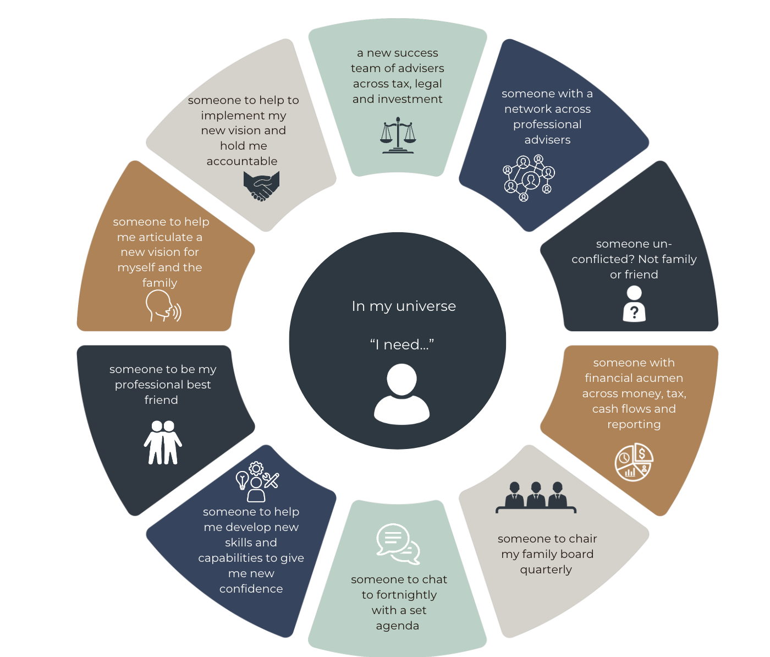
Why an Advocate?

Slide 60
Confidence Levels

Slide 61
Skills & Competencies in all areas of life

Slide 62
SAN Advocate – 4 Sets of Sights

Slide 63
Business- 4 Sets of Sights

Slide 64
Advisory Board- 4 Sets of Sights

Slide 65
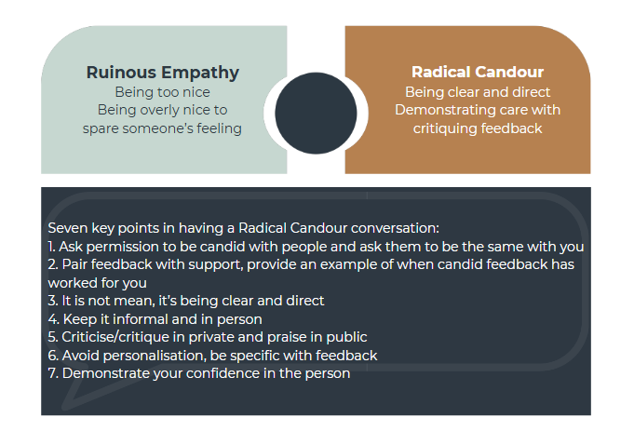
Ruinous Empathy -V- Radical Candour

Slide 66
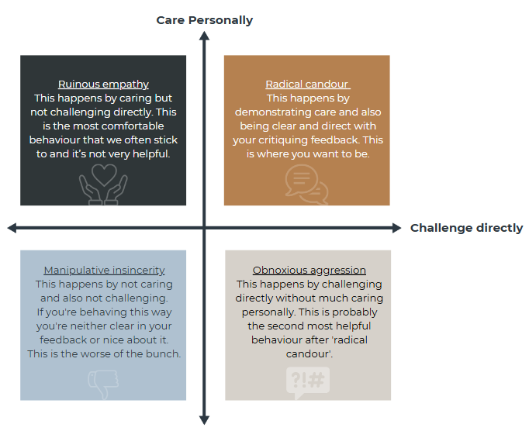
Ruinous Empathy -V- Radical Candour

Slide 67
SAN Adviser - Development

Slide 68
Personne De Confiance

