Slide 1
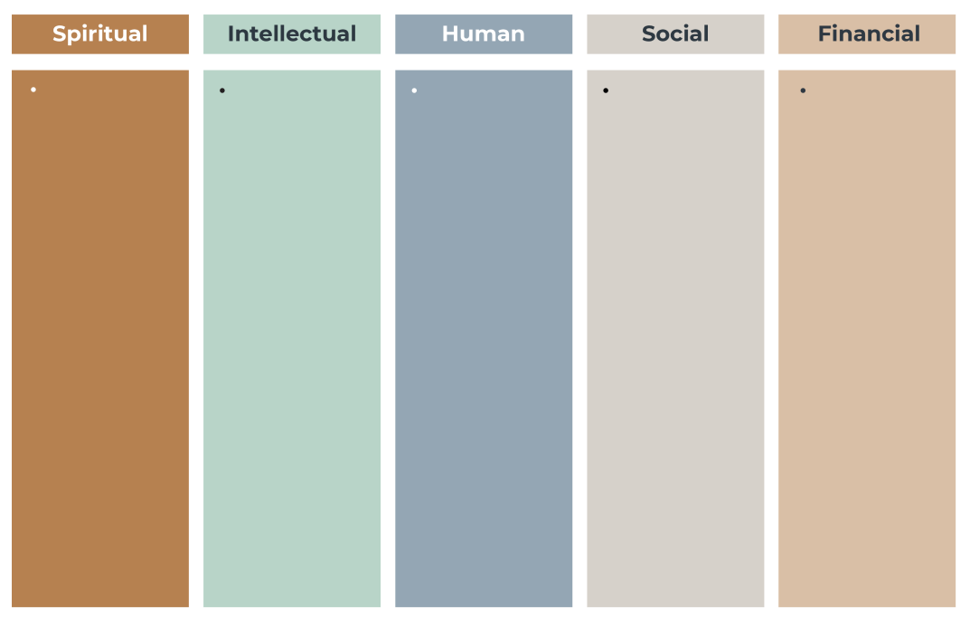
Your Family Wealth

Slide 2
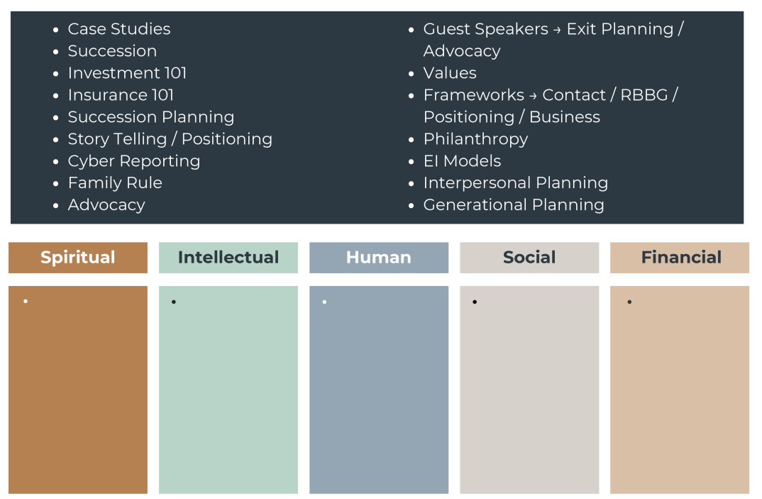
SAN Conference Agenda

Slide 3
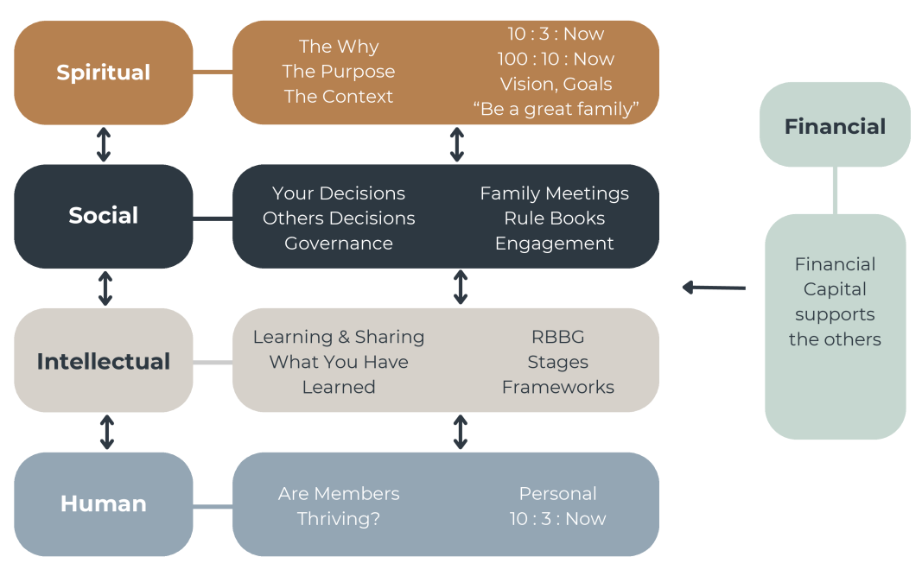
Can The Family Live The Plan ?

Slide 4
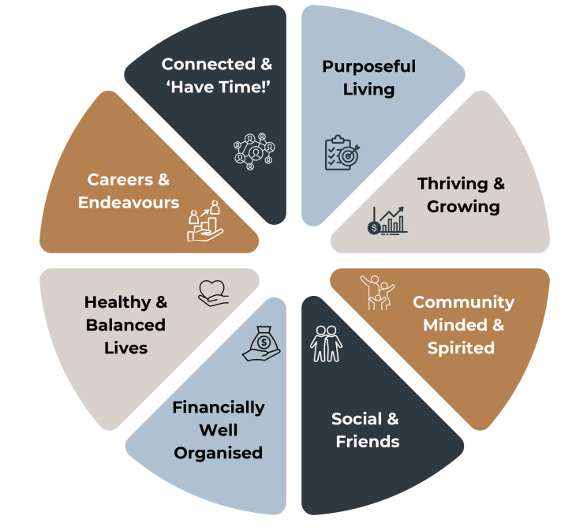
True Wealth – Our Family

Slide 5
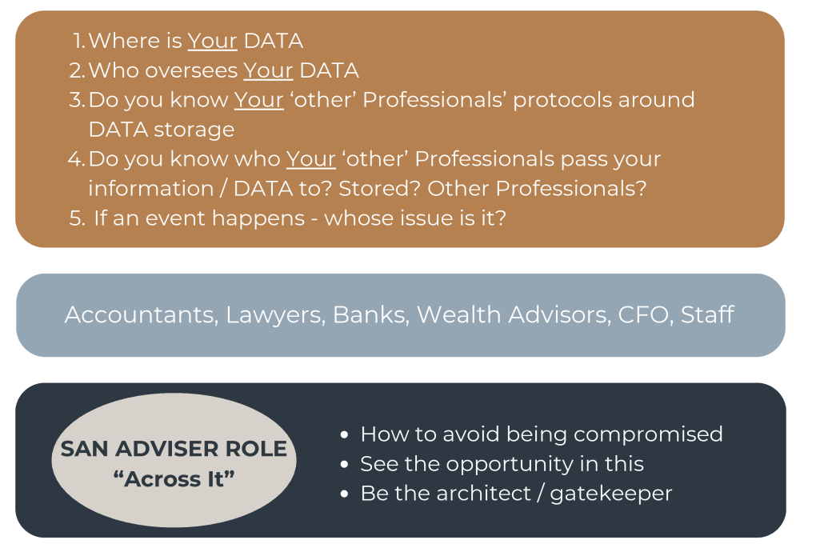
Protect Your Wealth

